Slide 1
A Changing Nation
(1800-1830)

Slide 2
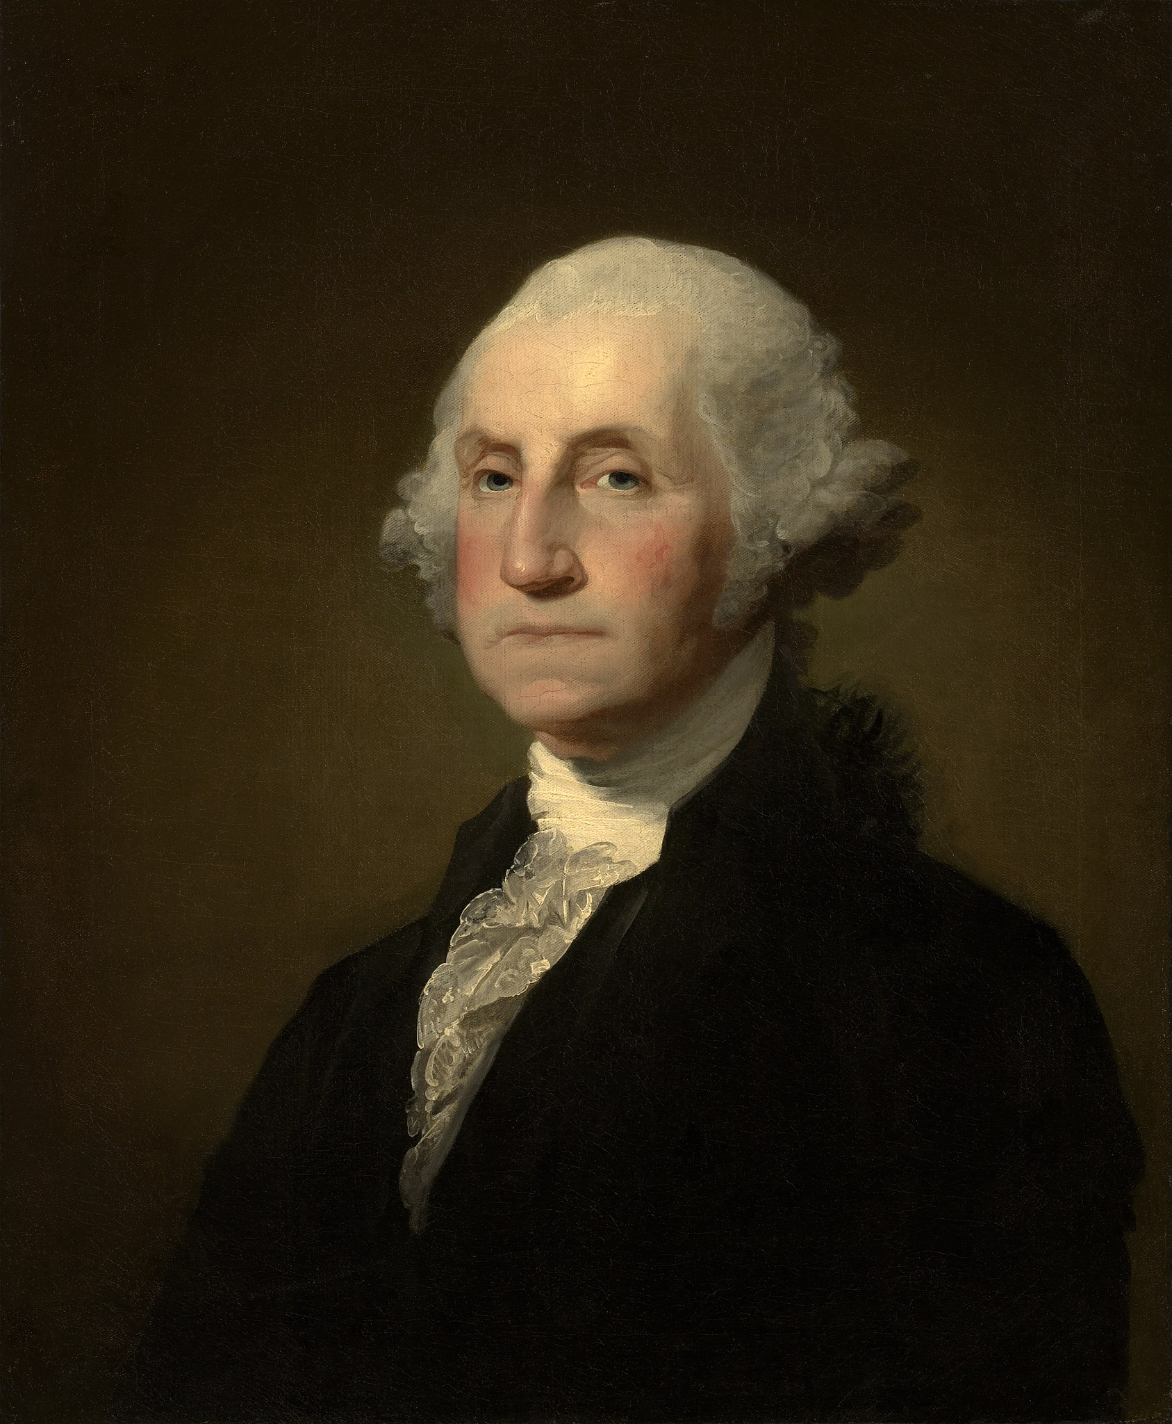
George Washington
Review
Served as the 1st elected President of the United States.
Elected unanimously by the Electoral College
Set the following precedents:
Addressed as Mr. President
Selected a presidential cabinet
Established the powers of the Executive Branch
Adopted an manufacturing economy for our nation
Left the presidency after 8 years

Slide 3
Issues During the Washington Presidency
Economic Crisis- War debt had made American credit questionable.
The Whiskey Rebellion- Farmers in western Pennsylvania revolted against a tax on whiskey.
Development of Political Parties- Hamilton’s Federalists vs. Jefferson’s Democratic-Republicans.
The French Revolution caused America to take sides in France.
War between France and Great Britain forced America to decide whether to support the French or the British.

Slide 4
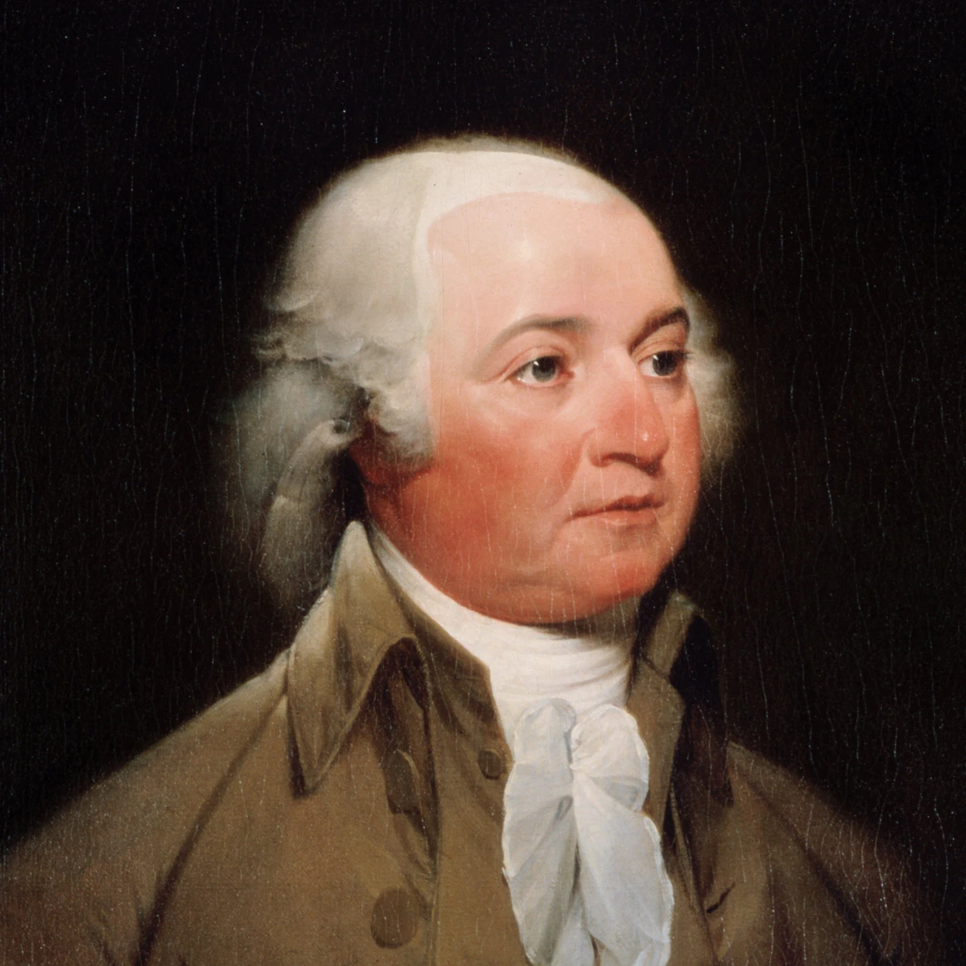
John Adams
President from 1797 to 1801
Supported by the Federalist.
The XYZ Affair- French diplomats demanded a bribe before they would speak to American diplomats.
The French government continued to attack American trading ships because of a treaty between the United States and Great Britain.
Adams was fearful of declaring war on France, but he did allow American warships to fire on French warships wherever they were attacking American merchant ships.

Slide 5
Comparing Presidents
Washington
Jefferson
Believed the best thing for our country was a strong national government
Believed that an intellectual-economic elite social class should run the government
Very formal in his interactions with people
Believed the power in the hands of state government was better
Believed that the more people who were involved in democracy the better
Very informal in his interactions with people

Slide 6
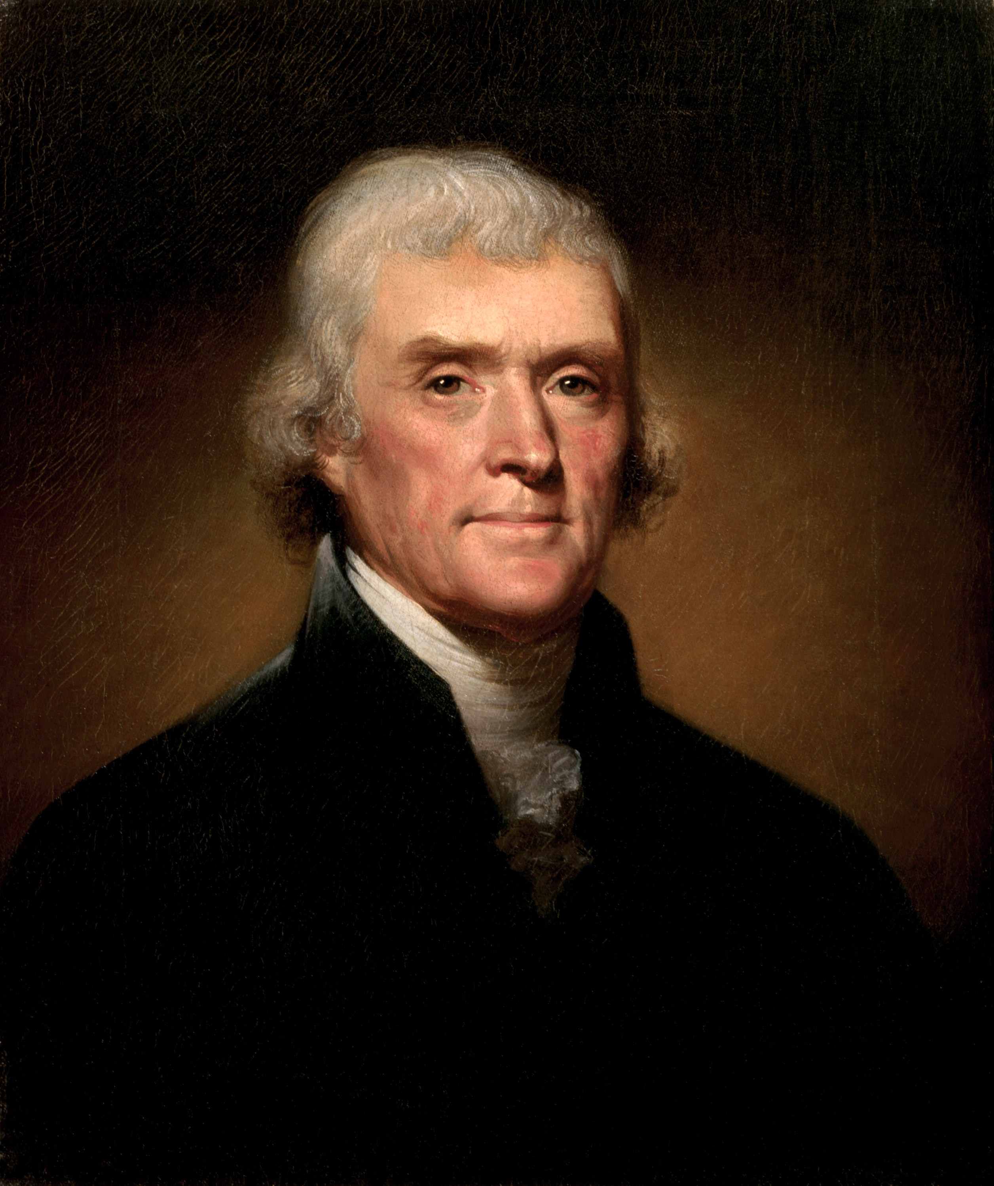
Thomas Jefferson
Democratic-Republican
Served two terms from 1801 to 1809
Believed in a small federal government
Believed that the government should stay out of economic affairs (laissez faire).
Reduced the size of the federal government
Did keep repaying the national debt
Did not fire Federalists who had been hired during the previous administration.

Slide 7
Focus Questions
What was the importance of the purchase and exploration of the Louisiana Territory?
What were the causes and effects of the War of 1812?

Slide 8
Louisiana Purchase
By 1800 more than 1 million settlers lived between the Appalachia Mountains and the Mississippi River.
The Mississippi River was very important to farmers for shipping goods.
Spain controlled the MS River and NOLA and had threatened to close the port.
In 1795 US negotiated a treaty with Spain.
This treaty guaranteed Americans’ right to ship goods down the Mississippi River to New Orleans.
Pinckney Treaty

Slide 9
Louisiana Purchase
Later, after the treaty had been signed, Spain secretly sold the land to France!
The Spanish suddenly changed their policy and closed New Orleans to American farmers.
Westerners demanded war with Spain.
French territory
Jefferson feared that France would become dominant in America, as it was becoming in Europe under Napoleon.
If this happened, westward expansion of the United States would be blocked.

Slide 10
Louisiana Purchase
Jefferson decided to try to buy New Orleans from the French.
Napoleon wanted to get rid of the Louisiana territory because France was dealing with a Revolution in Haiti and a war with Britain.
France sold the entire Louisiana Territory to the United States for $15 million!
Louisiana
New Orleans

Slide 11
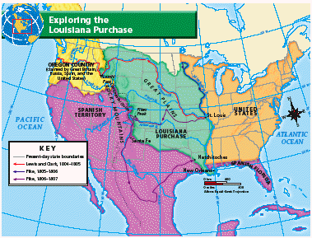
Borders of the Louisiana Territory
The Continental Divide
Mississippi River

Slide 12
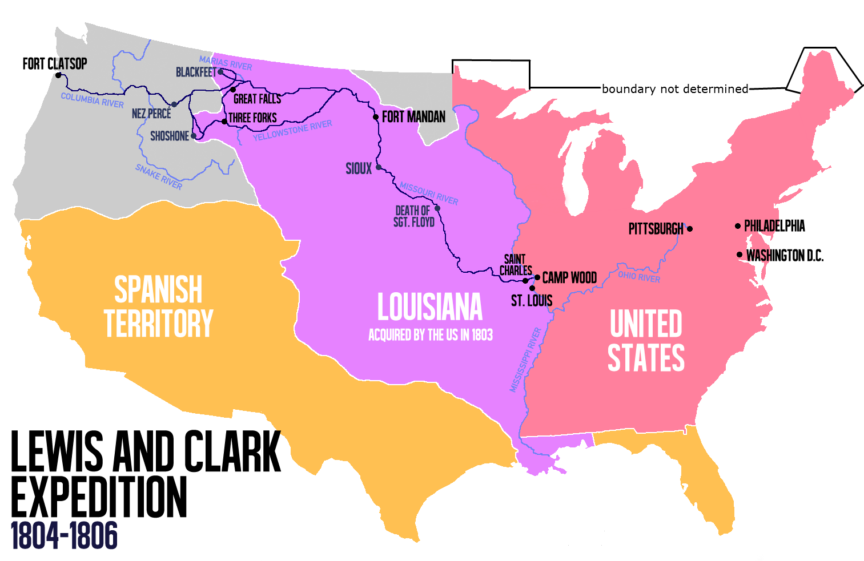
Lewis and Clark
After buying the Louisiana Territory in 1803, Thomas Jefferson was eager to have it explored and mapped.
Lewis and Clark Video

Slide 13
Lewis and Clark Expedition
The President wanted Lewis and Clark to find a waterway that existed between the Mississippi River and the Pacific Ocean.
This would provide a a more direct route to markets in China and India.
Lewis and Clark documented findings about the territory’s people, plants, and animals.
Their journey inspired people to move westward.

Slide 14
American Neutrality is Challenged
A war between Britain and France challenged Americas neutrality and ability to trade with both countries.
Britain and France both used the United States to weaken one another by seizing ships that were trading with their opponent.
Jefferson responds with an embargo – a government order that forbids foreign trade.
Notes:
President Jefferson looked for peaceful methods to force Britain and France to respect American neutrality.

Slide 15
Embargo Act
Jefferson’s purpose for creating the Embargo Act was to prevent American ships from sailing into foreign ports, thus protecting them from being raided.
Prices of American crops declined. Because of Jefferson’s Embargo Act tens of thousands of Americans lost their jobs with farmers and planters being hurt the most.
Many Americans began smuggling goods in order to evade the embargo act and continue foreign trade.

Slide 16
Congress replaced the Embargo Act with a law that allowed trade with every country except Britain and France. They would reopen trade with those countries when they started respecting America’s trading rights as a neutral nation.

Slide 17
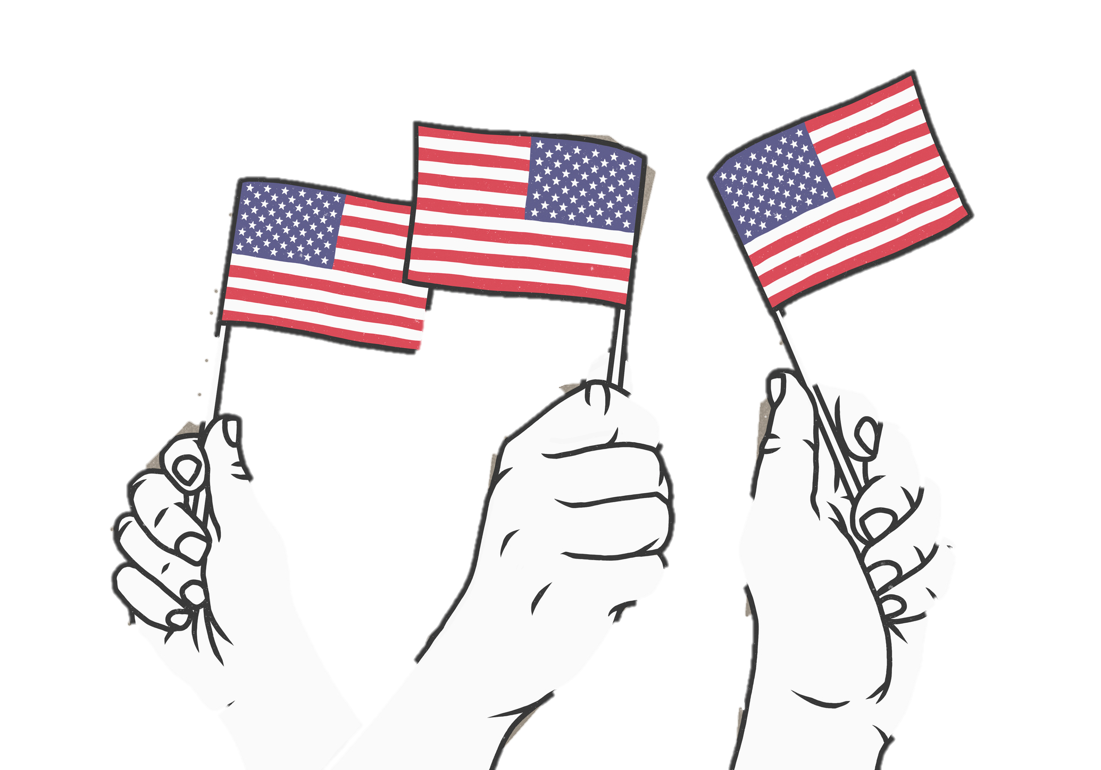
War of 1812
Americans were mad at the British for the impressment of U.S. sailors and for arming Native Americans in the Northwest.
They felt a new sense of nationalism – pride in one’s country.
Those who were eager to go to war with Britain were known as Warhawks.

Slide 18
Relations with Britain worsened steadily in early 1812.
The British vowed to continue impressment.
In June 1812, Congress declared WAR on Britain.
Native Americans began new attacks on settlers.

Slide 19
Americans were confident that they would win the war. However, the U.S. was not prepared.
Jefferson’s spending cuts had weakened the military.
The navy had only 16 warships ready for action.
The army had fewer than 7,000 soldiers.

Slide 20
Conflict in the South
Native American Creek warriors attacked southern American settlements.
Andrew Jackson took command and defeated the Creeks at the Battle of Horseshoe Bend.
After losing at the Battle of Horseshoe Bend Creeks were forced to give up millions of acres of land.

Slide 21
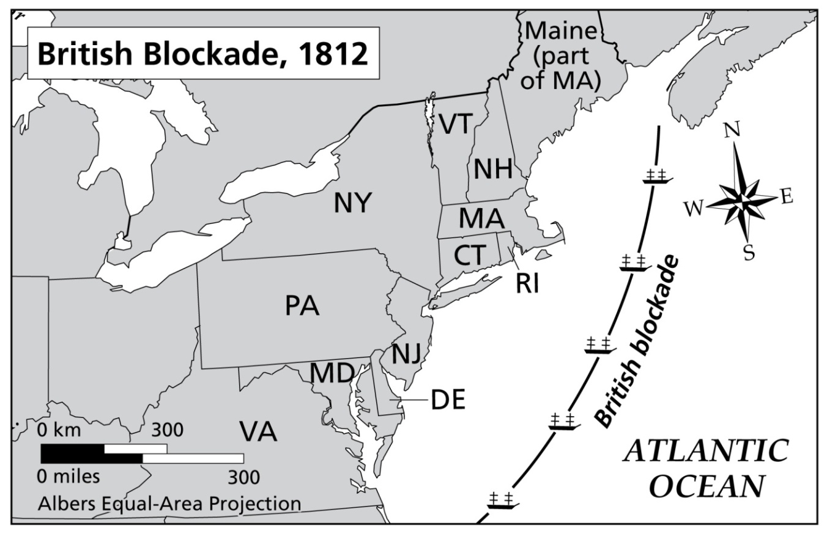
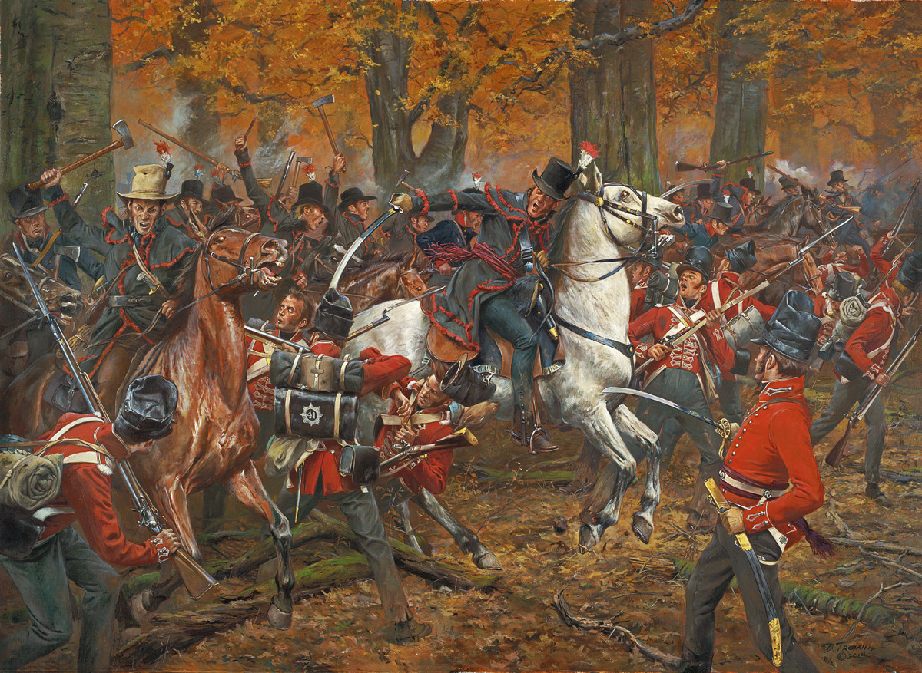
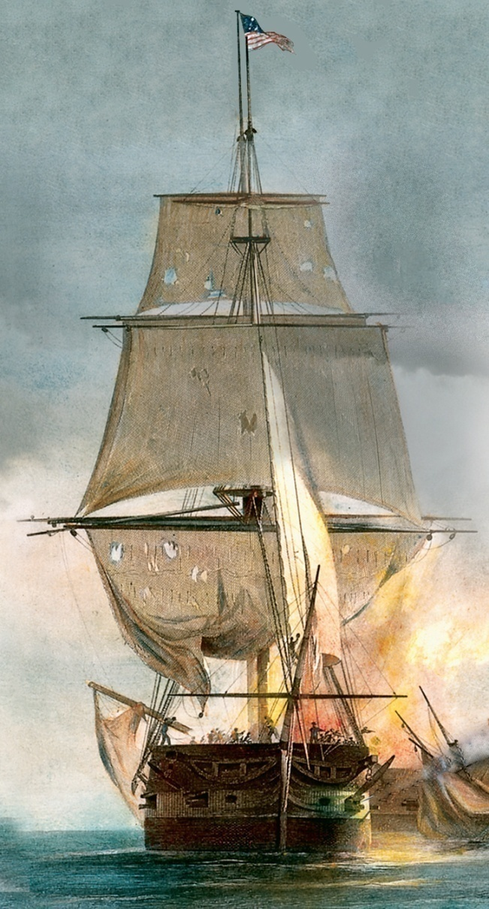
The British set up a blockade, the action of shutting a port or road to prevent people or supplies from coming into an area or leaving it.
Britain had closed off all American ports by the war’s end.
In August 1812, the USS Constitution defeated the British warship Guerrière in the North Atlantic.
The ship’s thick wooden hull earned it the nickname “Old Ironsides.”
Americans fought for control of the Great Lakes and forced the British to retreat to Canada. They followed them into Canada, defeating them at the Battle of Thames.

Slide 22
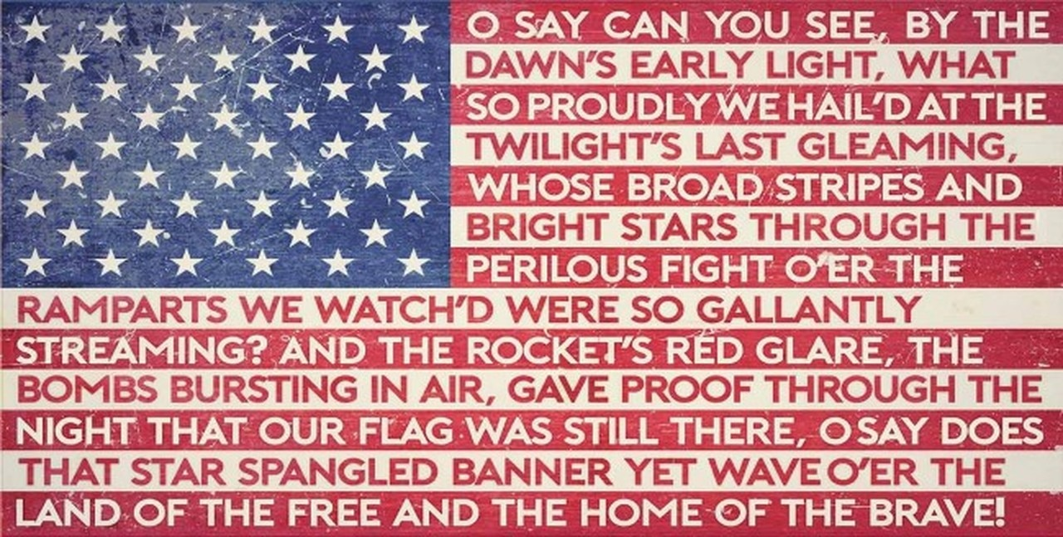
Final Battles
The British strategy was to attack the nation’s capital, Washington D.C., where they set fire to several government buildings, including the White House.
The British moved to Baltimore to attack Fort McHenry, which defended the city’s harbor.
After the Americans defense of Fort McHenry, Francis Scott Key saw that the U.S. flag was still flying and wrote a poem called the “Star Spangled Banner”.
Congress made this the national anthem of the U.S. in 1931.

Slide 23
War of 1812
Federalist critics who opposed the war called this “Mr. Madison’s War.”
New Englanders in particular disliked the war because the blockade had damaged their trade.
A group of Federalists met in Hartford, Connecticut in Dec. 1814.
At the Hartford Convention, delegates suggested that New England states withdraw from the United States.
The Convention ended with the news of a peace treaty.

Slide 24
War of 1812
In 1814 on Christmas Eve both sides signed a treaty to end the war this treaty would be called the Treaty of Ghent.
News of the treaty took several weeks to reach the U.S. In that time, one more battle was fought. American forces under General Andrew Jackson won a stunning victory over the British at the Battle of New Orleans.
The War of 1812 was also called the “Second War of Independence.” With a victory, European powers would now have to respect the United States.

Slide 25
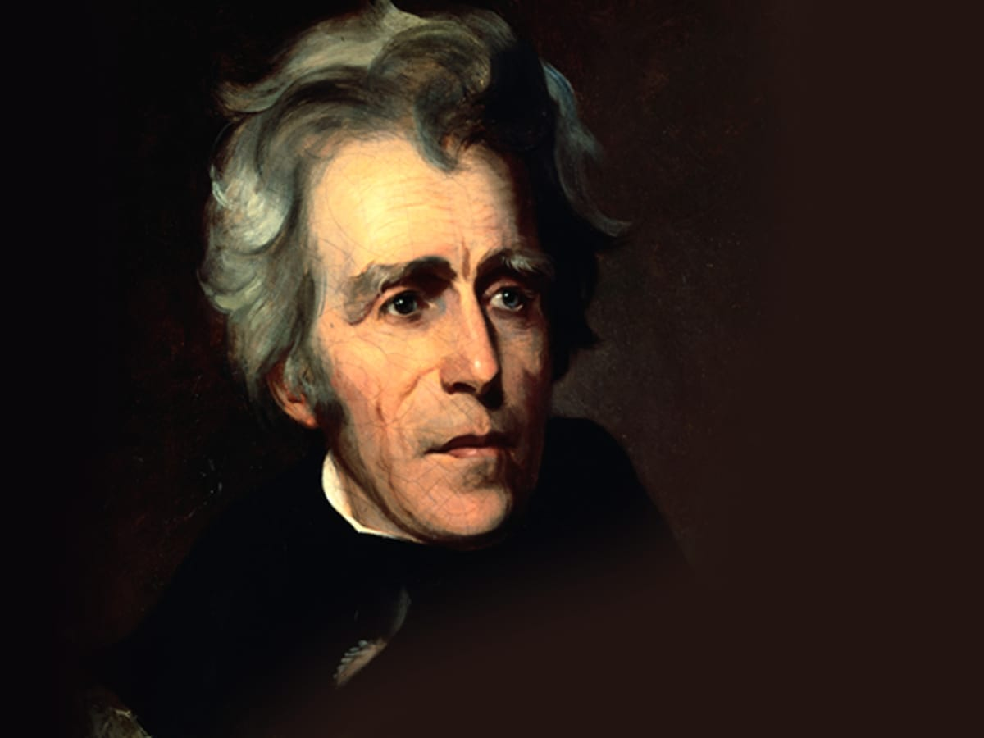
Andrew Jackson
Revolutionary War Hero
1829-1837
“Old Hickory”
Stood for the idea that ordinary people should participate in political life
Democratic party

Slide 26
Indian Removal
Native Americans of the Southeast:
100,000 Native Americans still lived east of the Mississippi River. Many were farmers or lived in towns.
Choctaw, Chickasaw, Cherokee, Creek – MS, AL, GA, NC, TN
Seminoles – FL
Cherokees adopted white customs, ran businesses, and claimed status as a separate nation.

Slide 27
Conflict over Land
Native Americans in the Southeast would not move.
In 1825 and 1827, Georgia passed laws forcing Creeks to give up their land, and tried to do the same with Cherokees.

Slide 28
Indian Removal
The Indian Removal Act of 1830 gave President Jackson authority to offer Native American nations land west of the MS in exchange for their land in the east.
The Choctaws singed a treaty in 1830 and moved west to Indian Territory, mostly in present-day Oklahoma.
Cherokees were reluctant to give up their land. In 1838 President Martin Van Buren forced the Cherokees to move.
The Cherokees were forced to march hundreds of miles with little food or shelter. 4,000 of 15,000 died along the way.
The route of the forced relocation of Native Americans to “Indian Territory” became known as the Trail of Tears.

Slide 29
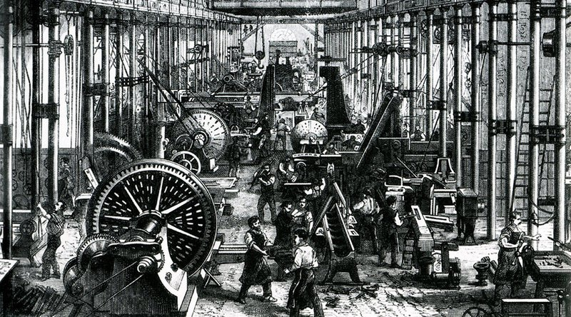
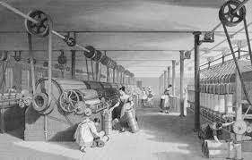
Industrial Revolution
During the Industrial Revolution, machines took the place of many hand tools.
Much of the power once provided by people and horses began to be replaced, first by flowing water and then by steam engines.
The Industrial Revolution began in Britain, in the textile, or cloth-making, industry.

Slide 30
Causes of Industrialization in the U.S.
The War of 1812 forced the United States’ industry to grow.
The British navy blockaded United States ports, which forced Americans to depend on their own industries to supply goods.

Slide 31
New Ideas
Samuel Slater constructed a steam-powered textile mill, completely from memory, that modeled those in Britain.
Samuel Slater’s textile plants would help modernize the United States’ industry.
Mass production: rapid manufacture of large numbers of identical objects.

Slide 32
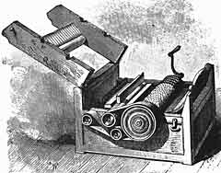
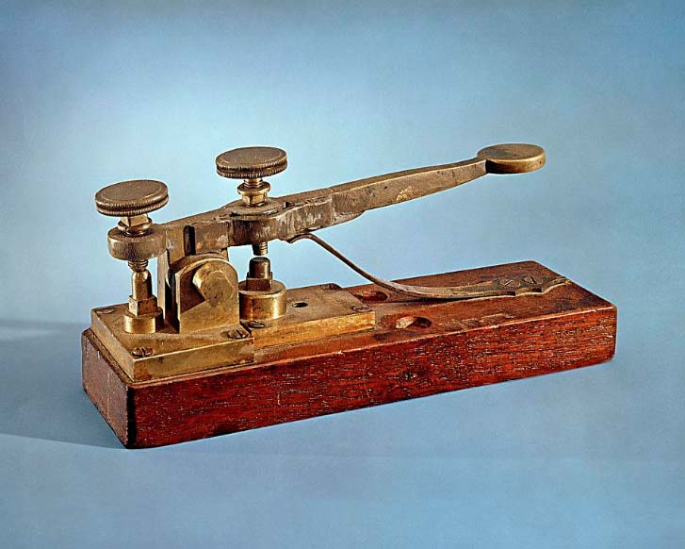
Inventions
Cotton Gin: Created In 1793 by Eli Whitney, it was a simple machine that increased the speed of cotton production.
A worker could process 50 times more cotton fiber with the gin than by hand.
This allowed cotton growing to become more profitable. Cotton production grew very quickly, so that it was ten times higher in 1820.
Telegraph: a device that used electrical signals to send messages quickly over long distances; invented by Samuel F.B. Morse

Slide 33
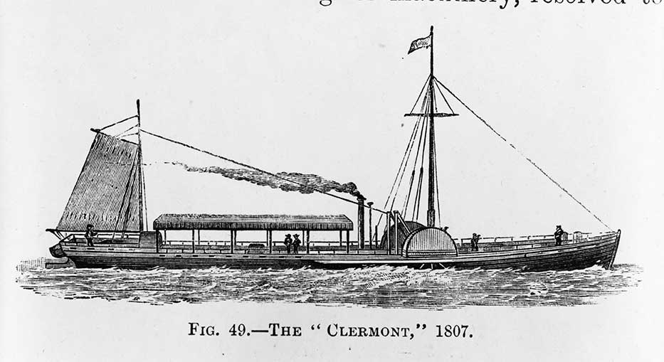
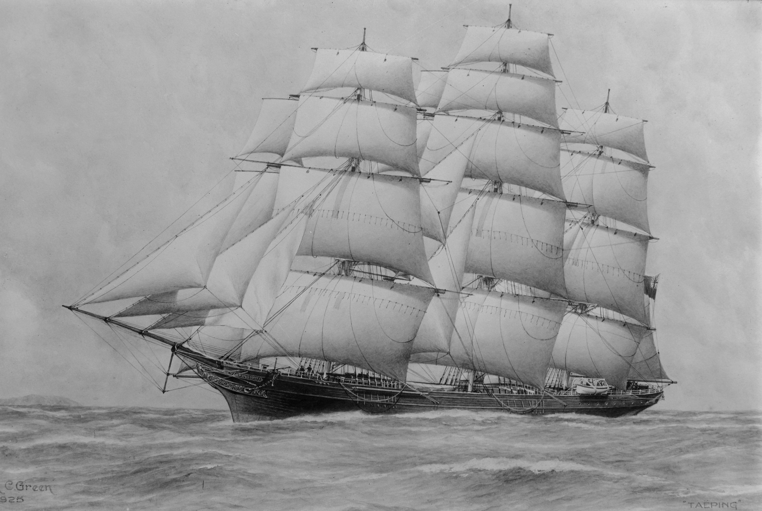
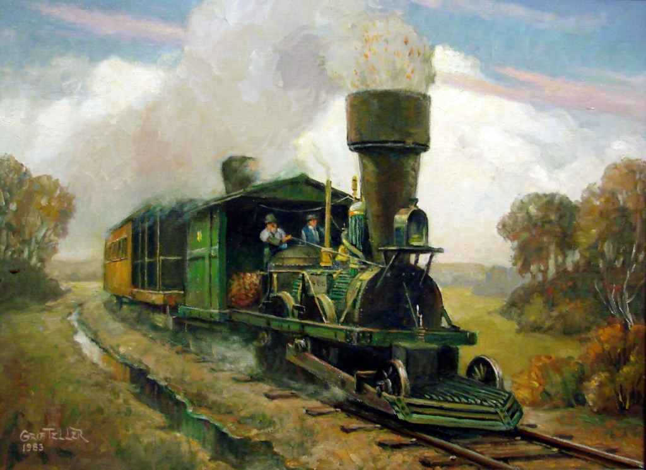
Transportation
Steamboats: Robert Fulton used a steam engine to power a boat.
Clipper Ships: a long slender ship with a tall mast that traveled much faster than steamboats
Railroads
Advantage: Railroads could be built almost anywhere.
First American-made steam locomotive was built in 1830. By 1840, about 3,000 miles of railway track had been built in the U.S.

Slide 34
Factory Life
Children were employed at factories as young as 7-8, with no opportunity for education. By 1880 more than a million children ages 10-15 worked for pay.
Factories were poorly lighted with little fresh air.
Machines caused injuries on the job.
Work days lasted 12-14 hours.

Slide 35
Urbanization
U.S. cities grew larger.
The Industrial Revolution spurred urbanization, or the growth of cities due to movement of people from rural areas to cities.
As more factories were built, agricultural workers were attracted to the new types of work available in the cities.

Slide 36
A New Wave of Immigrants
Millions of immigrants entered the United States, mostly from Western Europe, in the 1840s.
Causes:
They heard they could buy cheap land.
They thought their skills would serve them well in the U.S.
There were problems in their home country.

Slide 37
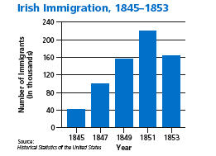
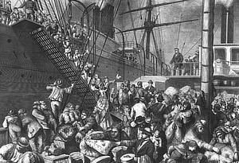
Irish Immigrants
A famine, widespread starvation, hit Ireland in 1845 when a fungus destroyed the potato crop. More than a million starved to death, and a million more left Ireland.
They found jobs in America in the lowliest jobs in construction or laying railroad track. Women were often employed as household workers.
German Immigrants
Many German immigrants had taken part in revolutions against harsh rulers and fled to the U.S. when the revolutions failed.
Most Germans moved west in the Ohio Valley and Great Lakes Region.

Slide 38
Reaction Against Immigrants
Some Americans worried about the growing foreign population.
Nativists: people who were fearful of or against immigrants
Nativists wanted to preserve the country for white, American-born protestants.
Nativists especially opposed Irish immigration because most of the Irish were Roman Catholics.

