Slide 1
Chapter 7: :Creating the Constitution (1776-1790)
^{7th} grade
Pearl Junior High

Slide 2
Section 1: Governing a New Nation page 202-211
Focus Question:
What were the major successes and failures of the government under the Articles of Confederation?
Student Outcomes:
Discuss the ideas that guided the new state governments.
Describe the government under the Articles of Confederation.
Explain the Ordinances of 1785 and 1787 and their importance to westward expansion.
Identify the problems created by a weak central government.

Slide 3
Terms and People
constitution – document stating the rules under which a government will operate
executive – person who runs the government and sees that the laws are carried out
economic depression – period when business activity slows, prices and wages drop, and unemployment rises
Daniel Shays – army veteran and Massachusetts farmer who led an uprising to protest economic conditions

Slide 4
With independence came a new nation and a new form of government.
What type of government should the Americans create after winning the American Revolution?

Slide 5
Type of Government
Democracy = Everyone votes on everything
Republic = Each state would vote for representative to vote in your place.
Monarchy = The states chooses one person to be king or queen.
Who will make, enforce, and judge the laws?

Slide 6
Even before independence was won, many colonies—now states—began to create new state governments.
Each State thought of itself as its own independent nation. With its own Constitution which established its form of government, laws, currency, and system of taxation.
State
Constitutions
In most states, the problems colonists had experienced with Britain helped shape the new state constitutions.

Slide 7
Colonists believed the king had abused his powers.
States gave few powers to the governors to avoid the problems that started the revolution.
Powers
of the
legislature
Powers
of the
executive
Most powers went to legislatures elected by the people.

Slide 8
Most states allowed more people to vote than in colonial times.
Voter Qualifications
White
Male
Over 21
Property ownership
Still, African Americans and women were not allowed to vote in almost all the states.

Slide 9
To make sure that people’s rights would not be abused again, many states included a bill of rights in their constitutions.
Virginia Bill of Rights
Freedom of Religion
Freedom of the Press
Trial by Jury
Limits on Searches
Limits on Arrests
No Cruel and Unusual Punishment

Slide 10
While the states were writing new constitutions, so was the Continental Congress.
In 1777, the Congress adopted a new plan of government for the nation: the Articles of Confederation.
Articles
of
Confederation

Slide 11
Many of the concerns about colonial rule that shaped the new state constitutions also shaped the Articles of Confederation.
Powers
of the
legislature
Under the Articles, the powers of the central government were given to Congress—a legislature elected by the people.

Slide 12
In fact, the legislature was the only branch of government created by the Articles.
There was no chief executive.
There were no national courts.
Executive
Branch
Judicial
Branch

Slide 13
Powers given
to Congress
To make sure the new legislature did not become too strong, its powers were limited.
deal with foreign countries
deal with Native Americans
make laws
declare war
coin or borrow money
run a postal service

Slide 14
Even more important than the powers given to Congress, however, were the powers not given to Congress.
Powers not
given to
Congress
regulate trade
collect taxes
Congress was forced to depend on the states when it needed money. This weakened the central government and gave considerable power to the states because of this Britain still held forts in the Northwest Territories.

Slide 15
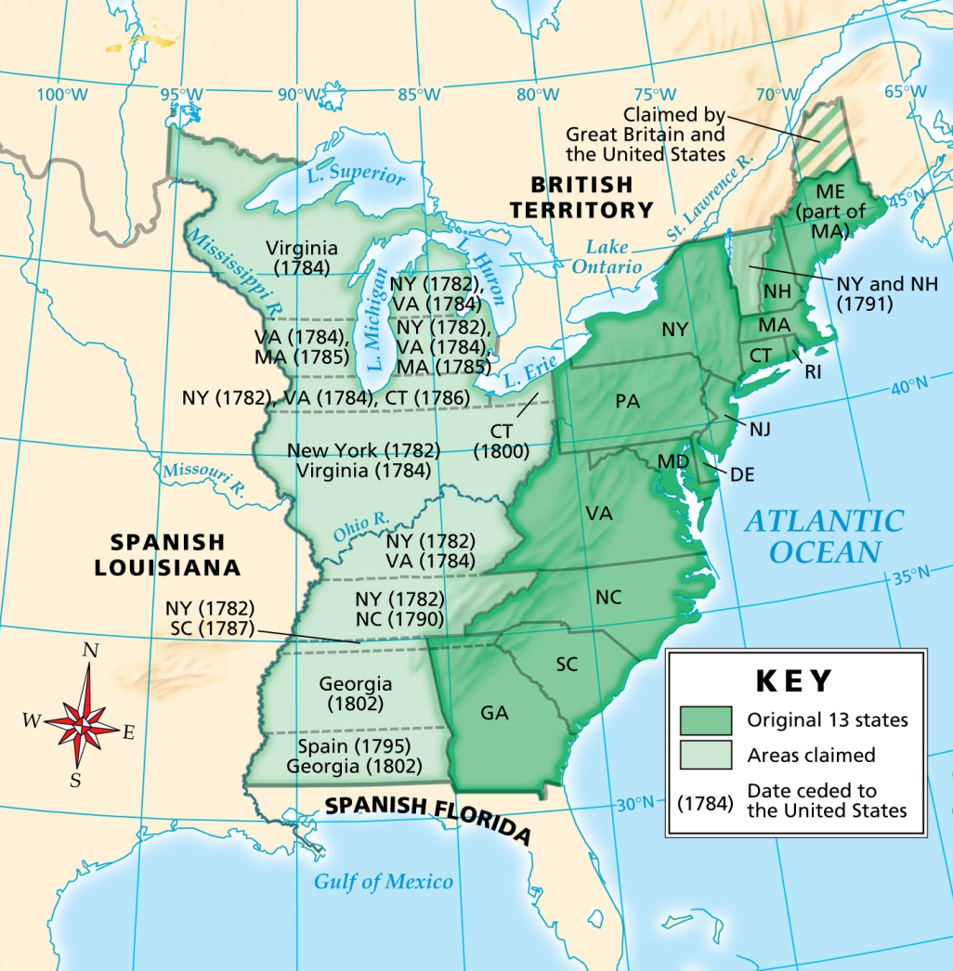
Some states refused to approve the Articles until other states gave up their claims to lands in the west of the Appalachian Mountains.
Western Land Claims
Finally, the Articles were approved, and the land was turned over to the national government.

Slide 16
The western lands were very valuable and in great demand.
To provide for the sale and settlement of these lands, Congress passed two new laws.
The Land Ordinance of 1785
The Northwest Ordinance of 1787

Slide 17
Land Ordinance of 1785
Lands would be divided into 6 miles on each side. townships
Townships would be divided into 36 sections.
Each section would be sold piece by piece for no less than $1 per acre.

Slide 18
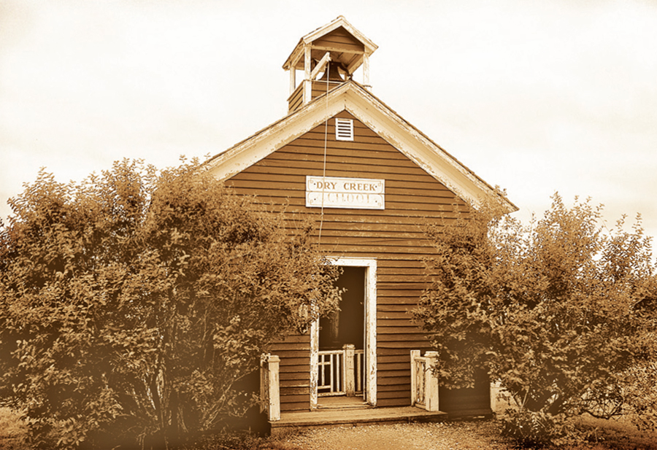
Within each township, one section would be set aside for schools.
The nation’s leaders believed that democracy could not survive without education.

Slide 19
Northwest Ordinance of 1787
Created government for the Northwest Territory—the lands north of the Ohio River
Guaranteed basic rights for settlers
Banned slavery
Created a system for a territory to become a state

Slide 20
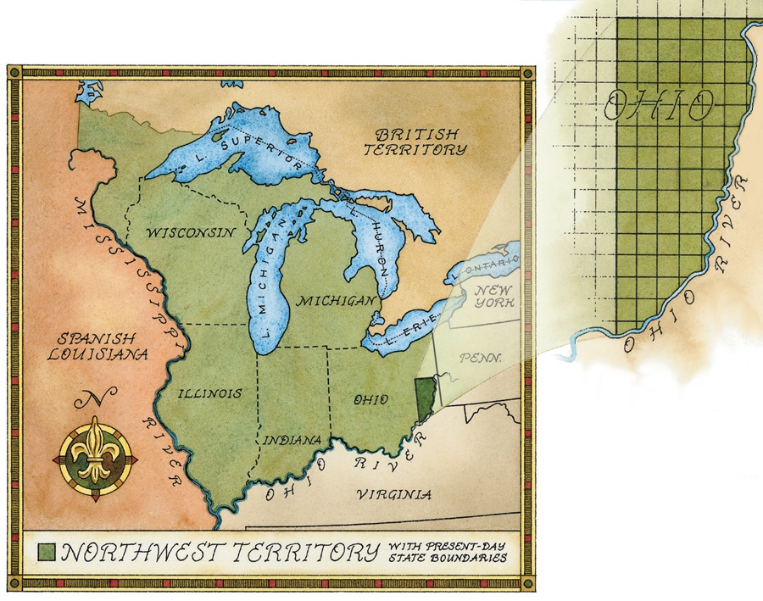
Five states were eventually carved from the lands of the Northwest Territory.

Slide 21
While the government succeeded in organizing the settlement of western lands, it faced mounting problems.
Problems
States
taxed
each
other’s
goods
Congress
had
no
money
Other
countries
ignored
U.S.
States
used
different
money

Slide 22
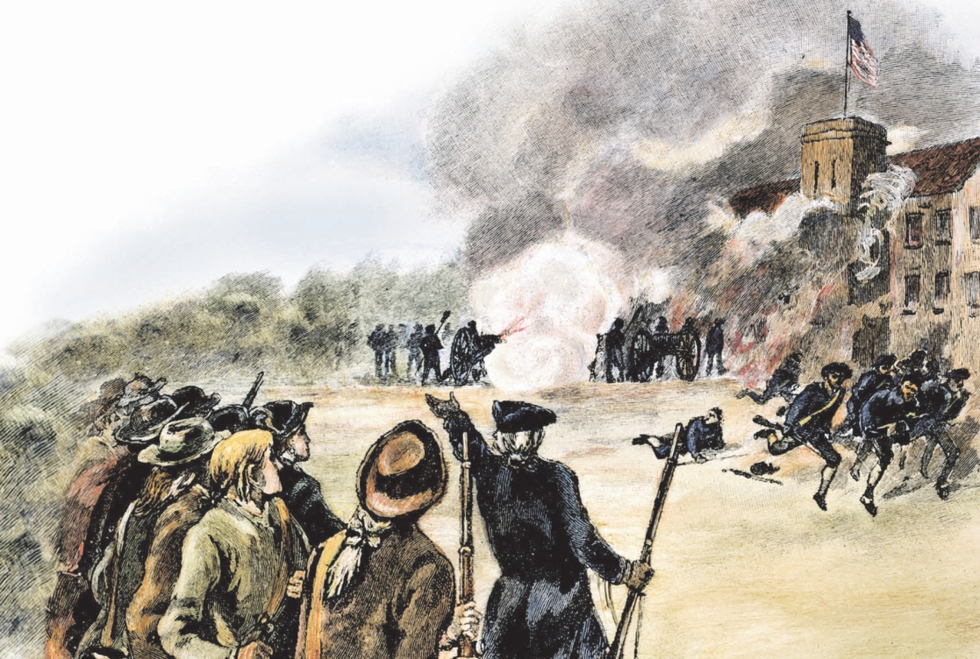
To make matters worse, an economic depression gripped the states.
Farmers were hit especially hard, with many losing their lands.
Angry and in despair, a group led by Daniel Shays attacked an arms warehouse.

Slide 23
Shays’ Rebellion failed, but it focused attention on the weaknesses of the new nation’s government.
Strong
central
government
Many began to think that a weak central government was ineffective
In response, Congress asked the states to send delegates to a convention in Philadelphia to revise the Articles of Confederation.

Slide 24
Section 2: The Constitutional Convention page 212-217
Focus Question:
What role did compromise play in the creation of the United States Constitution?
Student Outcomes:
Describe the proceedings of the Constitutional Convention.
Identify the specifics of the Virginia Plan.
Explain how the Great Compromise satisfied both large and small states.
Describe the disputes over slavery and the compromises that were reaches.
Discuss the drafting of the new Constitution.

Slide 25
Terms and People
James Madison – delegate from Virginia who took notes at the Constitutional Convention; called the Father of the Constitution
judicial branch – branch of government that consists of a system of courts to interpret the law
Roger Sherman – delegate from Connecticut who helped draft the Great Compromise
James Wilson – delegate from Pennsylvania who argued in favor of election of the legislature

Slide 26
Terms and People (continued)
compromise – agreement in which each side gives up part of what it wants
Gouverneur Morris – delegate responsible for writing the Preamble to the Constitution

Slide 27
What role did compromise play in the creation of the United States Constitution?
In the summer of 1787, leaders from across the country met in Philadelphia to discuss the nation’s growing problems.
They agreed that the current government had many weaknesses. The question was how to fix them.

Slide 28
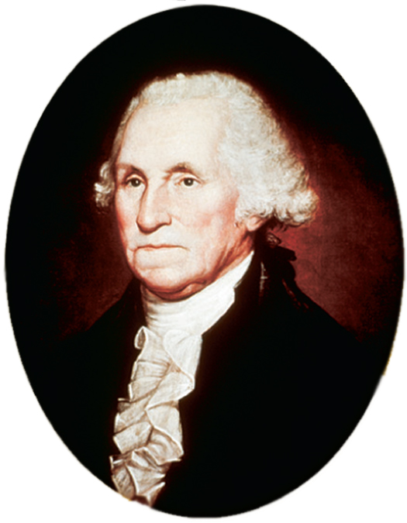
Fifty-five delegates attended the meeting in Philadelphia. They represented 12 of the states, all but Rhode Island.
The delegates included heroes of the Revolution as well as younger state leaders.
George Washington was elected the convention’s president.

Slide 29
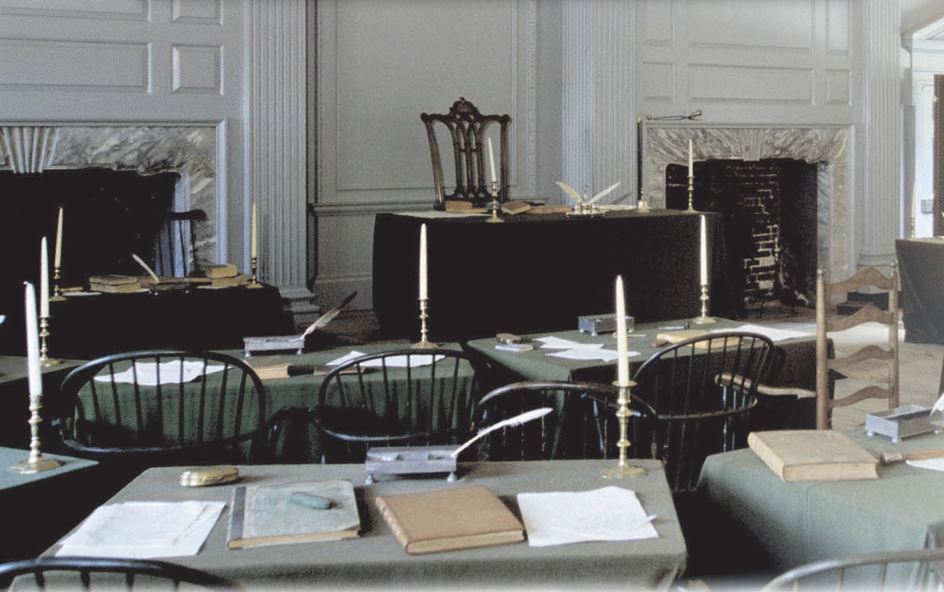
The purpose of the convention was to revise the Articles of Confederation.
From the beginning, however, many delegates believed that the Articles could not be saved.
Independence Hall

Slide 30
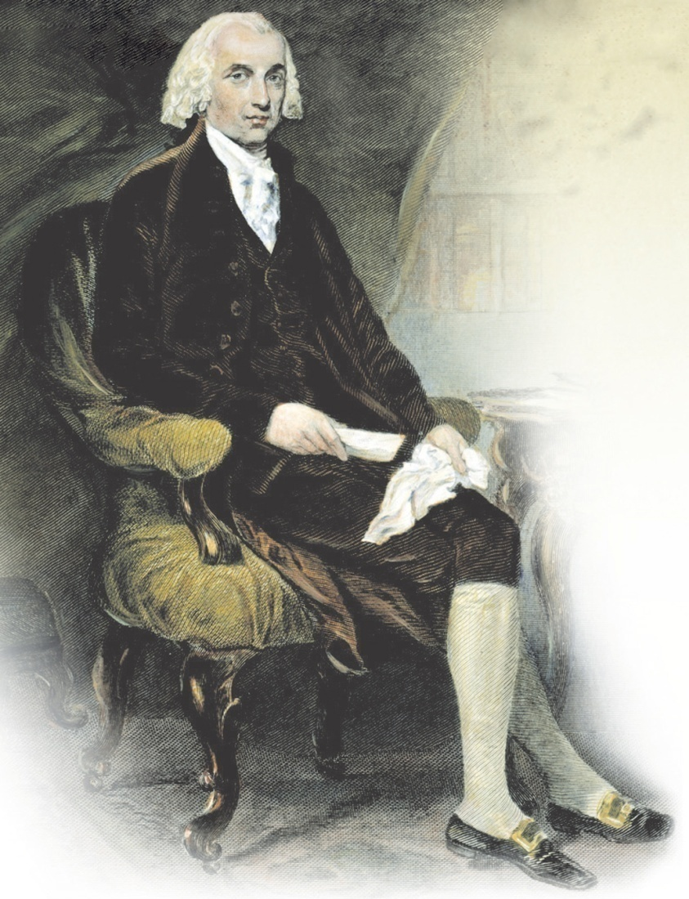
On just the third day of the convention, a proposal was presented to replace the Articles with a totally new plan of government.
The plan was written largely by James Madison of Virginia.

Slide 31
The Virginia Plan called for a strong central government with three separate branches.
Central Government
Legislative
Branch
Congress
make laws
Executive
Branch
President
carry out laws
Judicial
Branch
Courts
interpret laws

Slide 32
The Virginia Plan also called for Congress to have two separate houses—an upper and a lower house.
Congress
Upper
House
Lower
House
Representation in both houses would be determined by a state’s population.

Slide 33
Delegates from the small states opposed the Virginia Plan. Each state, they argued, should have the same number of votes in Congress.
William Paterson of New Jersey introduced his own plan, calling for Congress to have one house, and for each state to have one vote.
New Jersey
Plan

Slide 34
The issue of representation in Congress nearly tore the convention apart.
Virginia Plan
More people, more votes
New Jersey Plan
One state gets
one vote

Slide 35
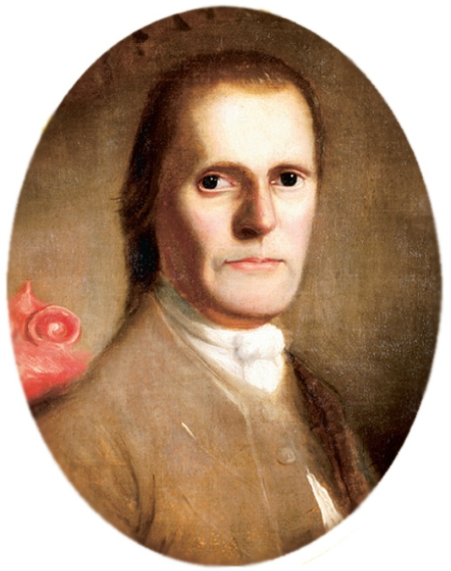
Finally, Roger Sherman of Connecticut introduced a compromise that gave each side part of what it wanted.
The convention approved Sherman’s compromise, which became known as the Great Compromise.

Slide 36
The Great Compromise
Proposed by Roger Sherman
Called for a two-house Congress.
House of Representatives: representatives elected by population and serve for 2 years.
Senate: 2 seats per state and serve for 6 years.

Slide 37
The issue of representation in Congress came up again—this time concerning slavery. Should slaves be counted as part of a state’s population?
Southern
delegates
said yes
Northern
delegates
said no
A compromise was reached. Each enslaved person would be counted as three fifths of a free person.

Slide 38
The Three-Fifths Compromise, however, did not address the issue of the slave trade itself.
Some Northern delegates wanted to completely ban the slave trade. Southern delegates argued that such a move would ruin the South’s economy.
Again, a compromise was reached.

Slide 39
Slave Trade
Compromise
Ships could bring enslaved people into the country for 20 years.
After 1808, enslaved people could not be brought into the country.
The slave trade within the country would stay the same.

Slide 40
When the last compromise was reached, the delegates finally agreed on the provisions of the new Constitution.
Gouverneur Morris wrote the Preamble, which identifies the source of the new government’s authority in its opening words.
We the People
of the United States . . .

Slide 41
Section 3: Debating the Constitution page 218-221
Focus Question:
How did those in favor of the Constitution achieve its ratification?
Student Outcomes:
Compare the positions of the Federalists and the Antifederalists.
Discuss the debate over ratification.
Describe the Bill of Rights and how it protects the people.

Slide 42
Terms and People
ratify – approve
Alexander Hamilton – supporter of the Constitution and an author of the Federalist Papers
John Jay – supporter of the Constitution and an author of the Federalist Papers
George Mason – Anti-Federalist leader who argued in favor of a bill of rights

Slide 43
How did those in favor of the Constitution achieve its ratification?
The nation’s leaders had written a new plan of government, but it could not yet be put in place.
Constitution
of the
United States
First, it had to be approved by the states. And approval was far from certain.

Slide 44
The process for the states to ratify the new Constitution had been set up by the delegates in Philadelphia.
Ratification
Each state holds a convention.
The Constitution takes effect
when approved by nine states.

Slide 45
From the beginning, Americans were divided over whether to support the new Constitution and its strong national, or federal, government.
Federalists
favored
ratification.
Anti-Federalists
were against
ratification.

Slide 46
James Madison was a leading Federalist.
Madison and others argued that a strong national government was needed for the Union to survive.
At that time, the national government could not even enforce its own laws.

Slide 47
Madison, Alexander Hamilton, and John Jay explained their support for the Constitution in a series of newspaper articles that drew wide attention.
Federalist
Papers

Slide 48
George Mason and Patrick Henry were among Anti-Federalists leaders who argued that the new national government would have too much power.
weakened the states
Constitution
of the
United States
no Bill of Rights
President could become a king

Slide 49
The debate over the Constitution intensified as the states began to hold their ratifying conventions.
Delaware was the first to ratify, followed quickly by Pennsylvania, New Jersey, Georgia, and Connecticut.
1
Delaware

Slide 50
A close vote was expected in Massachusetts, where hard feelings still lingered from Shays’ Rebellion.
Federalists
Anti-Federalists
Massachusetts
A final push by Federalists helped win the state. Approval followed in Maryland and South Carolina.

Slide 51
Eight of the nine states needed had now approved the Constitution. Attention turned to Virginia.
Virginia
A “no” vote in this large,
powerful state could trigger
“no” votes elsewhere.
Despite the arguments of Patrick Henry, an Anti-Federalist, Virginia approved the Constitution in a narrow vote.

Slide 52
While Virginia debated, however, a ninth state ratified the Constitution.
9
New Hampshire
In time, the remaining states—New York, North Carolina, and Rhode Island—also voted to ratify.

Slide 53
The new government could now be put in place.
George Washington was elected President.
John Adams was elected Vice President.
A new Congress was elected, too, and one of its first tasks was to take up the question most debated during the ratification process—whether to add a Bill of Rights to the new Constitution.

Slide 54
While the Constitution established the powers of the Federal and State governments, it said nothing about the rights of the American people.
The first Congress passed a series of amendments to the Constitution, listing individual rights.
Bill of Rights
In 1791, ten amendments were ratified by the states.

Slide 55
The United States Constitution
Made up of three parts: The Preamble, The Articles, The Amendments
The Preamble is the introduction that states the purposes of the Constitution to form a perfect union, establish justice, ensure domestic tranquility, provide for the common defense, promote the general welfare, secure the blessings of liberty.
The Articles established the 3 branches of our government (legislative, executive, and judicial)
Amendments are formal changes. The first 10 are known as the Bill of Rights as they guarantee personal rights and freedoms.

Slide 56
Principles of the Constitution
Popular Sovereignty- government gets its power from the people
Limited Government- The government has only the powers that the Constitution gives it.
Separation of Powers- three branches of government to insure no one branch has all the power.
Checks and Balances- guarantees that no one branch will become too powerful.
Federalism- the national government has more power than the state governments.
Republicanism- Citizens elect representatives
Individual rights- The Constitution protects the personal rights of its citizens

Slide 57
Legislative Branch
Congress is the top of this branch
The Legislative branch makes the laws
They can override a presidential veto
Can impeach and remove the President and other high ranking officials
Can declare war
They set the budget (spending for the government0
They can approve taxes

Slide 58
The Executive Branch
The top of this branch is the President
This branch enforces the law
They can propose laws
Can Veto laws
Serve as commander and chief
Appoint federal judges, ambassadors, and other high officials
Can grant pardons to federal offenders

Slide 59
The Judicial Branch
The top of this branch is the Supreme Court
This branch interprets the laws.
They can declare laws unconstitutional.
They can declare executive actions unconstitutional.

Slide 60
Checks and Balances
This is a system of safe guards against abuse of power.
Executive branch can check the power of the Legislative branch with a veto of a law and the power of the Judicial Branch by appointing federal judges.
Legislative branch can check the power of the Executive branch by impeaching the president and the the judicial branch by approving federal judges.
The Judicial branch can check the power of the Executive branch by declaring executive actions unconstitutional of the legislative branch by declaring laws established by Congress as unconstitutional.

Slide 61
Responsibilities of Citizenship
Must Do (jail time or major fines)
Should Do
Obey all local, state, and federal laws
Pay taxes
Serve on juries if called
Defend the nation if called (boys must register for a possible draft at 18)
Vote
Stay informed on important issues
Serve the community
Help to create a just society

