Slide 1
Chapter 6: The American Revolution
(1776-1783)

Slide 2
Second Continental Congress
A meeting held in Philadelphia in May of 1775.
The Congress was originally planned for how to deal with the growing tensions over taxes but by the time they met the Battles of Lexington and Concord had occurred.
The delegates established the Continental Army and chose George Washington as the leader.

Slide 3
New England Delegates proposed armed conflict and preparation for war. The delegates from the Middle Colonies and the Southern Colonies were in favor of begging forgiveness and pledging loyalty to the crown.
Colonists were divided:
The Olive Branch Petition was sent to King George pledging loyalty and asking for an end to hostilities before full war broke out.
Patriots:
Those who favored
independence and
were willing to fight
for it.
Loyalists:
Those who remained
loyal to Britain and
the King

Slide 4
Battles of the American Revolution
Bunker Hill
Long Island
Trenton
Saratoga
Brandywine
Germantown
Charlestown
Cowpens
Yorktown

Slide 5
Battles of the War
Bunker Hill- This was the first official battle of the American Revolution.
  While it was a British victory because the British took Breed’s Hill and the Patriots retreated, the British lost 226 men and 924 were wounded while the Patriots suffered 140 killed and 301 wounded.
Long Island- British victory that gave the British control of New York and the Hudson River.
Trenton- Washington’s sneak attack gave the Patriots a much needed victory.
Saratoga- The defeat of the British, gave France the encouragement they needed to join the war on the Patriots side. This battle lifted Patriot spirit.

Slide 6

Why did many colonists favor declaring independence?
By 1776, tension filled the colonies. The king had declared the colonists to be in open rebellion. Battles had been fought, and soldiers had died.
Still, the path ahead was not clear. Though blood had been shed, many colonists still hoped for peace.

Slide 7
As 1776 began, most colonists were neither Patriots nor Loyalists. They were in the middle, torn about what to do.
Patriots
Loyalists
Undecided

Slide 8
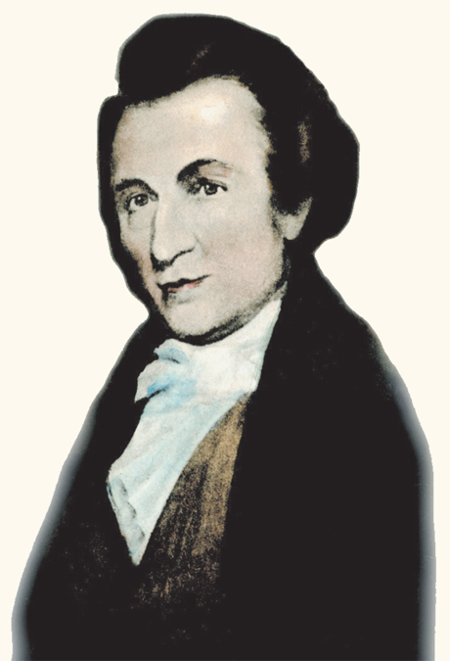
That soon began to change. In January 1776, a colonist named Thomas Paine wrote a pro-independence pamphlet titled Common Sense which persuaded many colonists to favor independence.

Slide 9
In Common Sense, Paine made powerful arguments in favor of independence.
George III
is a
“royal
brute.”
Kings
should not
rule over
people.
Americans
should
govern
themselves.

Slide 10
Common Sense became a bestseller, and public opinion began to shift.
More colonists began to favor independence. So, too, did their representatives in the Second Continental Congress.
Number of
colonists
favoring
independence

Slide 11
Virginia’s Resolution
In May, Virginia delegate Richard Henry Lee introduced a resolution declaring that the colonies should be free and independent states.
Congress formed a committee to write a statement explaining the reasons for independence.
The statement would be presented to Congress, then the question of independence would be put to a vote.

Slide 12
The Declaration of Independence
Thomas Jefferson wrote most of the Declaration of Independence, with minor changes from John Adams and Ben Franklin.
Main purpose: to declare the separation of the United States from Britain.

Slide 13
The Declaration of Independence has four parts, beginning with a preamble.
Preamble
Declaration of Natural Rights
List of Grievances
Resolution of Independence
An introduction to explain why the colonists were breaking ties with Britain.

Slide 14
To begin the explanation, Jefferson declared that everyone has unalienable rights.
Preamble
Declaration of Natural Rights
List of Grievances
Resolution of Independence
Governments are created to protect those rights.
If a government violates those rights, the people must change their government.

Slide 15
List of Grievances: declares that the British government had violated the colonists’ rights.
Preamble
Declaration of Natural Rights
List of Grievances
Resolution of Independence
To prove this, he presented a long list of grievances, including that the colonists were:
denied trial by jury
taxed without their consent

Slide 16
Therefore, Jefferson concluded, the colonies are free and independent states.
Preamble
Declaration of Natural Rights
List of Grievances
Resolution of Independence
All ties between the colonies and the British government are now dissolved.

Slide 17
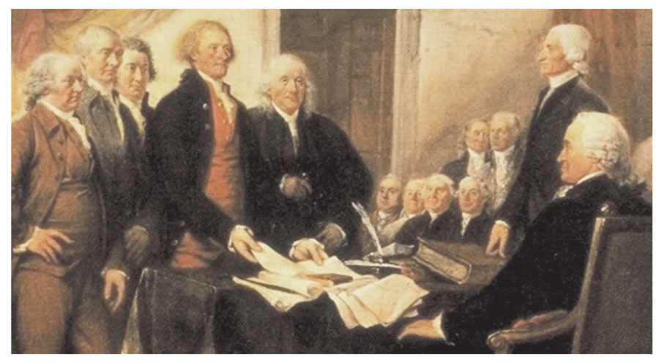
The Declaration of Independence was approved by Congress on July 4, 1776.

Slide 18
For Americans in 1776, however, declaring independence was a serious and frightening step.
The colonists were challenging one of the most powerful nations in the world—and risking their lives.
The purpose of the war changed: Patriots were fighting for fairer treatment from Britain, but now they were fighting to create their own nation.

Slide 19
Americans still celebrate July 4th as Independence Day.
Today, the Declaration of Independence remains a source of inspiration for Americans and for people around the world.

Slide 20
How were the early years of the war a critical time?
In 1776, Americans declared their independence. But they were not yet free.
Declaration
of
Independence
First, they had to defeat one of the world’s most powerful nations.

Slide 21
In a series of battles and American retreats, the British drove Washington from New York, across New Jersey, and into Pennsylvania.
British
Americans

Slide 22
The Battle of Saratoga proved to be a turning point for the Americans.
Battle of
Saratoga
ended British threat to New England
lifted Patriot spirits
convinced Europeans Americans could win

Slide 23
Help From Overseas
Soon after Saratoga, France forms an alliance with the Americans.
Fighting between France and Britain in Europe and the Caribbean left fewer British troops to fight in North America.

Slide 24
European volunteers from many nations made key contributions to the Patriot cause.
France
Marquis de
Lafayette
Officer in
Washington’s
army
Poland
Casimir
Pulaski
Cavalry
expert
Poland
Thaddeus
Kosciusko
Military
engineer

Slide 25
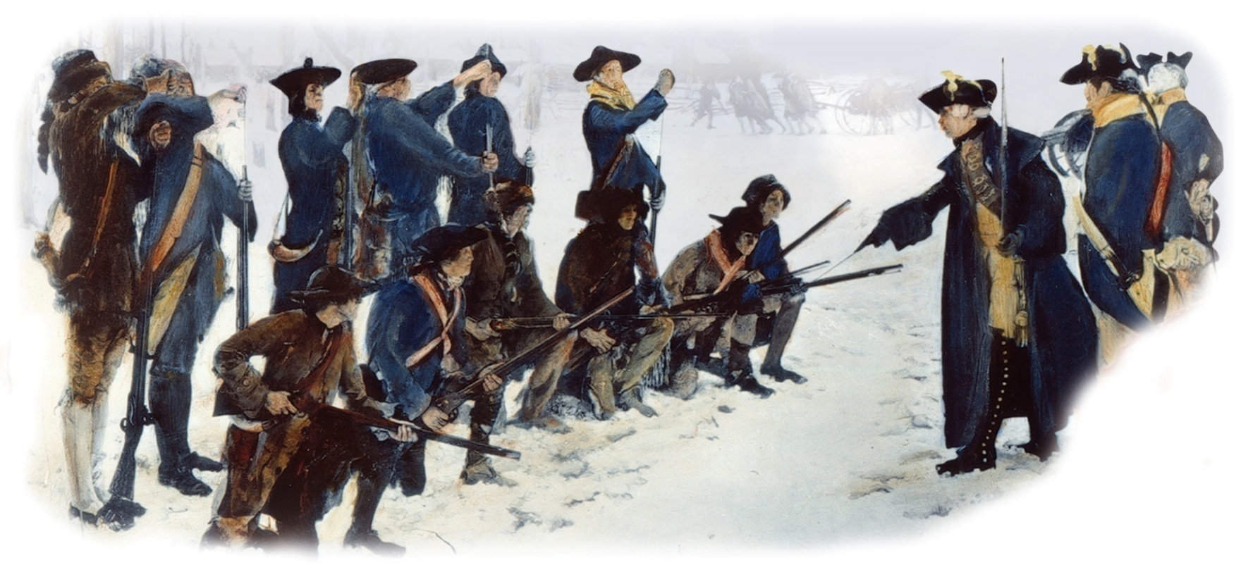
Valley Forge
Born von Steuben, a German soldier, helped train American troops and build the Continental army into a more effective fighting force.

Slide 26
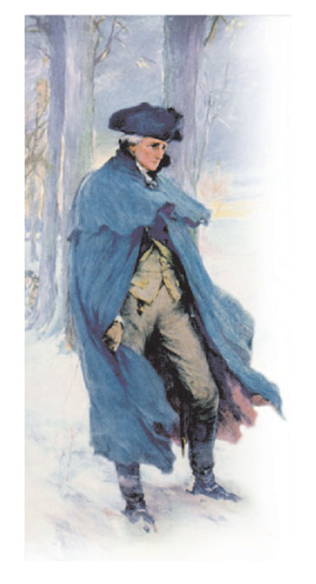
Despite Patriot advances, the winter of 1777–1778 was difficult.
Washington and his troops faced terrible hardships at Valley Forge. They had little warm clothing, and almost no food. Many died from disease and starvation.
American women collected and sent food and supplies.
Yet spring finally came, and the army slowly regained strength for the battles ahead.

Slide 27
The War Widens
Focus Question:
How did the effects of the war widen?

Slide 28
How did the effects of the war widen?
While Continental soldiers faced battle in the thirteen colonies, many people in other places also felt the war’s effects.
American Revolution
Native
Americans
Western
settlers
Women
African
Americans

Slide 29
African Americans fought on both sides during the American Revolution.
African Americans
Patriots
British

Slide 30
Free African Americans fought for the Patriots from the beginning, seeing action at several key battles.
Lexington and Concord
Bunker Hill
Saratoga
Some enslaved people also supported the Americans after escaping from their owners.

Slide 31
If they fought for the British, however, enslaved people were offered something of immense value.
Freedom
Enslaved African Americans helped the Patriot cause by acting as spies or providing manual labor.
The British tried to destroy the economy of the South by offering slaves freedom in exchange for fighting on the British side.

Slide 32
At first, George Washington refused to accept African American soldiers.
Washington reversed his policy, however, after so many African Americans began to join the British forces.
By the end of the war, more than 7,000 African Americans had fought for the Patriots.

Slide 33
Most southern states refused to accept African American soldiers, fearing armed slave revolts.
Some northern states took steps to end slavery during the war.
A Pennsylvania law of 1780 provided for a gradual end to slavery. It said slaveholders could not buy additional slaves.

Slide 34
Women, too, were affected by the war, often taking on new responsibilities.
At home, women:
planted crops
tended livestock
ran businesses
While men
enlisted in the
military,
women at home
took over their
responsibilities.

Slide 35
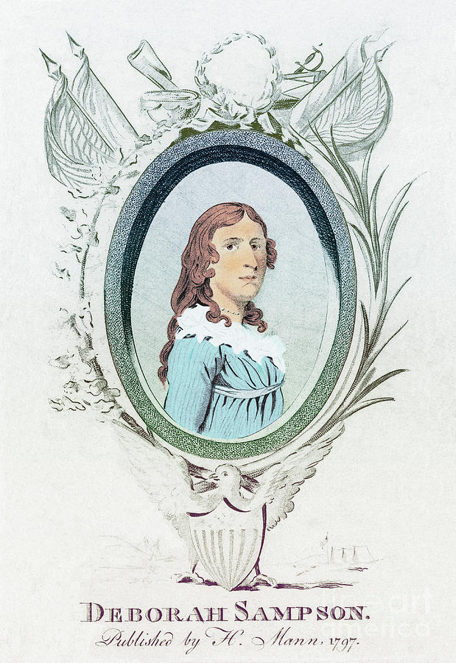
Some women accompanied their husbands to military camps to cook and to clean uniforms.
They provided supplies, food, and water. They cared for the wounded.
Some women disguised themselves and enlisted in the army.
  Deborah Sampson
Wounded in battle, Sampson tended to her own wounds in order to keep her secret.
Others overtly fought for the Patriots cause. Mary Ludwig jumped in and assisted on a cannon crew when her husband was wounded.

Slide 36
Soldiers and civilians alike were affected by the financial burdens of paying for the war.
Congress had no power to tax, and the states had little money.
Continental
Continental
Congress printed continentals to pay expenses, but the money soon lost its value.
Amount printed
Value
Continental
Continental

Slide 37
Those on the western frontier also felt the war’s effects.
British
Native
Americans
Most Native Americans sided with the British, fearing an American victory would bring more settlers onto their lands.

Slide 38
Many Indian groups, however, were bitterly divided about which side to support. Some split into warring factions.
A deadly epidemic added to the crushing effects of war.
Infighting
Western
raids
Smallpox
Native Americans

Slide 39
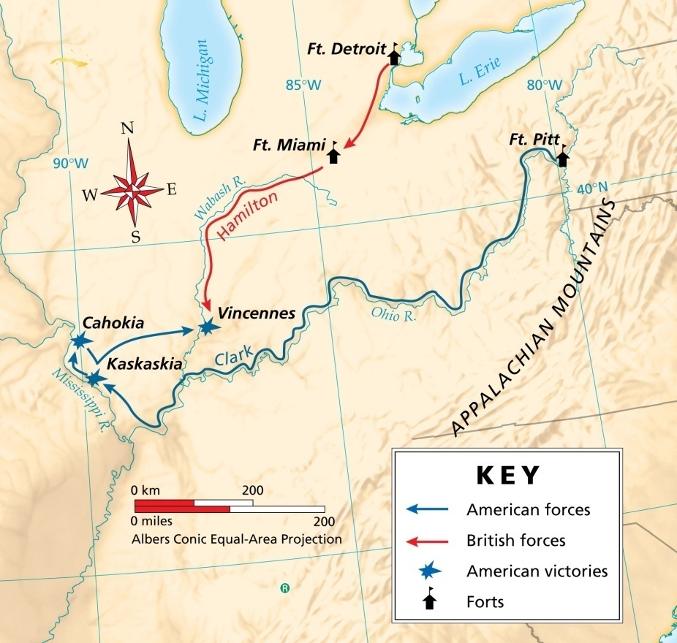
George Rogers Clark pushed west to strike British forts on the frontier.
Clark won key battles against the British and their Native American allies.
These victories allowed settlers to remain on the frontier.

Slide 40
Clark and other Americans were given help by the Spanish, who declared war on Britain in 1779.
Spanish
Patriots

Slide 41
Battles of the War
Brandywine- British victory that allowed the British to capture Philadelphia the capital of the colonies.
Germantown- British victory the last of 1777 before both sides would settle into winter quarters.
Charlestown- British victory that gave the British control of Charleston Harbor. From here they could invade the Southern Colonies.
Cowpens- American victory that caused the British to retreat toward Yorktown Virginia. The beginning of the end for the British in the colonies
Yorktown- An American victory! The final battle of the American Revolution.

Slide 42
Winning Independence
Focus Question:
How did the Americans win the war and make peace?

Slide 43
How did the Americans win the war and make peace?
Armed with a new battle plan, the British were determined to finally end the rebellion.
For a time, it seemed they might succeed. But the Americans fought on, still believing in victory.

Slide 44
After losing New England, the British tried to win the war by capturing the South, then marching north.
Charles Cornwallis, the British commander, seemed unstoppable as he swept through Georgia and into the Carolinas.
North Carolina
Charles Towne,
South Carolina
Savannah,
Georgia

Slide 45
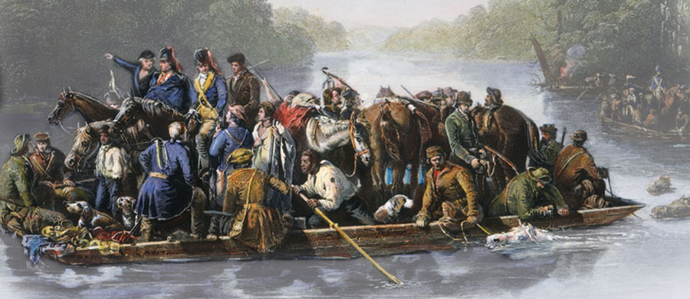
American Francis Marion, called the Swamp Fox, used hit-and-run guerrilla tactics to slow the British.
guerrilla – fighter who works in a small band to make hit-and-run attacks

Slide 46
But the British kept pushing on, battle after battle.
Helping the British was the American traitor,
Benedict Arnold.
Benedict
Arnold
Patriot
had fought bravely for the Patriots
plotted to give West Point to the British
led Loyalist raids in Virginia

Slide 47
Finally, American forces rallied at two key battles in South Carolina.
Kings
Mountain
Frontier fighters defeated British and Loyalist troops atop Kings Mountain
Cowpens
Nathanael Greene split his army in two; American General Daniel Morgan led the western force in a victory over British fighters.

Slide 48
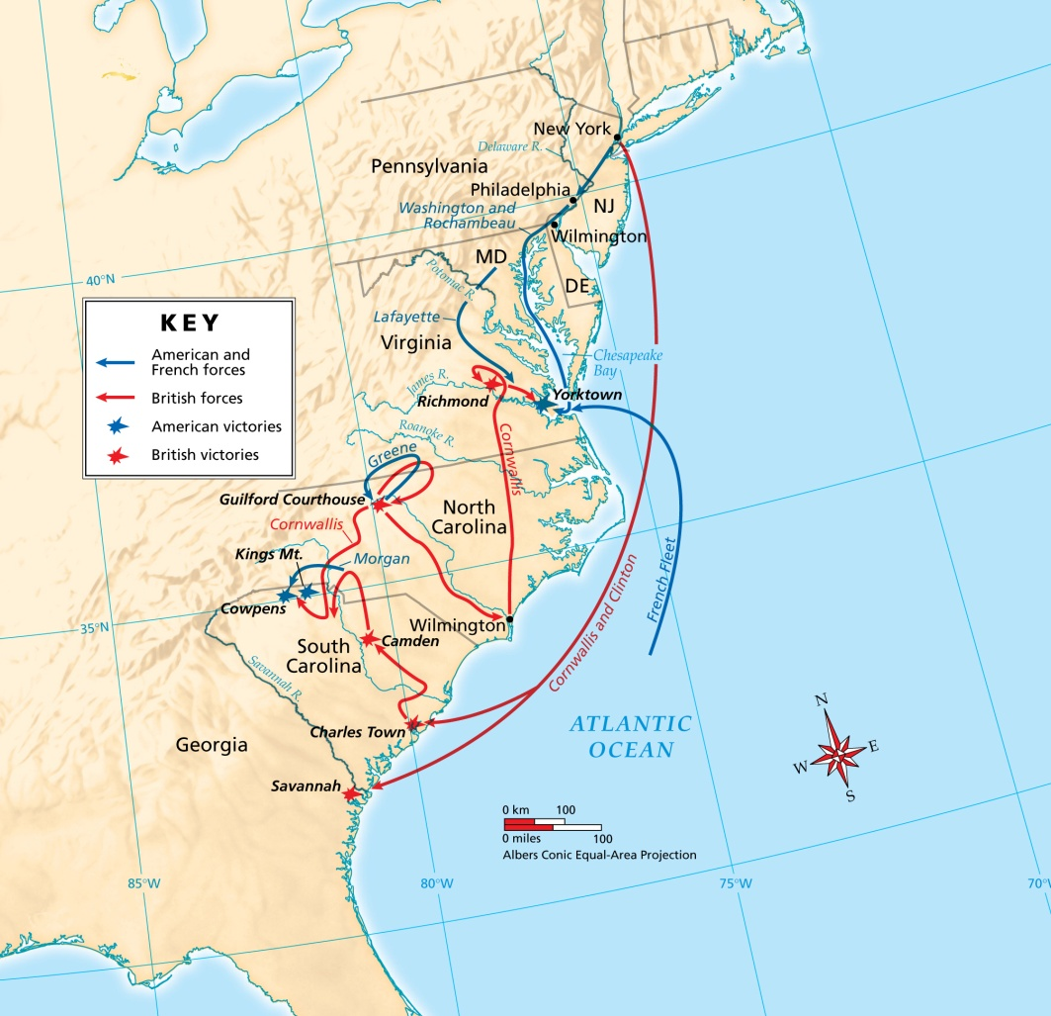
The War in the South, 1778–1781
Weakened, Cornwallis continued the march north, into Virginia.
At the same time, Washington rushed to Virginia with American and French troops.

Slide 49
At Yorktown, Cornwallis moved his main army onto the peninsula.
He believed that the British naval fleet could reinforce his position there.
But Cornwallis soon realized that he was trapped.

Slide 50
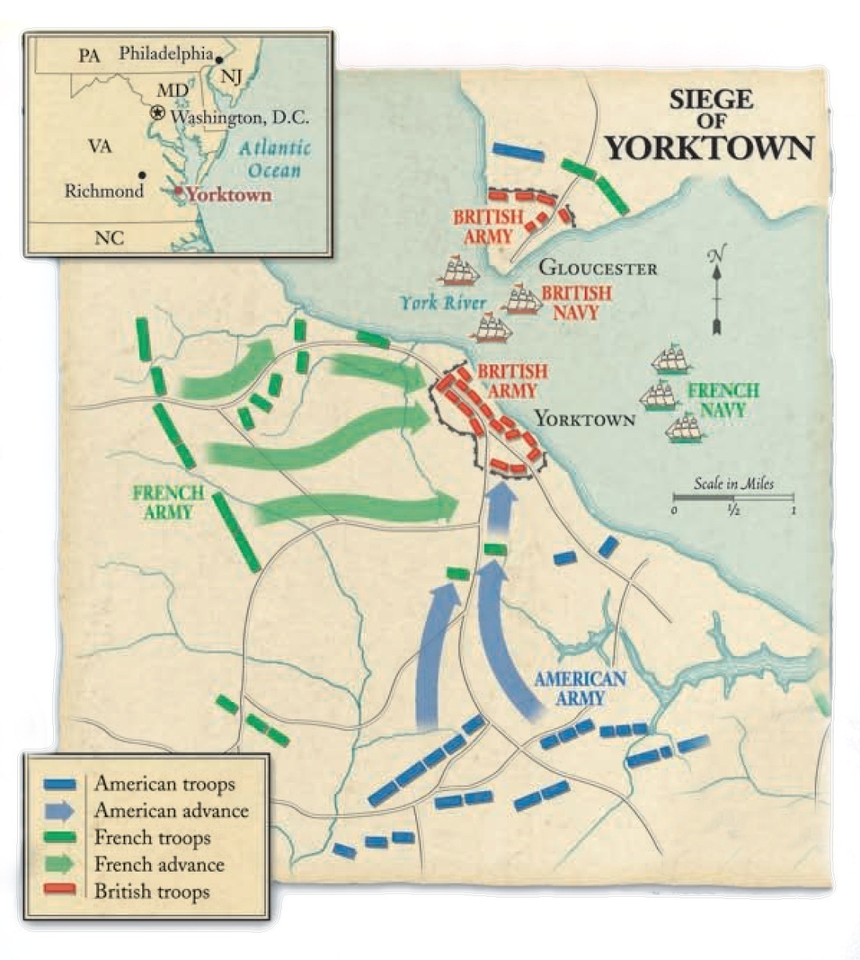
American and French troops arrived, blocking an escape by land.
The French fleet also arrived, blocking an escape by sea.
On October 19, 1781, Cornwallis surrendered.

Slide 51
For many, it seemed the impossible had happened. How had the Americans defeated one of the most powerful nations in the world?
Geography: Americans were fighting on home ground
patriotic spirit
skilled leadership
help from abroad

Slide 52
The war for independence lasted almost eight years.
Now, it was time to make peace.
Peace talks between the two sides were held in Paris, France.
Congressional approval of the Treaty of Paris marked the official end of the Revolution.

Slide 53
Treaty of Paris
Britain recognized the
independence
of the United States.
Both sides agreed to
new U.S. boundaries.

Slide 54
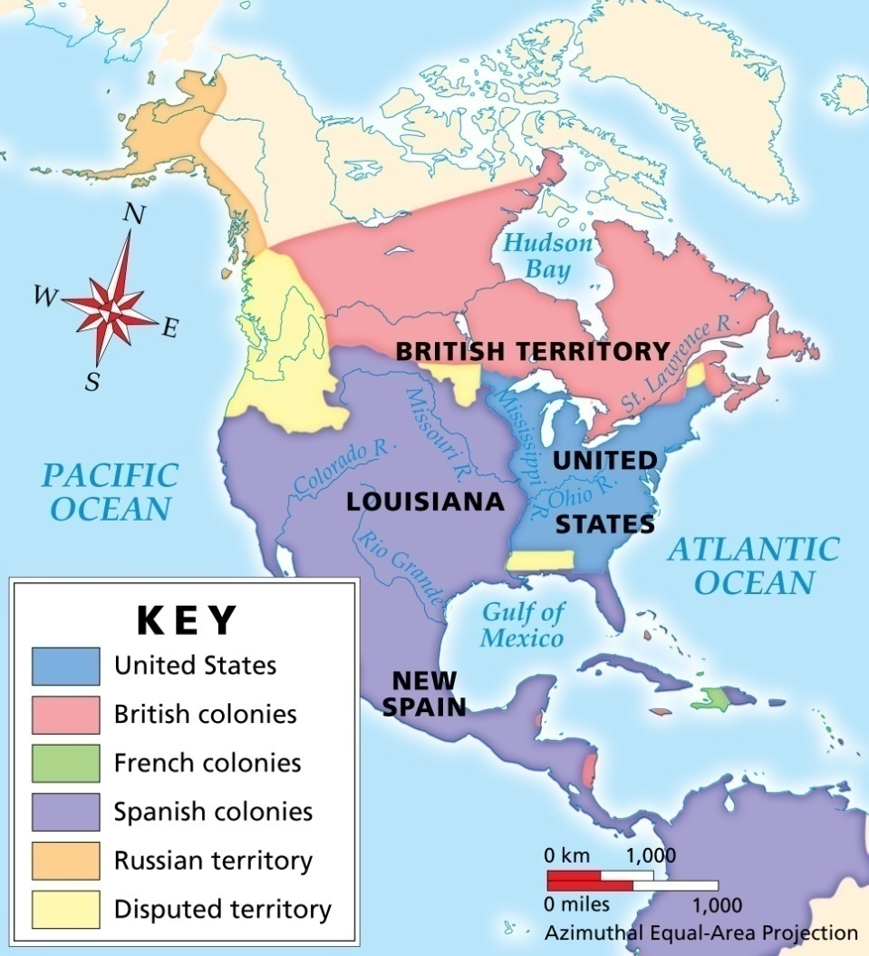
North America in 1783
The boundaries of the new nation were:
Canada on the north
Atlantic ocean to the east
Mississippi River on the west
Florida on the south, but it was returned to Spain.

Slide 55
The U.S. Continental Congress agreed to “earnestly recommend” that the states restore rights and property taken from Loyalists during the war.
However, most states ignored this pledge and property was not returned.

Slide 56
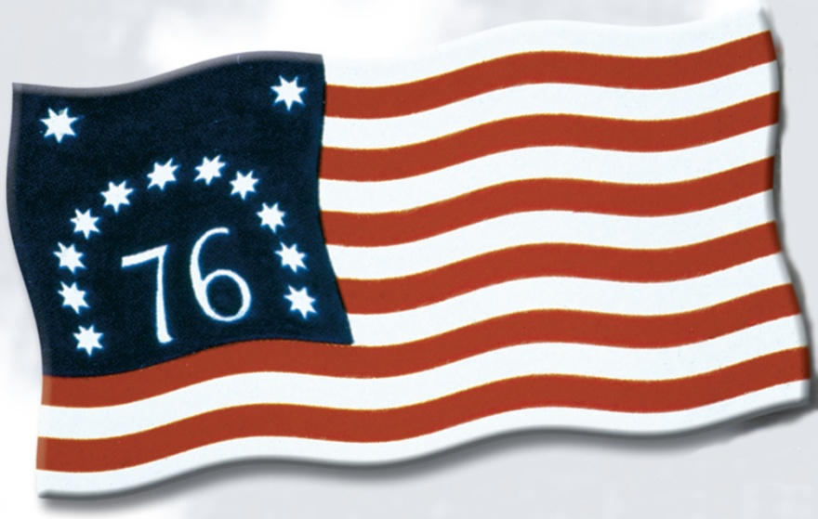
The immediate effect of the Revolution was to create a new nation—the United States of America.
The nation was made up of thirteen independent states, linked by custom and history.

Slide 57
The long-term effects of the Revolution, however, continue today.
American
Revolution
• The ideals of equality and liberty continue to gain broader meaning.
• The Revolution has inspired independence movements around the world.
Ex: France and Latin America

Slide 58
Test Review

Slide 59
Chapter Summary
Section 1: A Nation Declares Independence
In January 1776, many colonists continued to hope for peace with Britain. However, Thomas Paine’s Common Sense rallied support for the Patriot cause. By May, the Second Continental Congress had voted to become independent. The Declaration of Independence was approved on July 4, 1776.

Slide 60
Chapter Summary (continued)
Section 2: A Critical Time
At the beginning of the War for Independence, the Continental army suffered defeat because they were poorly trained and lacked supplies. The Battle of Saratoga was an exciting turning point, and it convinced France and other European nations to lend their support.

Slide 61
Chapter Summary (continued)
Section 3: The War Widens
The war widened as the Spanish declared war against Britain and naval battles ensued. The Revolution affected everyone, including African Americans, women, and Native Americans. African Americans and Native Americans fought on both sides. Women took on responsibilities that had previously been reserved for men.

Slide 62
Chapter Summary (continued)
Section 4: Winning Independence
Charles Cornwallis tried to win the war by marching British troops from Georgia to the north, but he was surrounded at Yorktown and forced to surrender. In the Treaty of Paris, Britain recognized American independence. The ideals of equality and liberty continue to influence events around the world.

