Slide 1
The American Revolution – Part 1: Causes (1745-1776)

Slide 2
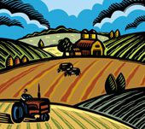
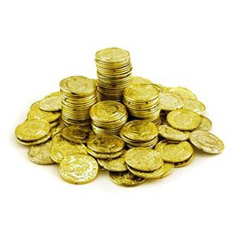
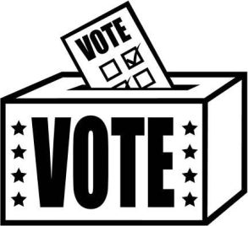
What brought the colonists?
Cheap land
Religious Tolerance
Economic Opportunity
Self-government!

Slide 3
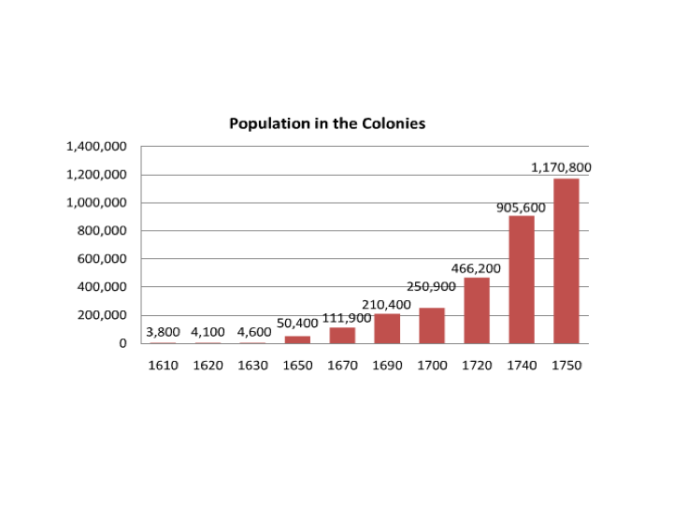

Slide 4
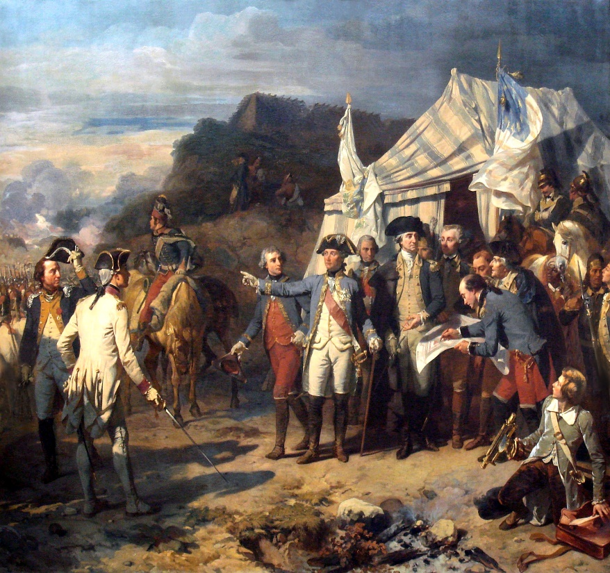
French and Indian War
Focus Question:
How did the British gain French territory in North America?
By the mid-1700s, both Britain and France each controlled a large amount of territory in North America—lands long settled by Native Americans.

Slide 5
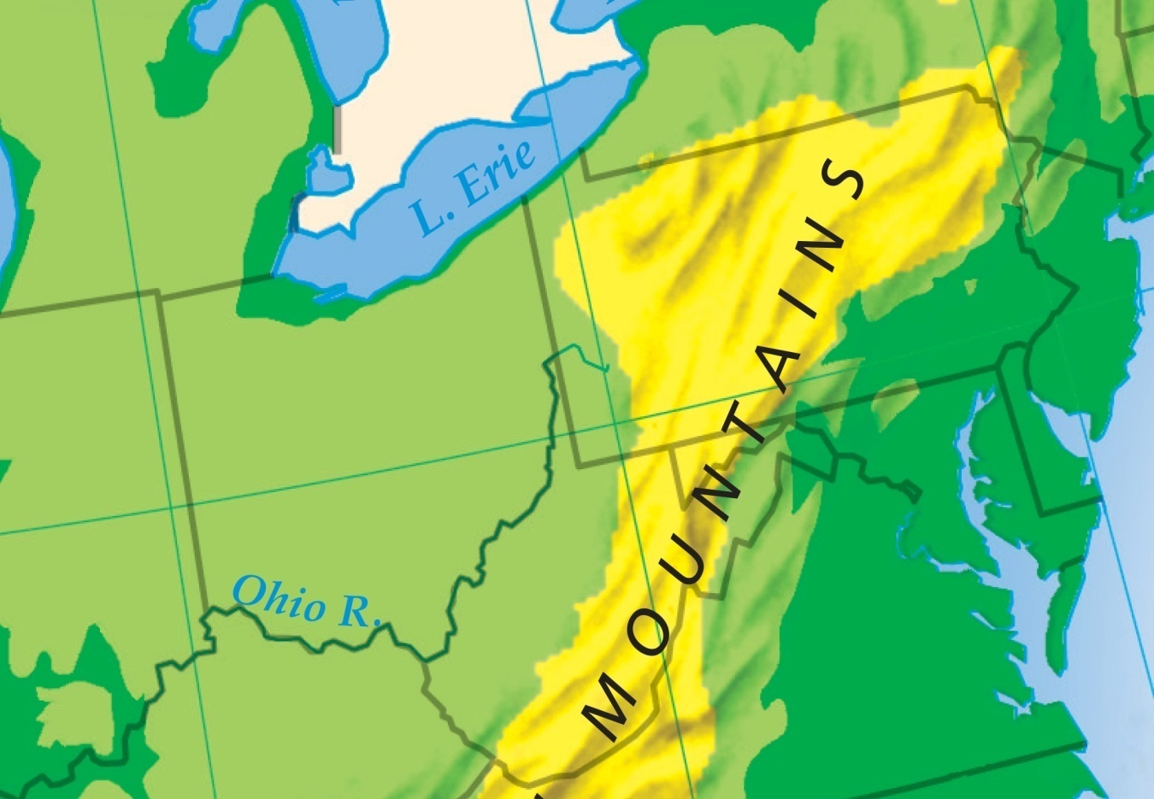
French and Indian War
Conflicts over land led to the French and Indian war, with the future of much of North America at stake.
In the 1750s, land disputes erupted in the Ohio River valley.
Native Americans sided with the French.

Slide 6
France claimed the
Ohio River valley as
part of its territory.
The Virginia colony
also claimed the land, and
British settlers continued
to move west.

Slide 7
In 1753, the French began building forts in the Ohio River valley to protect their claims.
George Washington led a militia a military force made up of civilian soldiers, to order the French out of the land.
The French ignored Washington’s warnings.

Slide 8
War with France seemed certain.
The British called a meeting of colonial leaders and local Iroquois tribes in Albany, New York.
They were hoping to form an alliance with the Iroquois.
The Iroquois refused to join the British alliance out of fear they would lost.

Slide 9
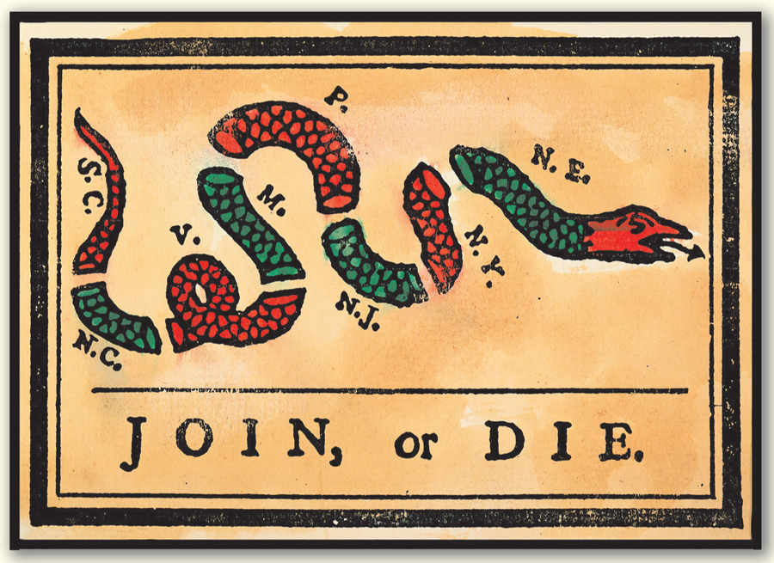
Colonial leaders at the Albany Congress still tried to work out a plan to defend themselves against the French.
Benjamin Franklin urged the colonists to unite against the enemy.

Slide 10
Albany Plan of Union
Ben Franklin drew up a plan:
which called for elected council to have authority over western settlement, and relations with Native Americans. It also could form armies and collect taxes to pay expenses.
The Albany Plan of Union was rejected by the colonial assemblies. They wanted to control their own taxes and armies.

Slide 11
Despite the failure to form a united front, the British decided it was time to act. In 1755, troops led by General Edward Braddock marched on Fort Duquesne.
The French and their Native American allies ambushed the British, defeating them.
The British knew little about fighting in North America.
Red uniforms provided targets.
The British suffered several defeats at the beginning.

Slide 12
Britain’s string of defeats finally ended when a new prime minister, William Pitt, took office electing James Wolfe as general.
Pitt’s generals soon turned the tide of the war. The British victories helped win support of the Iroquois.
British
Iroquois join
a British alliance

Slide 13
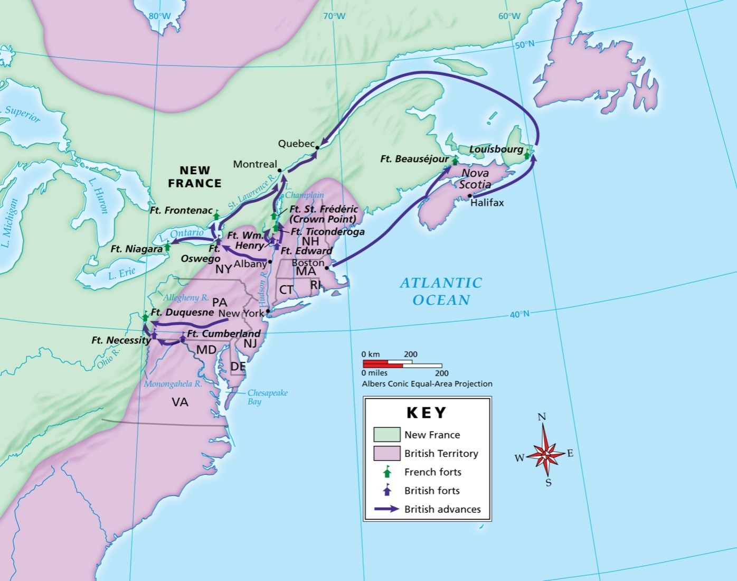
The French and Indian War
British victories in 1758 and 1759 set the stage for the key battle of the war—the Battle of Quebec was a turning point for the British.

Slide 14
Quebec, the capital of New France, was located atop high cliffs.
The British climbed the cliffs on an unguarded trail and captured the city.
Without Quebec, France could no longer defend its territory. In 1763, Britain and France signed the Treaty of Paris, ending the war.

Slide 15
Effects of the French and Indian War
France lost its North American territories.
Britain is left with a large debt.
Colonists develop a sense of unity (both with Great Britain and the other colonies). There is a strong sense of pride in being British.
Colonists begin settling in the Ohio River Valley, which upsets Native Americans.

Slide 16
Tighter Control on The Colonists: New laws & Taxes
Focus Question:
How did the French and Indian War draw the colonists closer together but increase friction with Britain?
Student Outcomes:
Explain the conflict between Native Americans and British settlers in 1763.
Describe how the colonists responded to British tax laws.
Describe what happened during the Boston Massacre.

Slide 17
Why did the French and Indian War increase friction within the colonies and with Britain?
The end of the war brought celebration. But it did not bring peace. New conflicts soon threatened to tear the colonies apart.
Fighting with
Native
Americans
Disputes with
the British
government

Slide 18
Navigation Acts
-placed heavy restrictions on trade in the colonies.
Pros
Colonial traders had a sure market for their goods in England.
The law contributed to a booming shipbuilding industry in New England.
Cons
The laws favored English merchants.
Colonists felt they could make more money if they were free to sell to foreign markets themselves.

Slide 19
With the French defeat, Britain gained vast new lands in North America.
Native Americans
saw a new threat
to their lands.
Colonists saw
endless room
for settlement.

Slide 20
In Pontiac’s war, the leader of the Ottawa nation, took action to stop settlers from pushing farther west.
Pontiac and his allies launched a bloody attack on British forts and towns. The British responded with equally brutal attacks against Native Americans.
The British defeated Pontiac in 1764, but thousands of settlers and Native Americans had been killed.

Slide 21
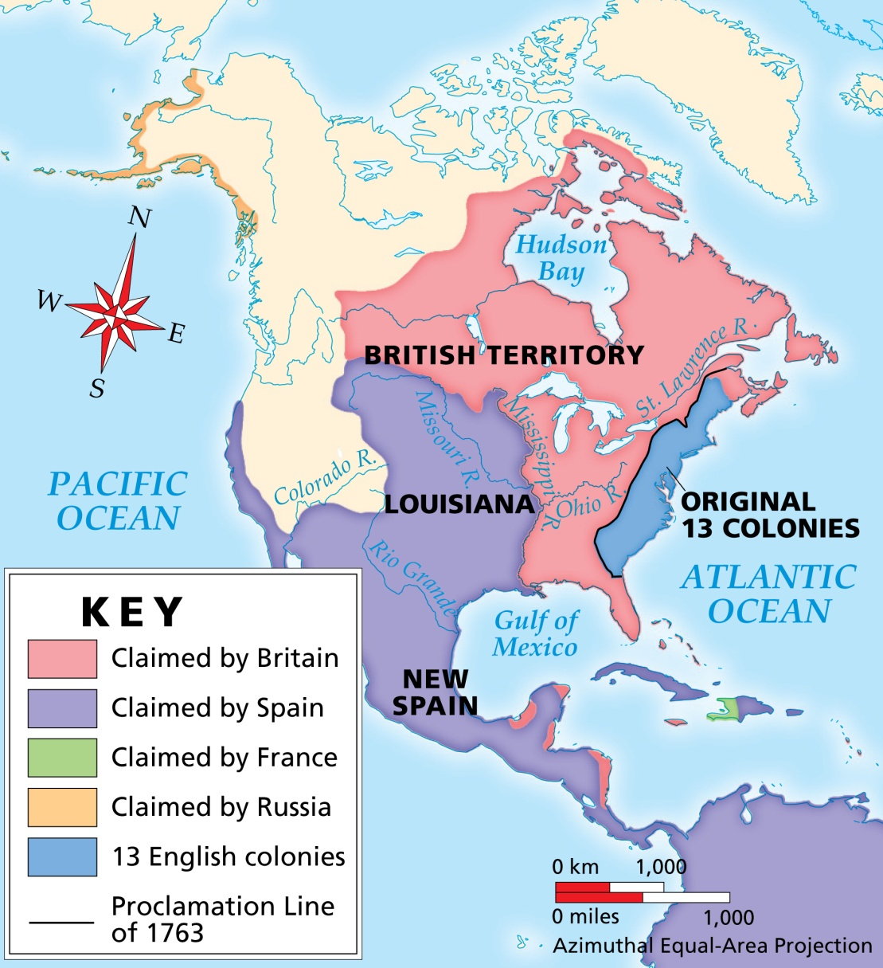
Hoping to avoid further wars, the British issued a new law.
The Proclamation of 1763 declared colonists had to remain east of the Appalachian Mountains.

Slide 22
Frontier settlers who had already moved west were told to move back. Colonists could settle only east of the line.
Colonists
Native
Americans
Colonists
Appalachian Mountains
West
East

Slide 23
The Proclamation of 1763 angered many colonists, who believed they had the right to settle wherever they wanted.
Proclamation
of 1763
The colonists largely ignored the proclamation, and Britain found it impossible to enforce. Tensions rose.

Slide 24
Colonists had fought
and died to help
win the war.
After the war, colonists felt separated
from Britain.
Colonists expected Britain
to be grateful for the
their help.
Colonists were
loyal subjects; they
expected to have the
same rights as other
British citizens.
Colonists increasingly
believed their rights
were being
threatened.

Slide 25
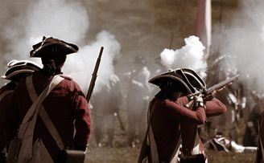
The war had put
Britain in debt.
Britain continued to
spend money on
troops to protect
colonists from
Native Americans.
British leaders
expected the colonists
to help pay expenses.
British leaders
were concerned
about paying for
their costly
colonies.
=

Slide 26
To raise money, British leaders imposed a series of new laws forcing the colonists to share the financial burden.
Sugar Act | 1764 | Put a tax on products such as molasses
Quartering Act | 1765 | Required colonists to house British troops
Stamp Act | 1765 | Required colonists to buy special stamps for many products and activities

Slide 27
How did the colonists react?
The colonists were upset because these laws and taxes were implemented without any direct vote or representation from the colonists.
Outrage and protests quickly spread throughout the colonies.
The Virginia House of Burgesses and other colonial assemblies declared that they alone—the only places where the colonists were represented—had the right to tax the colonists.

Slide 28
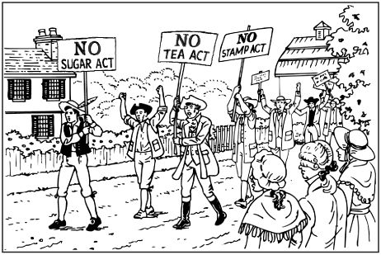

Slide 29
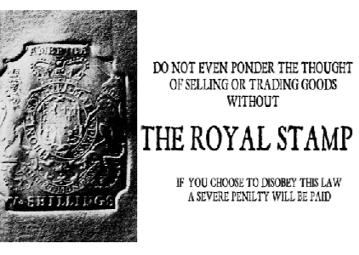

Slide 30
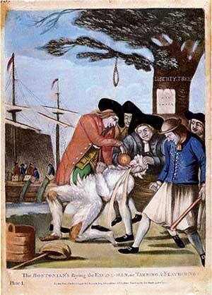
The colonists got so upset about the British taxes that there were several stories about the colonists grabbing tax collectors, dumping hot tar on them, and then pouring boiling hot tea down their throats.

Slide 31
How do you think the British felt about the colonists’ response to to the Stamp Act?
“And now will these Americans, children planted by our care, nourished up by our Indulgence until they are grown to a degree of strength and opulence, and protected by our arms, will they grudge to contribute their mite to relieve us from heavy weight of the burden which we lie under?”
- Charles Townshend, British Politician

Slide 32
Delegates from nine colonies formed the Stamp Act Congress to take action.
The Congress sent a petition
to the king and Parliament,
demanding the repeal
of the tax laws.

Slide 33
The Brits repeal the Stamp Act just one year later, but would threaten the colonies even while doing so.
Parliament has... “full power and authority to make laws and statutes of sufficient force and validity to bind the colonies and people of America...in all cases whatsoever.“
-Declaratory Act of 1767

Slide 34
1767 Townshend Acts
put a tax on imported good such as glass, lead, and tea. By law, these goods could only be produced by Britain.
Also authorized Writs of assistance allowed officers to search homes and warehouses for goods that might be smuggled
Colonists protested by boycotting these goods, meaning they refused to buy these products.
Anger on both sides soon led to a bloody confrontation.

Slide 35
The Boston Massacre

Slide 36
Boston massacre
Bostonians were angered by the presence of British soldiers being stationed in Boston to enforce the Townshend duties.
Group of Boston civilians began insulting and throwing snowballs at a British guard. More soldiers arrived.
Mob of civilians surrounded soldiers in protest
British soldiers stationed outside the Old State House, seat of Royal power in the colony, shot and killed 5 Bostonians and wounding another 6.
African American Crispus Attucks was the first to die. He has been recognized as first to fall for American Independence.

Slide 37
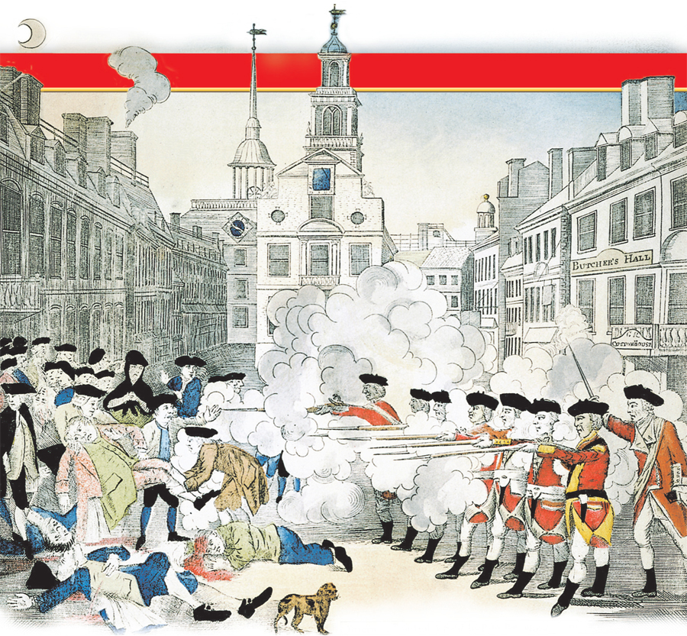

Slide 38
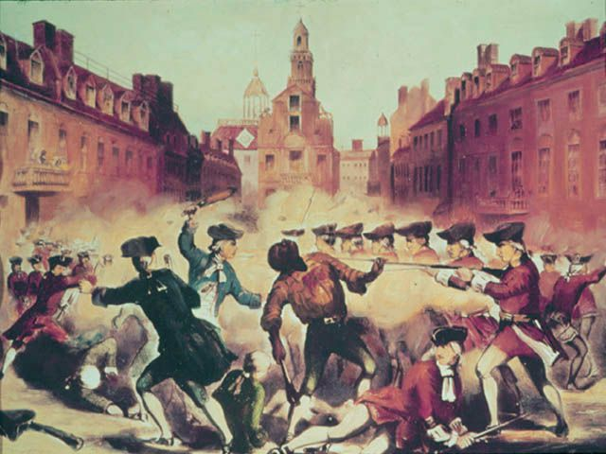
What is Propaganda?
Propaganda is information that is spread for the purpose of promoting some cause.
What was the cause/reason for calling the shooting of five people in Boston a massacre by the English soldiers?

Slide 39
John Adams: a Massachusetts lawyer and colonial leader; future president
He defended the soldiers, believing they should receive a fair trial. Still, the Boston Massacre became a rallying point for the colonists.
Leaders from different colonies, one being Samuel Adams began exchanging information and ideas, helping to unite the colonists against the British.
Leaders formed a group called Committees of Correspondence, whose purpose was to keep colonists informed of British actions.

Slide 40
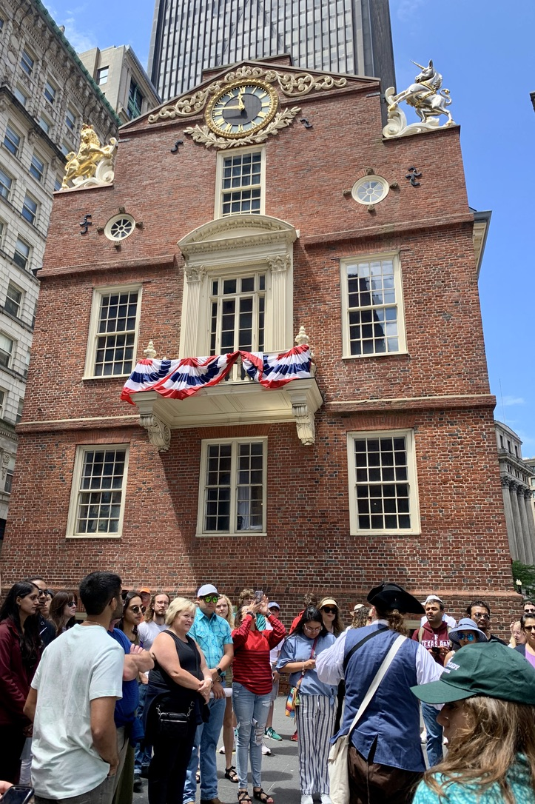
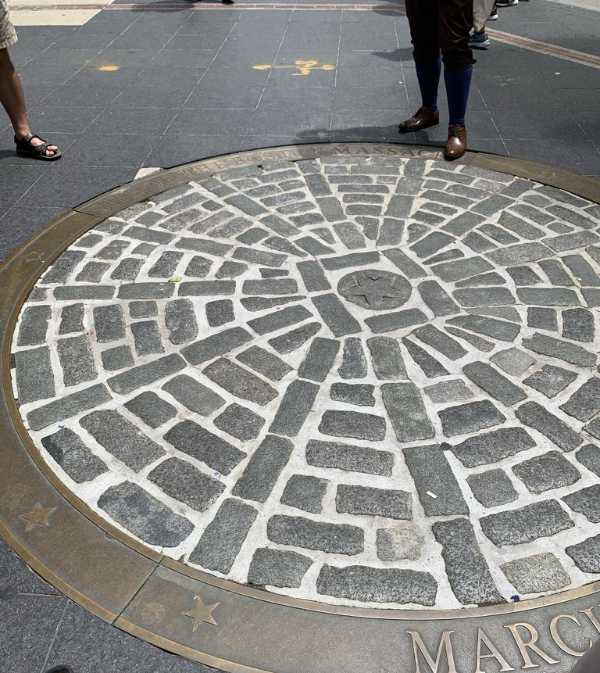

Slide 41
From Protest to Rebellion Boston Tea Party
Focus Question:
How did British tax policies move the colonists closer to rebellion?
Student Outcomes:
Identify the causes of the Boston Tea Party.
Explain how the colonists protested the Intolerable Acts.
Describe the events of April 19, 1775, at Lexington and Concord.

Slide 42
Terms and People
monopoly – total control of the market for a certain product
repeal – to cancel; officially end

Slide 43
How did British tax policies move the colonists closer to rebellion?
Widespread protests over the Stamp Act and other taxes had taken Britain by surprise.
But even as British leaders repealed some taxes, they passed new ones, further angering the colonists.

Slide 44
The Tea Act
During the early 1770s, the protests against the British had quieted down.
Boston repealed the Townshend Acts—except the tax on tea.
Britain faced a new problem—The East India Company (largest in England) was losing money—to help it recover, Parliament came up with The Tea Act.
The company was not taxed to ship the tea to the colonies, but the colonies had to pay a tax to England for the tea.
The Act also let the Company decide which American merchants could sell the tea.
Colonists were angry that Parliament would give one company total control over a trade.

Slide 45
The Tea Act reduced the price of tea, but the law cut colonial
businesses out of money making.
Price
of
tea
The colonist resented the Tea Act because it established a British monopoly on tea.
The colonists thought they should be able to buy tea from whomever they wanted. Plus, they were angry that they were still paying the tea tax.

Slide 46
Divide in the Colonies
Many colonists were becoming members of a growing patriot movement.
The colonies were slowly becoming divided between loyalists and patriots.

Slide 47
Sons of Liberty
Colonial Anti-British protestors
In Boston they included John Hancock, Samuel Adams, John Adams, Dr. Joseph Warren, Paul Revere, James Otis and hundreds of others.
Their meetings were kept secret because talk of sedition was a serious crime.

Slide 48
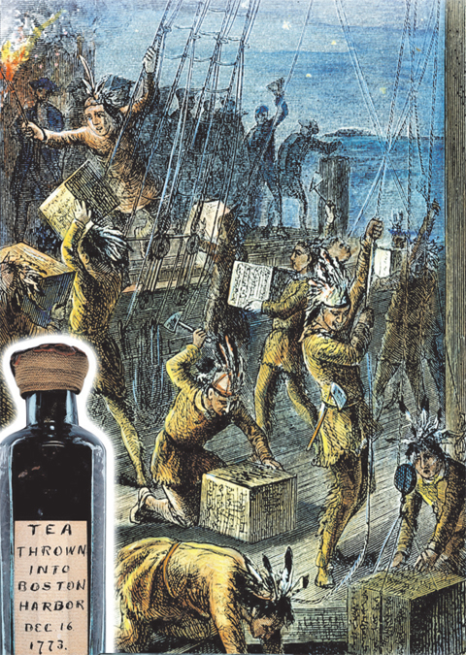
To protest, the Sons of Liberty tried to stop tea from being unloaded in colonial ports.
When officials ordered a shipment to be unloaded in Boston, the protestors took action.
Dressed as Native Americans, they dumped the tea into the harbor.

Slide 49
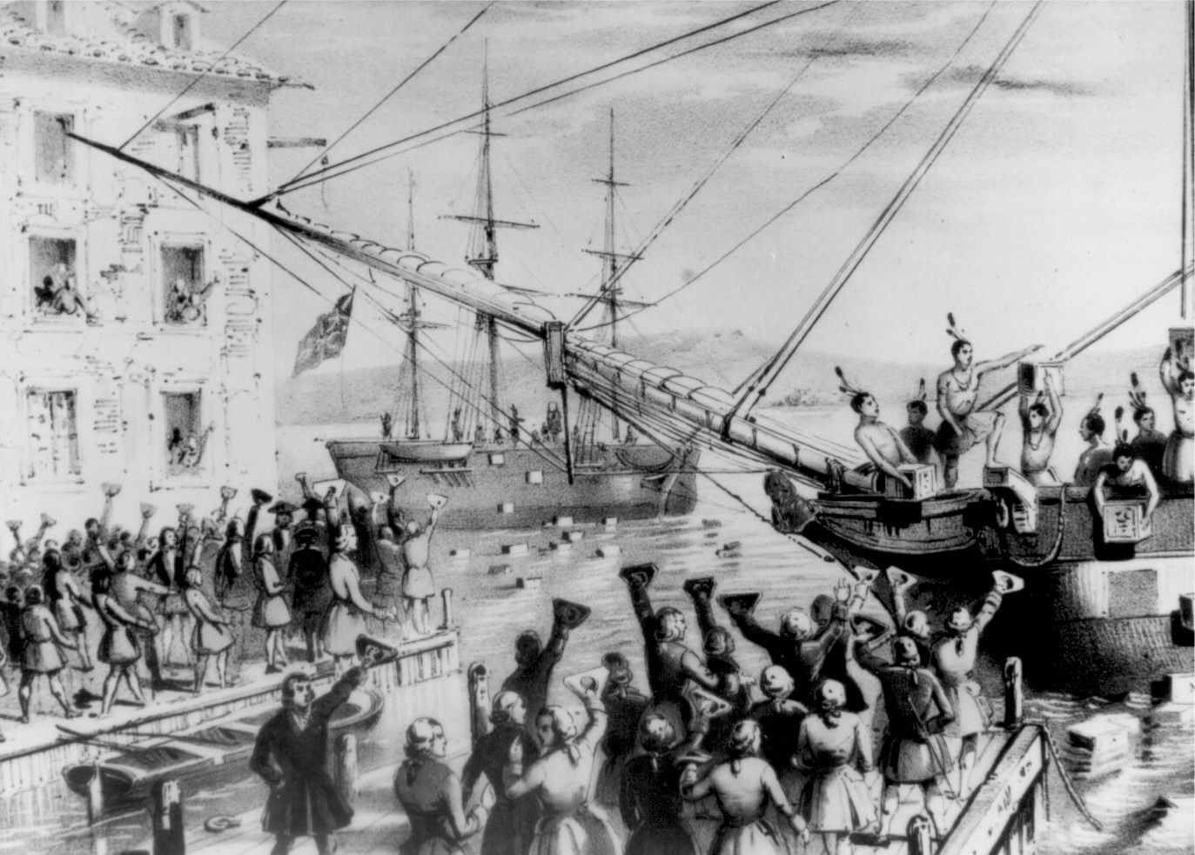

Slide 50
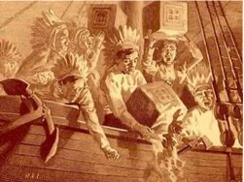

Slide 51
British leaders were outraged by the actions of these protestors. They were determined – once and for all – to show the Colonists that they are to be loyal and obey all Parliament laws. Otherwise, to coerce the colonists into action.
They passed a series of laws designed to punish the colonists of Massachusetts—especially those in Boston.
The new laws were so harsh that colonists called them the Intolerable Acts.

Slide 52
Intolerable Acts
Closed the port of Boston
Increased the powers of the royal governor
Abolished the upper house of the Massachusetts legislature
Cut the power of town meetings
Strengthened the Quartering Act

Slide 53
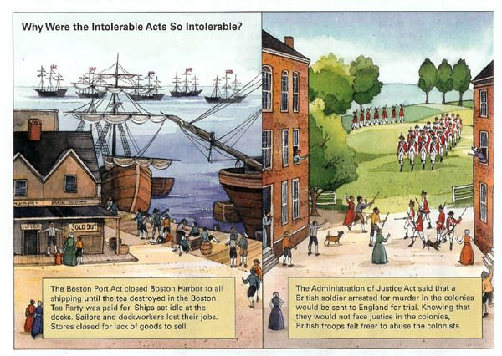

Slide 54
Colonists Take Action
Merchants in other colonies closed their shops to oppose treatment of colonists in Massachusetts.
Virginians called for a meeting of delegates from all the colonies to find a solution.
Towns and cities begin organizing their militias to prepare for a fight.
Patrick Henry urges colonists to start thinking of themselves as one people: AMERICANS

Slide 55
Colonial leaders held a meeting, the First Continental Congress in Philadelphia in September 1774.
First Continental Congress
Demanded the repeal of the Intolerable Acts. Declared the colonies had a right to tax and govern themselves Called for the training of militias Called for a new boycott of British goods

Slide 56
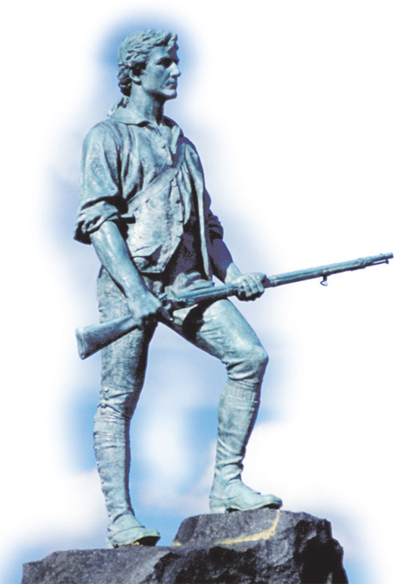
British responded to the colonists’ demands by marching toward Concord where they believed arms were stored.
On April 19, 1775, about 700 British troops marched toward Concord.
Patriots lit a signal in a church steeple, then Paul Revere rode off to warn the surrounding towns that the British were coming. (Along with William Dawes)

Slide 57
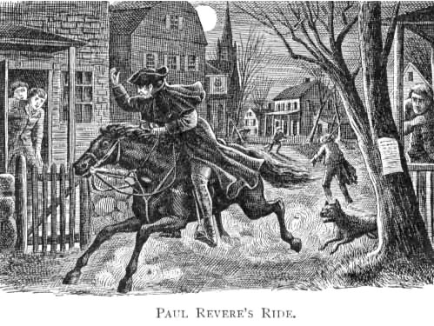

Slide 58
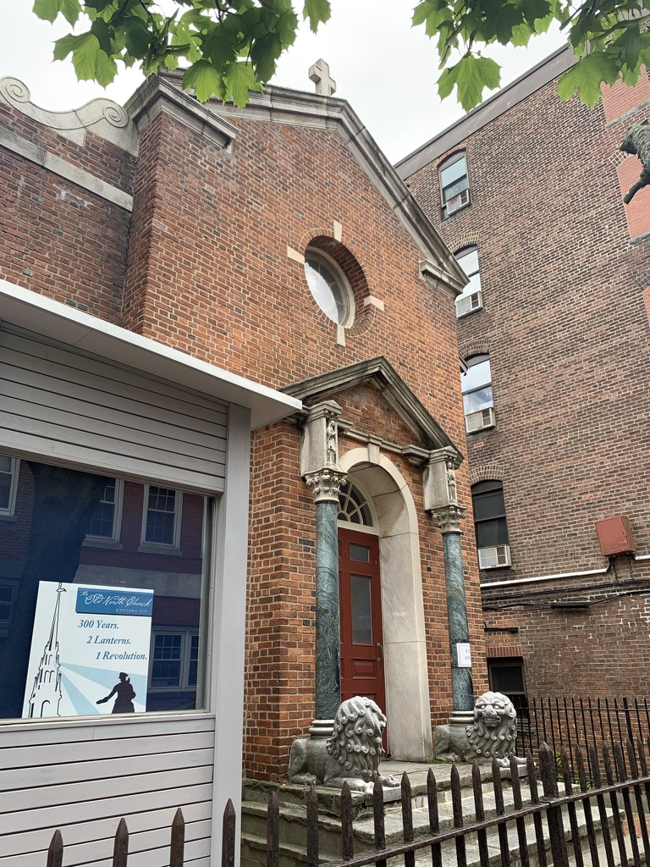
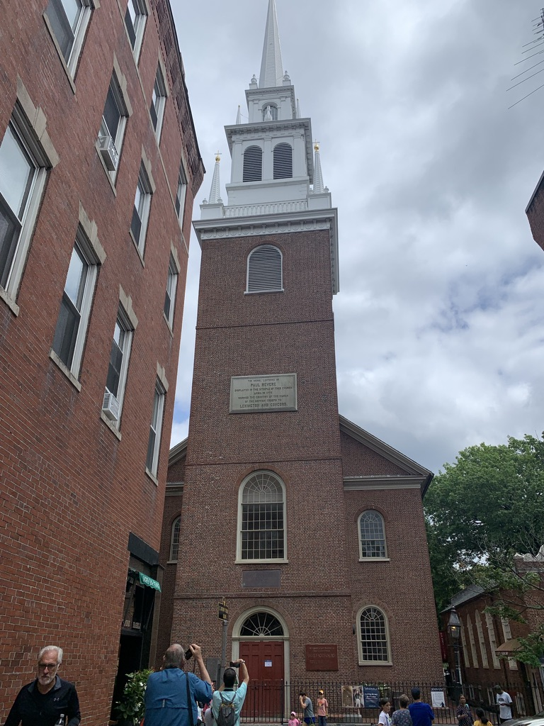
Old North Church in Boston

Slide 59
The Battles of Lexington and Concord, fought on April 19, 1775, kicked off the American Revolutionary War.
Minutemen, citizen soldiers who could be ready to fight at a minute’s notice, were waiting for British troops. A shot rang out, called “the shot heard round the world” It is unknown who shot first. British troops opened fire, killing eight Americans
Lexington
Concord
400 minutemen fought about 700 British troops The British retreated toward Boston About 300 British were killed by colonists firing from behind trees and fences

Slide 60
