Slide 1
Chapter 3: Colonies Take Root (1587-1752)

Slide 2
Section 1: The First English Settlements page 66-70
Focus Question:
How did the English set up their first colonies?

Slide 3
Terms
charter – a document issued by a government that grants specific rights to a person or company
John Smith – Englishman sent in 1608 to lead Jamestown
representative government – the form of government in which voters elect people to make laws for them
pilgrim – a person who takes a religious journey
Squanto – a Native American who helped the Pilgrims in Plymouth by showing them how to grow native plants for food

Slide 4
How did the English set up their first colonies?
England was a monarchy, but the powers of royalty were limited by law and by Parliament.
The king granted charters to groups of people who wanted to establish colonies.
The Colonies would provide new markets for English products and raw materials for English industries.

Slide 5
England Seeks Colonies
In England, power of the king or queen was limited by law, by the Parliament.
Since the 1200s, English law had guaranteed the right to trial by jury.
The king could only set new taxes with permission from Parliament.
Still, the king’s powers were greater than those of Parliament.

Slide 6
In the late 1500s, the English began to establish colonies on the east coast of North America.
Some colonists came for land, others for gold, and still others for religious freedom.
The first colony at Roanoke Island was established to provide new markets for English products and raw materials for English industries.

Slide 7
Two Early English Colonies
First Roanoke Colony | The first colony at Roanoke Island, off the coast of present-day North Carolina, was established in 1585. It was abandoned a year later.
Second Roanoke Colony | The second colony at Roanoke Island was established in 1587. Because of a war with Spain, England was unable to send a ship to visit the colony until 1590. By then, the colony had disappeared without a trace.

Slide 8
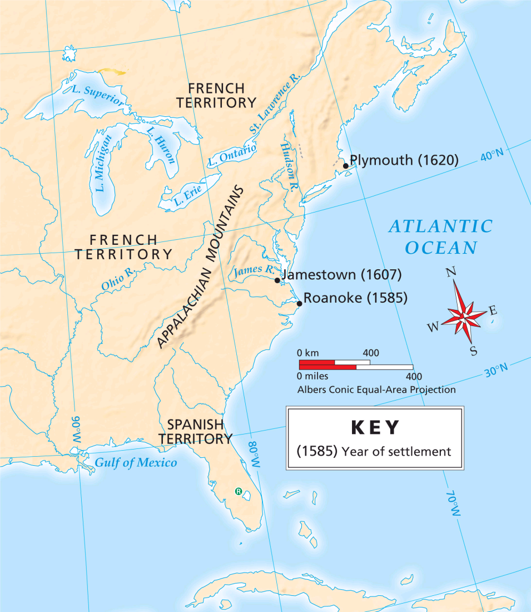
In 1607, England’s King James I granted a charter to a group of merchants to establish a colony called Virginia in North America.
The merchants, who formed the Virginia Company of London, were eager to gain a share of the wealth of the Americas.

Slide 9
They built a fort they called Jamestown, which proved to be England’s first permanent settlement in North America.
The first colonists—about 100 men—arrived in Virginia in the spring of 1607.

Slide 10
Jamestown barely survived its first year because many colonists:
died of diseases such as malaria
wanted to look for gold, not farm
Local Native Americans, led by a chief named Powhatan, gave the colonists some food.

Slide 11
By the spring of 1608, only 38 of the original colonists were still alive.
That fall, John Smith was sent from England to lead the colony.
Under his firm leadership, the colonists planted crops and built buildings.

Slide 12
Meanwhile, hundreds of new colonists—including the first English women to settle in Jamestown—arrived.
To get more food, John Smith and the settlers raided Native American villages, which angered Powhatan.
In the fall of 1609, Smith returned to England after being injured in an explosion.

Slide 13
With Smith gone, conditions quickly worsened.
Powhatan decided to drive the English away, and he began by refusing to give them more food.
The terrible winter of 1609–1610 is called the “starving time,” because by the spring, only 60 colonists were still alive.

Slide 14
Despite the hard times, Jamestown began to prosper.
Jamestown Survives
Efforts of the Virginia Company | The company sent new colonists, offered free land to existing colonists, and sent new leaders to restore order in the colony.
Efforts of the Colonists | The colonists found a dependable source of income to sustain the colony: tobacco. By the 1580s, smoking tobacco had become popular in parts of Europe. The colonists’ success in growing and selling tobacco drew new colonists from England.

Slide 15
The colonies developed a tradition of representative government.
In 1619, Virginia’s lawmaking body, the House of Burgesses, was elected.
The House of Burgesses marked the start of representative government in North America.

Slide 16
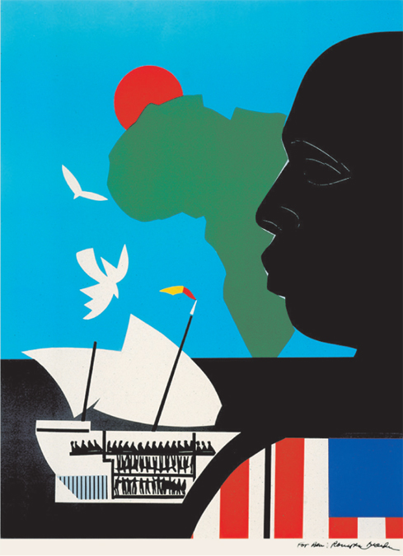
In 1619, a Dutch ship arrived from the West Indies carrying 20 Africans who were sold to the Virginia colonists as slaves.
In the early days of the colony, enslaved people had a chance to earn their freedom after working a certain number of years.
Permanent slavery for Africans was not established in Virginia until the late 1600s.

Slide 17
In the 1500s, English subjects were expected to support the Church of England, and they could be punished if they had different religious beliefs.
The Separatists wanted to separate from the Church of England and practice Christianity in their own way.
Between 1607 and 1609, several groups of Separatists left England and settled in Holland.

Slide 18
In 1620, one group of Separatists decided to leave Holland and settle in Virginia.
The Pilgrims sailed for Virginia aboard a ship called the Mayflower.
pilgrim – a person who takes a religious journey
A storm blew them off course, and so they landed in present-day Massachusetts.

Slide 19
The Pilgrims called their new home Plymouth.
Before leaving the ship, 41 men signed the Mayflower Compact, a document that called for a representative government.
Mayflower Compact
The Mayflower Compact was the first document in which American colonists claimed a right to govern themselves.

Slide 20
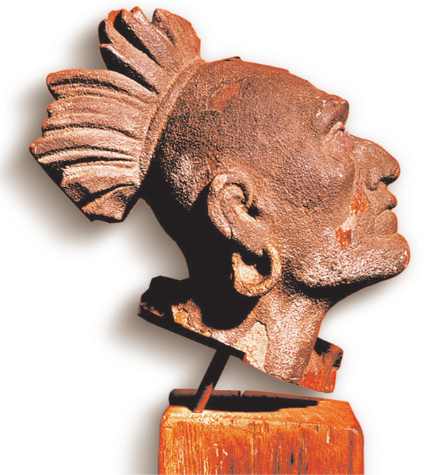
During the winter of 1620–1621, half of the Pilgrims died from hunger or disease.
In the spring, a local chief gave the Pilgrims food, and another Native American named Squanto taught the Pilgrims how to plant crops.
In the fall of 1621, the Pilgrims set aside a day to give thanks for their good fortune, which is now celebrated as the first Thanksgiving celebration.

Slide 21
Section 2: The New England Colonies page 70-76
Focus Question:
How did religious beliefs and dissent influence the New England Colonies?
Student Outcomes:
Describe the geography and climate of the New England Colonies.
Describe the Puritan settlement in Massachusetts.
Identify the new settlements that developed in New England as a result of Puritan religious practices.
Explain the changes that took place in the New England Colonies in the 1600s.

Slide 22
Terms and People
John Winthrop – leader of the Puritans who founded the Massachusetts Bay Colony
toleration – recognition that other people have the right to different opinions
Roger Williams – a minister who founded the town of Providence, Rhode Island
Anne Hutchinson – a Boston woman who established a settlement on an island that is part of present-day Rhode Island

Slide 23
Terms and People (continued)
Thomas Hooker – a minister who founded the town of Hartford, Connecticut
John Wheelwright – a man who founded the town of Exeter, New Hampshire
town meeting – an assembly of townspeople that decides local issues
Metacom – chief of the Wampanoag (also known as King Philip) who started a war meant to stop Puritan expansion

Slide 24
How did religious beliefs and dissent influence the New England colonies?
Religion played a key role in colonies that were established in New England.
Many colonies were established by people who were exiled because of their religious beliefs.

Slide 25
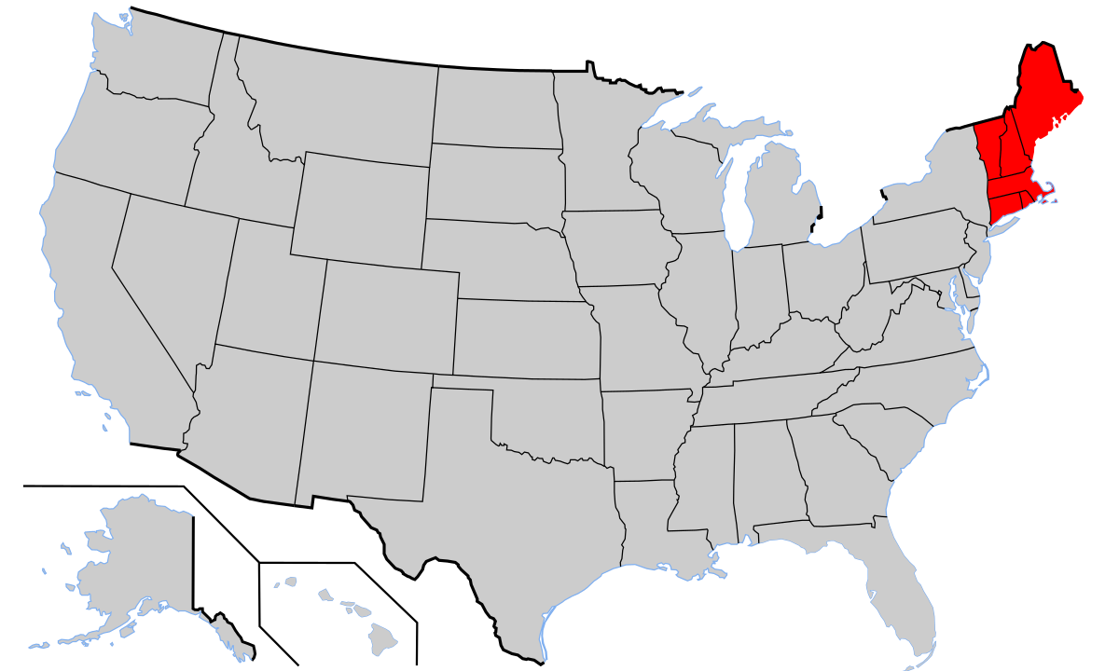
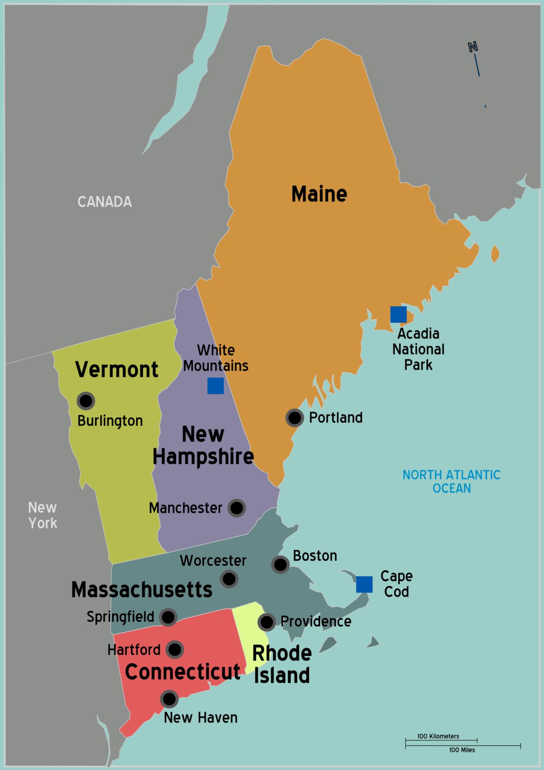
Geography of New England
New England experienced long and snowy winters and short warm summers.
→Colonists in this region caught fewer diseases and lived longer than the colonists in Virginia.
Southern: Massachusetts, Connecticut, and Rhode Island
Northern: New Hampshire, Vermont, and Maine
Much of New England is made up of hills, mountains, and forests.
Thin and rocky soil makes farming there difficult.

Slide 26
A group known as the Puritans wanted to reform the Church of England.
In the early 1600s, the Puritans were respected professionals who were influential in England.
But in the 1620s, King Charles I opposed the reform movement and persecuted the Puritans.

Slide 27
In 1630, about 900 Puritans left England to escape religious persecution by the King. They left in 11 ships, led by John Winthrop.
They had formed the Massachusetts Bay Company, which received a charter to establish settlements in present-day Massachusetts and New Hampshire.
Massachusetts Bay Company Charter

Slide 28
“We must consider that we shall be as a City upon a Hill. The eyes of all people are upon us.” – John Winthrop, “A Model of Christian Charity,” 1630

Slide 29
The Puritans established several settlements in their colony, including Boston.
By 1643, about 20,000 people lived in the Massachusetts Bay Colony.
By the mid-1630s, Massachusetts Bay had an elected governor and an elected assembly—the General Court—but only adult male Puritans could vote.

Slide 30
The Puritans believed:
towns and churches should manage their own affairs.
people should work hard and live in strong and stable families.
Each Puritan town governed itself by setting up a town meeting, but only men could participate.

Slide 31
Although they founded their own colony so they could have religious freedom for themselves, the Puritans did not believe in religious toleration for others.
Religious Toleration
Disagreements about religion led to the founding of other colonies in New England.

Slide 32
Providence, Rhode Island
Beginnings | Minister Roger Williams thought the Puritans should split entirely from the Church of England. He also thought colonists should pay Native Americans for their land. In 1635, Williams was expelled from Massachusetts Bay.
The Colony | Williams moved to present-day Rhode Island, bought land from Native Americans, and founded Providence in 1636.

Slide 33
Religious Freedom in Providence
Charter | In 1644, the colonists in Rhode Island received a charter from the king to govern themselves.
All Were Welcome | The colonists decided that Rhode Island would have no established church. Many people found religious freedom in Rhode Island, including followers of the Jewish faith.

Slide 34
Hutchinson’s Settlement
Beginnings | Boston resident Anne Hutchinson questioned some Puritan teachings. She was expelled from Massachusetts in 1638.
The Settlement | Hutchinson established a settlement on an island that is part of present-day Rhode Island.

Slide 35
Hartford, Connecticut
Beginnings | Thomas Hooker, who disagreed with Puritan leaders, left Massachusetts with 100 followers in 1636.
The Colony | They settled in present-day Connecticut, where Hooker founded the town of Hartford. Hundreds of Puritans followed, and soon there were new settlements.
Government | In 1639, the colonists established a new elected legislature and governor. In 1662, the king granted Connecticut a charter that made it self-governing.

Slide 36
Exeter, New Hampshire
Beginnings | John Wheelright was expelled from Massachusetts because he agreed with some of Hutchinson’s views.
The Colony | In 1638, Wheelright and some followers founded the town of Exeter, New Hampshire.
Government | Colonists form Massachusetts tried to control New Hampshire, but a new charter from the king made New Hampshire a separate colony in 1680.

Slide 37
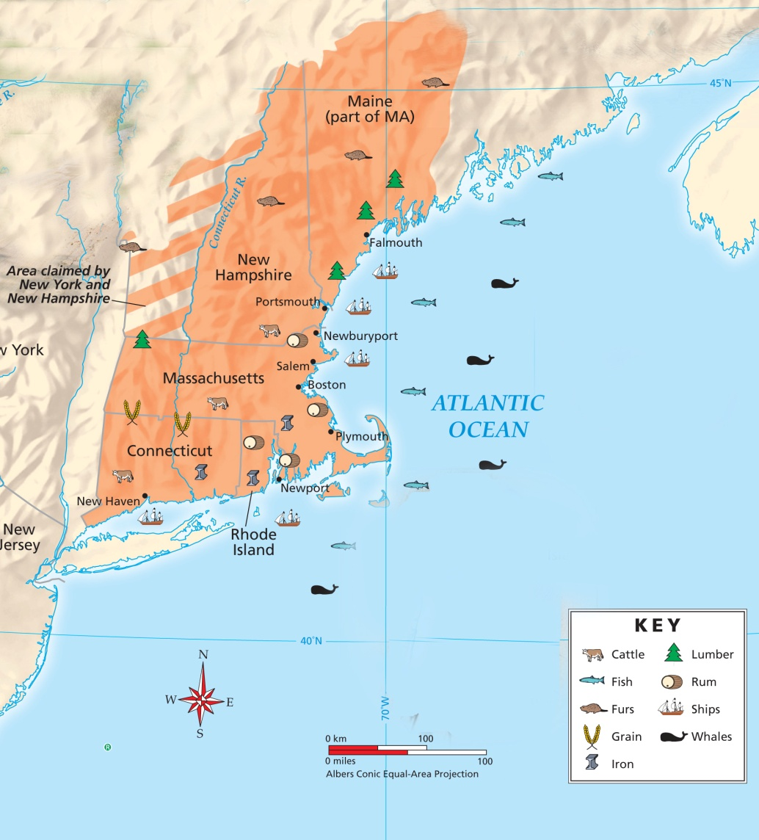
The New England colonies had a great variety of resources.
Seas, forests, and farms provided a good living for colonists.

Slide 38
While the colonies prospered, Native Americans in New England struggled.
v
By 1670, there were only 12,000 Native Americans in New England, one-tenth of their population 100 years earlier.
The main cause of this decline was diseases Native Americans caught from Europeans.

Slide 39
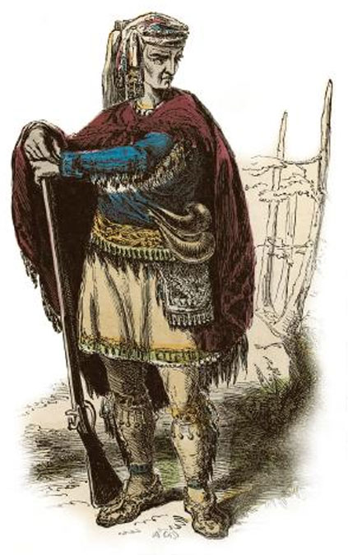
In 1675, a major conflict erupted between Native American groups and the Puritans.
Opponents were led by Metacom, chief of the Wampanoag, (a.k.a. King Philip.)
During the conflict, which was called King Philip’s War, Metacom and his allies destroyed 12 English towns.
After Metacom was killed in 1676, the war ended, leaving the English free to expand.

Slide 40
By the 1670s, a new generation of people had been born in North America.
This new generation had lost some of the older Puritans’ religious fervor.
$
Successful merchants were becoming the new community leaders.

Slide 41
Section 3: The Middle Colonies page 77-83
Focus Question:
How did the diverse Middle Colonies develop and thrive?
Student Outcomes:
Describe the geography and climate of the Middle Colonies.
Describe the early history of New York and New Jersey.
Explain how Pennsylvania and Delaware were founded.
Explain how the Middle Colonies changed in the 1600s and early 1700s.

Slide 42
Terms and People
proprietary colony – a colony created by a grant of land from a monarch to an individual or family
royal colony – a colony controlled directly by the English king
William Penn – a Quaker leader who established the Pennsylvania colony and its capital, Philadelphia
backcountry – a frontier region extending through several colonies, from Pennsylvania to Georgia

Slide 43
How did the diverse Middle Colonies develop and thrive?
Colonists settled in the Middle Colonies for freedom of religion or to profit from trade, farming, or other occupations.
Factors such as fertile soil, manufacturing, and social equality promoted the colonies’ prosperity.

Slide 44
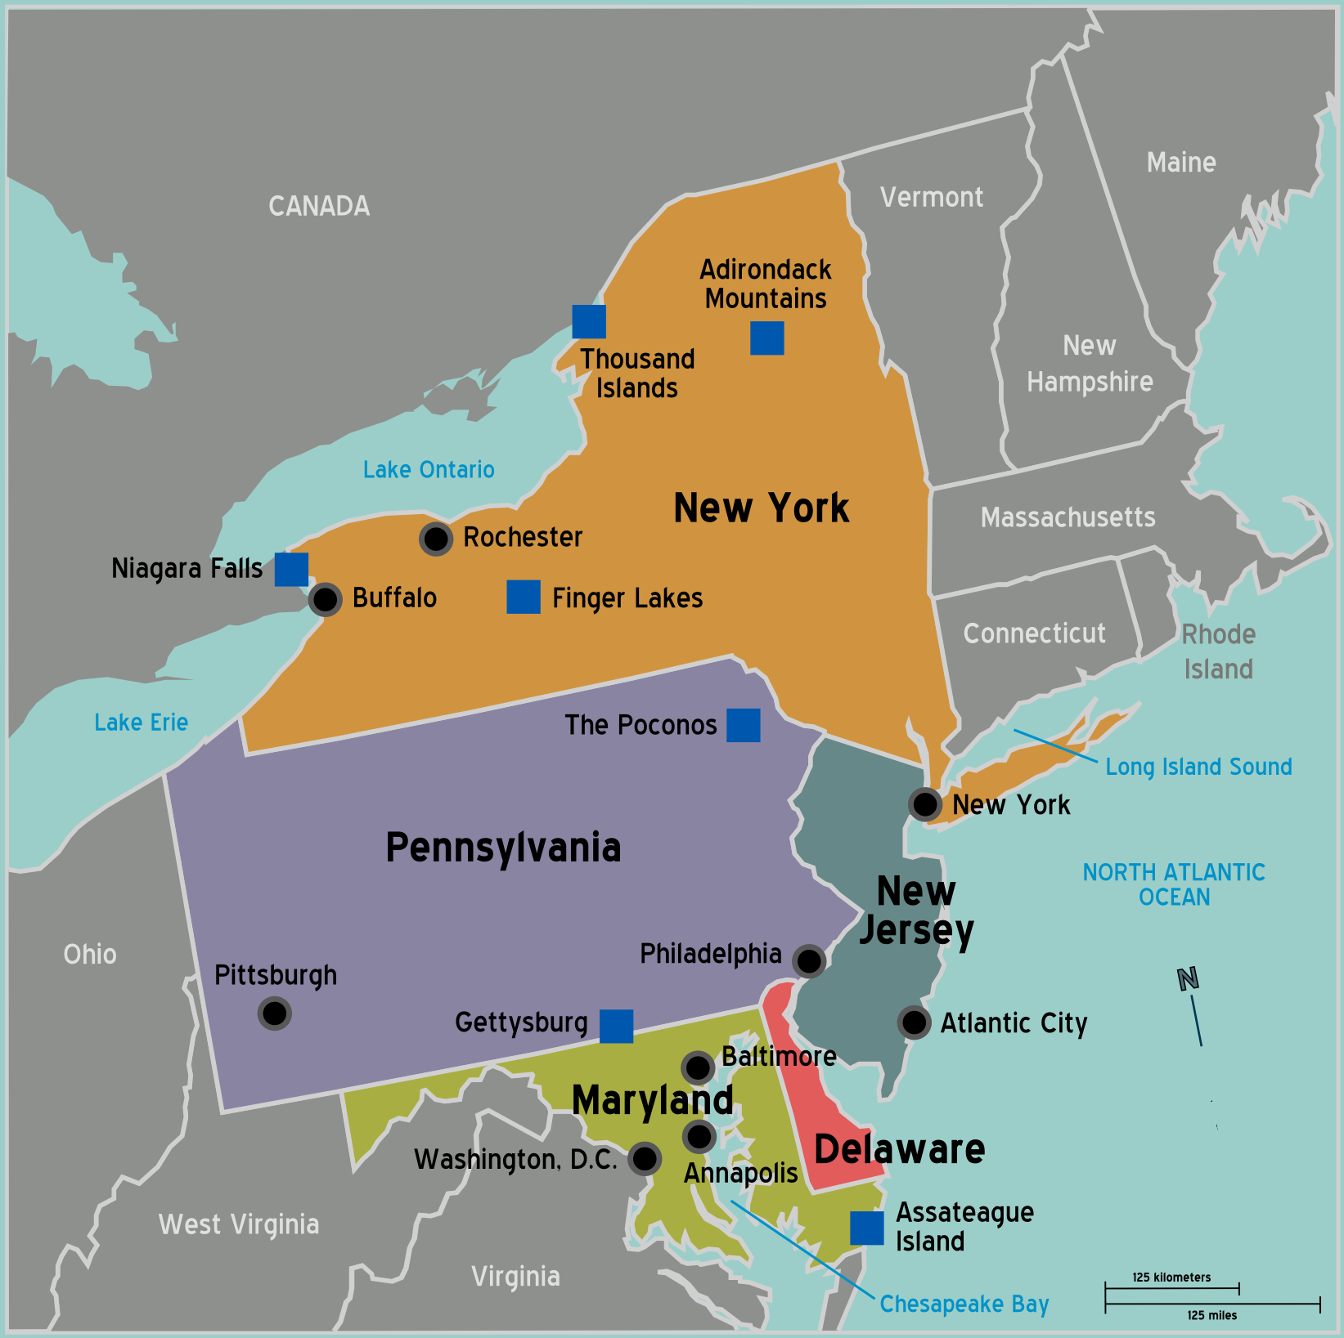
Geography of the Middle Colonies
 | New York, Pennsylvania, New Jersey, and Delaware (in order from largest to smallest) were the Middle Colonies.
 | Much of the Middle Colonies is lowlands. The Hudson and Delaware rivers are important waterways in the region. The soil is fertile and well-suited for crops like wheat, fruits, and vegetables.
 | The climate is warmer, with a longer growing season, than the New England climate.

Slide 45
New York began as the Dutch colony of New Netherland, which owed its economic success to trade with Native Americans and British colonies.
Population of New Netherland
However, New Netherland had only a small Dutch population, and its other colonists were often hostile to Dutch rule.
Swedish
French
Portuguese
English
Dutch

Slide 46
England
Holland
England and Holland had tense relations because:
New Netherland separated England’s northern colonies from its more southern colonies.
New Netherland traded with English colonies, which violated Britain’s mercantile laws.

Slide 47
In 1664, England’s King Charles II told his brother James, Duke of York, that he could have New Netherland if he conquered it.
___________________
With the help of a few warships, James did just that.
New Netherland
New York
James renamed the colony New York and its capital New York City, and it became a royal colony in 1685.

Slide 48
New York
In 1665, part of southern New York split off and formed a new colony, New Jersey.
At first, New Jersey was a proprietary colony, but in 1702, it received a new charter as a royal colony.
New Jersey

Slide 49
The Quakers emerged as a new religious group in England during the 1640s and 1650s.
Slavery
The Quakers believed:
People do not need ministers because everyone has a direct link with God.
All people are equal in God’s eyes; therefore, women are equal to men in spiritual matters, and slavery is wrong.

Slide 50
Quaker leader William Penn wanted to find a place where Quakers could live free of persecution.
He used his connections to get a charter from the king for a new colony in North America.
Pennsylvania charter
Penn arrived in the Pennsylvania colony in 1682 and established its capital, Philadelphia.

Slide 51
Penn considered his colony to be a “holy experiment” of people from different faiths living together in peace.
Home Countries of Pennsylvania Settlers:
England
Scotland
Wales
Ireland
Germany
Holland
Switzerland
In 1682, Penn wrote a document that granted Pennsylvania an elected assembly and provided for freedom of religion.

Slide 52
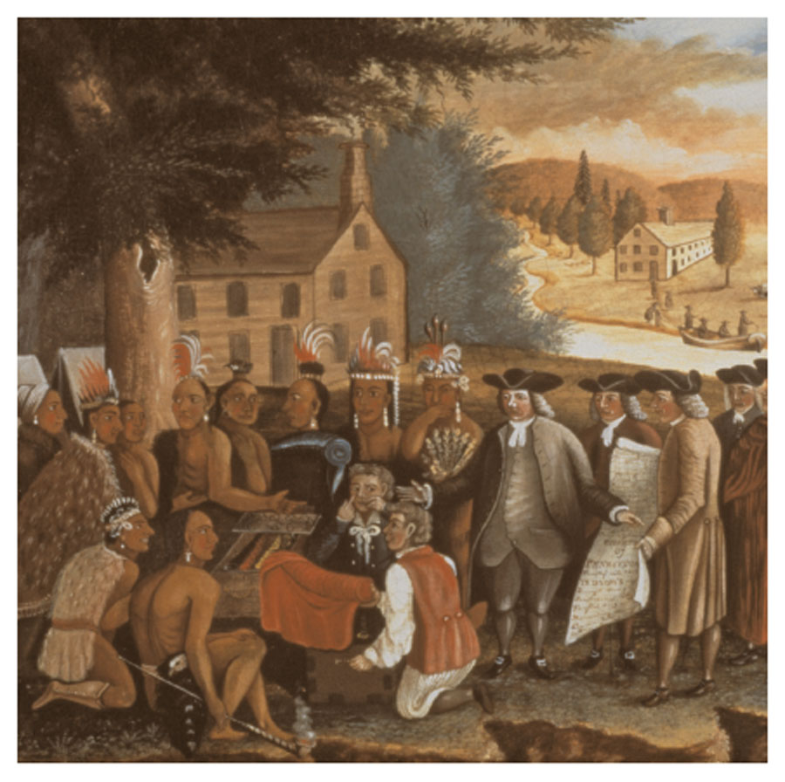
Penn tried to deal with Native Americans fairly; he did not allow colonists to settle on land until Native Americans sold it to them.
During Penn’s lifetime, relations between Native Americans and colonists were much better in Pennsylvania than they were in other colonies.

Slide 53
Control of the Delaware colony passed from the Swedish to the Dutch to the English.
Penn’s charter for Pennsylvania included Delaware, but he gave the colony its own representative assembly.
In 1704, Delaware became a separate colony.

Slide 54
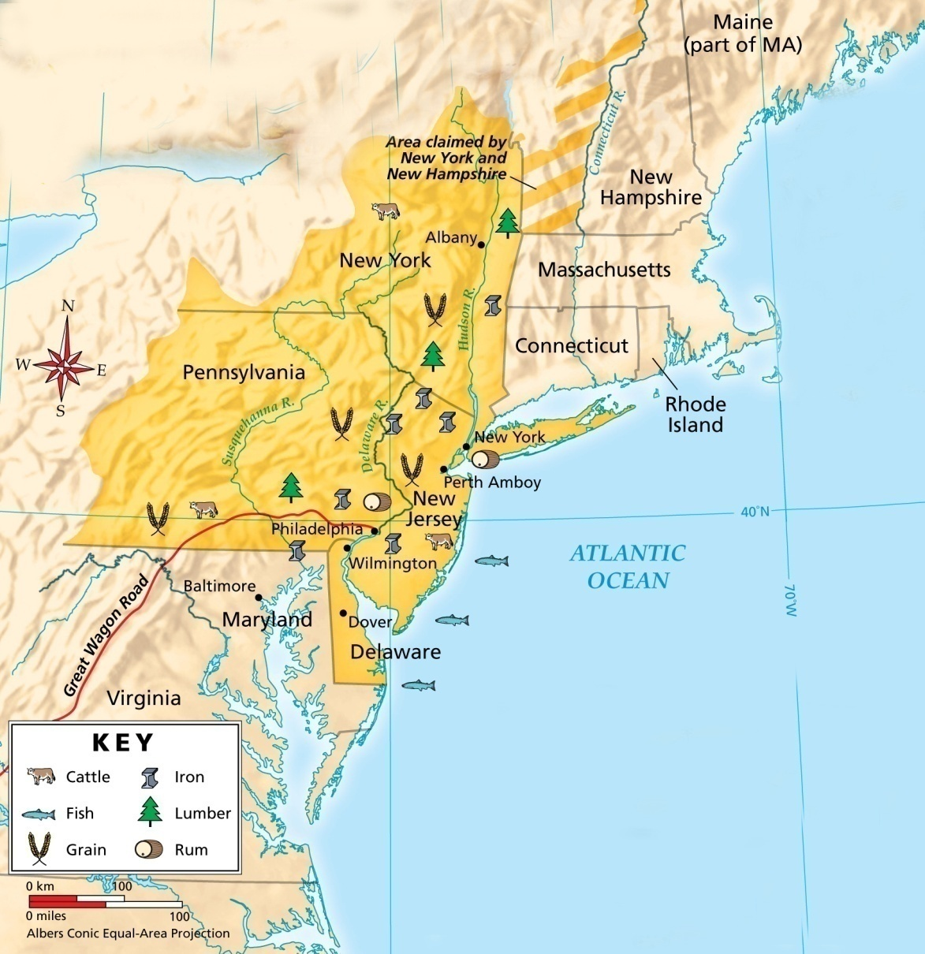
By the early 1700s, more than 20,000 colonists lived in Pennsylvania.
Its wheat farms were productive, and Pennsylvania was called America’s breadbasket.

Slide 55
Manufacturing was just beginning in the Middle Colonies during the 1700s.
Manufacturers produced iron, flour, and pepper.
Town artisans worked as weavers, masons, coopers (barrel-makers), and in many other trades.

Slide 56
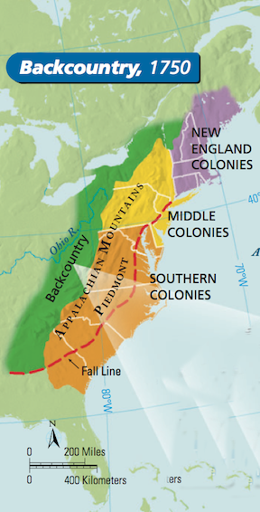
The western section of Pennsylvania was considered part of the backcountry, frontier region between Pennsylvania and Georgia.
The backcountry settlers that traveled along the Great Wagon Road often fought with Native Americans.
Backcountry Settlers
Native Americans

Slide 57
Many of the people who settled in the backcountry were not English.
Some were Scotch-Irish, and others were German.

Slide 58
By 1750, non-English immigrants had made the Middle Colonies the most diverse part of English North America.
Philadelphia and New York had become the largest cities and busiest ports in the colonies.
All of the colonies had thriving economies.

Slide 59
Section 4: The Southern Colonies page 84-89
Focus Question:
What factor influenced the development of the Southern Colonies?
Student Outcomes:
Describe the geography and climate of the Southern Colonies.
Describe the early history of Virginia.
Explain how Maryland, the Carolinas, and Georgia were founded.
Identify the factors that produced the Tidewater and backcountry ways of life.

Slide 60
Terms and People
Nathaniel Bacon – the leader of the frontier settlers who fought “Bacon’s Rebellion,” an attack against Native Americans who were trying to defend their land from colonists
Lord Baltimore – the Catholic proprietor of the Maryland colony who convinced its assembly to pass the Act of Toleration

Slide 61
Terms and People (continued)
James Oglethorpe – a wealthy Englishman who founded the colony of Georgia, where English debtors would be protected
debtor – a person who owes money
plantation – a large farm

Slide 62
What factors influenced the development of the Southern Colonies?
Maryland, Virginia, North Carolina, South Carolina, and Georgia were Southern Colonies.
Factors that influenced the development of these colonies include the climate, the plantation system, religion, and relations with Native Americans.

Slide 63
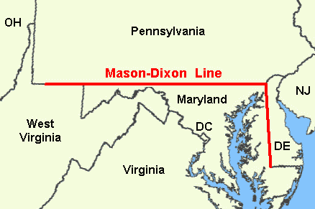
Geography of the Southern Colonies
Location | These colonies were located south of the Mason-Dixon line, a boundary drawn between Pennsylvania and Maryland. After the American Revolution, the Mason-Dixon line was the dividing line between anti-slavery northern states and pro-slavery southern states.
Landforms | The Southern Colonies shared a coastal area called the Tidewater, a flat lowland that includes many swampy areas. On its west, the Tidewater blends into a region of rolling hills called the Piedmont.

Slide 64
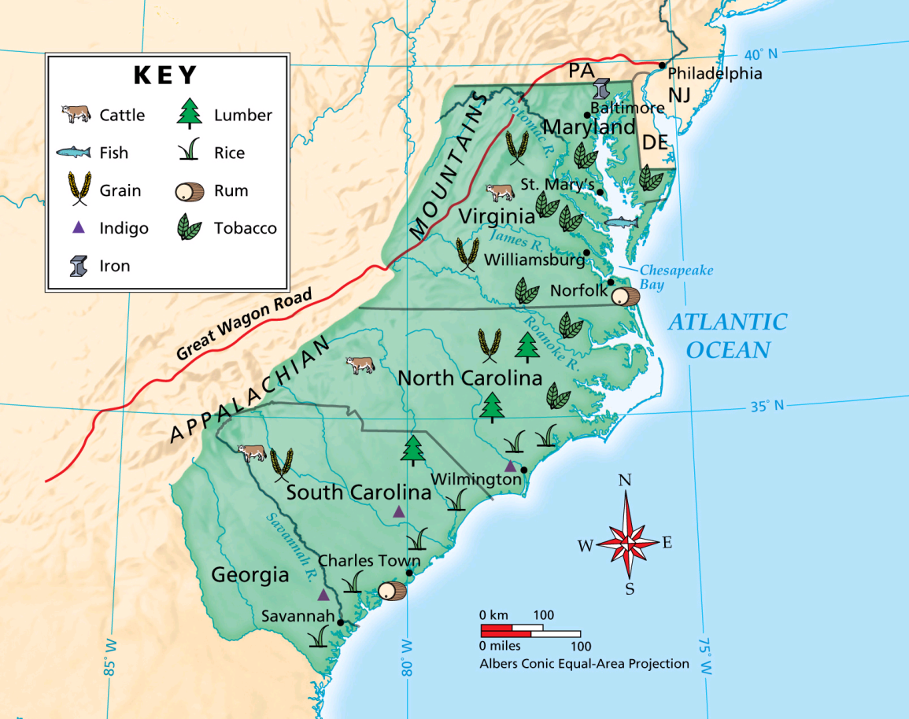
Then and now, the climate of these southern states is warm and humid.
These states have a long growing season perfect for crops such as tobacco and rice.

Slide 65
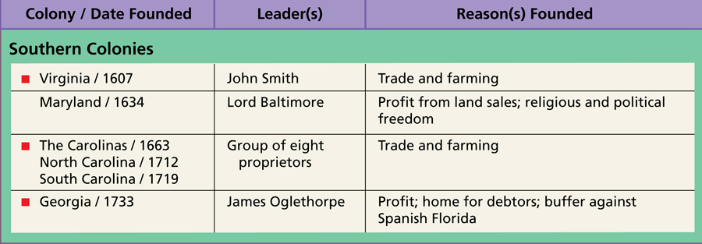
England’s Southern Colonies, like its other colonies, were founded for various religious and political reasons and for economic opportunities.

Slide 66
In 1607, there had been 8,000 Native Americans in Virginia, but disease and violence took their toll.
By 1675, only 2,000 Native Americans were left.
In 1622 and 1644, violence broke out between farmers who wanted more space to plant tobacco and Native Americans trying to defend their land.

Slide 67
Causes of Bacon’s Rebellion
Land and Voting Rights | Poor young white men could not get farmland near the coast because wealthy Virginia tobacco planters bought it all. Without property, men could not vote. Many poor colonists moved inland to find good farmland, but they had to fight Native Americans for it.
Politics | Poor colonists asked the governor to force the Native Americans to give up their land. The governor did not want to disrupt the fur trade with Native Americans.

Slide 68
In 1675, Nathaniel Bacon organized 1,000 settlers to kill Native Americans for their land.
Virginia’s governor declared the settlers rebels, and in retaliation Bacon burned Jamestown.
Bacon’s Rebellion collapsed when Bacon died, but the governor still could not stop settlers from moving onto Native American lands.

Slide 69
In 1632, King Charles I granted a charter for a new colony to George Calvert, an English Catholic.
Calvert set up the colony of Maryland, where Catholics could live free of the persecution they suffered in England.
The first settlers included both Catholics and Protestants.

Slide 70
When Calvert died, his son Cecil Calvert, Lord Baltimore, became proprietor of the colony.
Soon there was tension between Protestants and Catholics, and Lord Baltimore feared Catholics might lose their rights.
In 1649, he convinced Maryland’s assembly to pass the Act of Toleration, which welcomed all Christians and gave adult male Christians the right to vote and hold office. It did not protect non-Christians.

Slide 71
The Carolina Colony
Beginnings | In 1663, King Charles II granted a charter for a new colony called Carolina to be established south of Virginia.
Northern Carolina | The northern part of Carolina developed slowly because it had no harbors or rivers. Settlers grew tobacco on small farms.
Southern Carolina | Sugar grew well in the southern part of Carolina, which expanded quickly. Planters came from Barbados in the West Indies, bringing slaves to grow sugar and rice, which became the area’s most important crop.

Slide 72
As rice production spread, Carolina’s main city, Charles Town (today’s Charleston) became the biggest city in the Southern Colonies.
By then, Carolina had become two colonies: North Carolina and South Carolina.
North Carolina
Carolina
South Carolina

Slide 73
Georgia, the last of England’s 13 colonies, was founded for two reasons:
An English colony south of Carolina would confine the Spanish to their Florida colony.
A group of wealthy Englishmen led by James Oglethorpe wanted a colony where there would be protection for English debtors.

Slide 74
Georgia’s founders wanted Georgia to be a colony of small farms, not large plantations, and so slavery was banned.
But this restriction was unpopular with settlers and did not last.
By the 1750s, slavery was legal in Georgia.

Slide 75
During the 1700s, the Southern Colonies developed two distinct ways of life.
Backcountry Life
Plantation Life
The backcountry was cut off from the coast and many poor families lived in one-room shacks on isolated farms.
Along the coast, in the Tidewater region, the economy was dominated by wealthy plantations.

Slide 76
Tidewater region: A flat often swampy, lowland area along the southern coast.
The most important feature of life along the coast in the Southern Colonies was the plantation, a large farm especially in a hot country where crops such as cotton, sugar, and rice are grown.

Slide 77
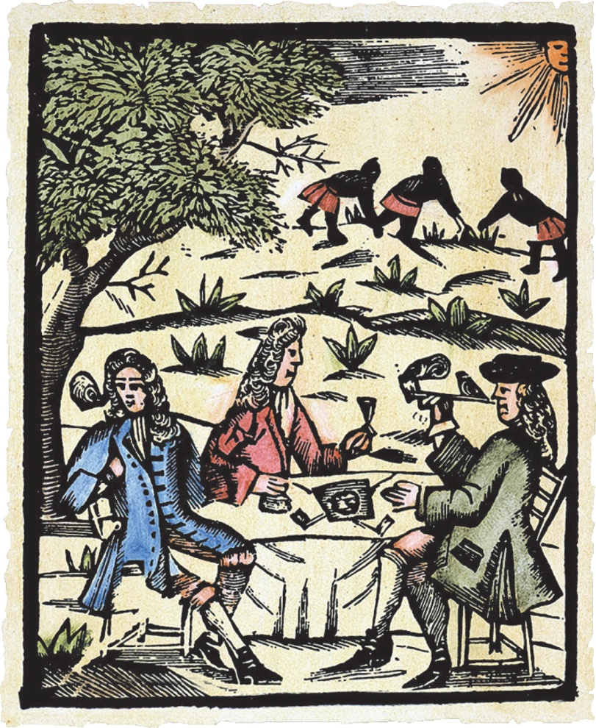
The plantation system began in Virginia and Maryland when settlers began growing tobacco.
The Tidewater region in South Carolina and Georgia was well suited for rice.
However, rice-growing required many workers to labor in unpleasant conditions, and this was one reason rice-farming helped promote the spread of slavery.

Slide 78
In time, the enslaved populated outnumbered the free population of South Carolina.
The plantation system also divided the white community into:
A much larger group of poor people with little or no property who lived in the backcountry South.
A small group of wealthy people.

Slide 79
The backcountry was cut off from the coast by poor roads and long distances.
Families lived on isolated farms in shacks, often on land not legally their own.
Backcountry people believed colonial governments on the coast cared only about the interests of plantation owners, not about them.

Slide 80
Section 5: Spanish Colonies on the Borderlands page 90-93
Focus Question:
How did the Spanish establish colonies on the borderlands?
Student Outcomes:
Describe Spain’s colony in Florida.
Explain how Spain established settlements throughout much of North America.
Describe the significance of Spanish missions.

Slide 81
Terms and People
borderlands – lands along a frontier
Junípero Serra – a Spanish missionary who built a mission that eventually became the city of San Diego, California
presidio – a military post
pueblo – a civilian town

Slide 82
How did the Spanish establish colonies on the borderlands?
While France and England were building colonies in North America, Spain’s colonies in the Americas were already hundreds of years old.
The Spanish established colonies on the borderlands by building missions, presidios, and pueblos.

Slide 83
Early in the 1500s, Spanish explorers reached Florida, but at first they did not build permanent settlements.
Fearing that France might take over the area, Spain built a fort called St. Augustine in northern Florida.
St. Augustine was the first permanent European settlement in the present-day United States.

Slide 84
Spanish control was threatened as English colonies spread southward.
To weaken the English colonies, in 1693 the Spanish offered land to enslaved Africans who would help defend Florida.
During the 1700s, hundreds of African slaves fled to Florida.

Slide 85
By 1763, there were only three major Spanish settlements in the Florida colony.
All the settlements were centered around forts, and all were in the north.
The Spanish had little control over the rest of Florida.

Slide 86
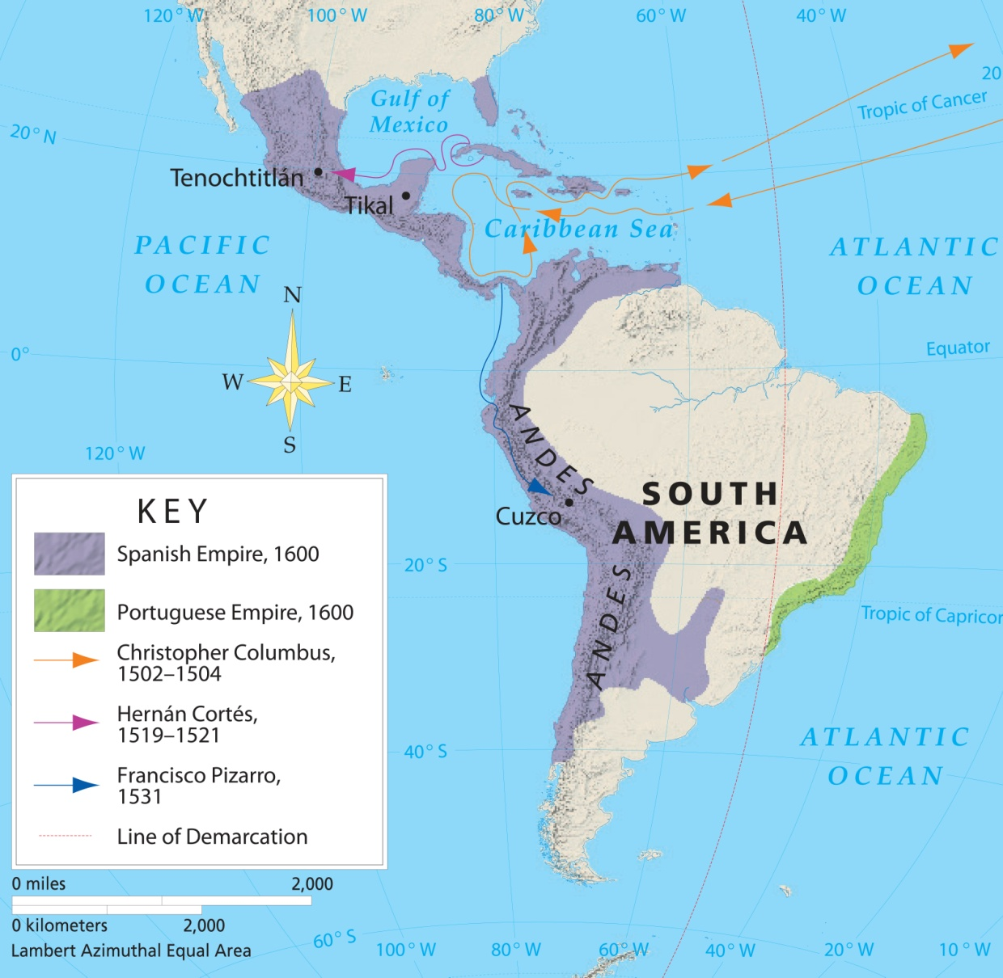
Spain’s most important colonies were in Mexico and South America.

Slide 87
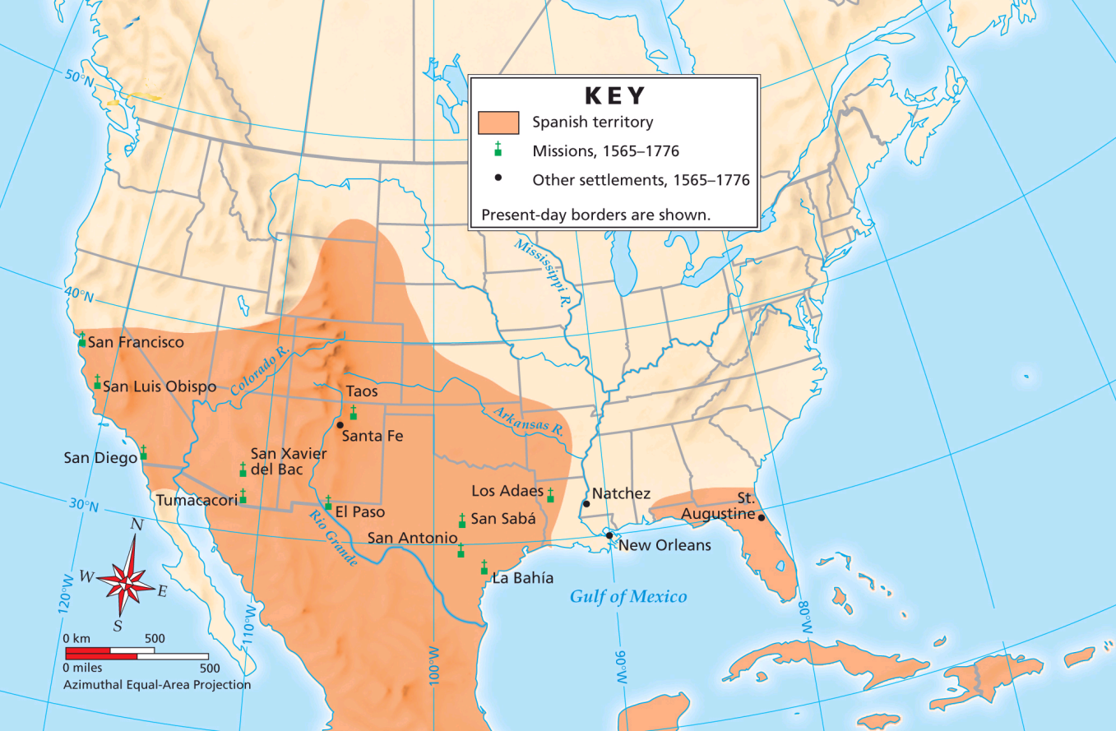
Spain’s territories north of Mexico were called the borderlands, and their main function was to protect Mexico from other European powers.

Slide 88
The vast area of the borderlands has many different kinds of landforms and climates, from humid lowlands to highlands, mountains, and deserts.
The borderlands included:
Florida
Texas
New Mexico
Arizona
Colorado
Utah
Nevada
California

Slide 89
Juan de Oñate in New Mexico
His Goals | In 1598, Oñate went to New Mexico. He planned to find gold, convert Native Americans to Christianity, and establish a permanent colony. In 1598, he established Santa Fe, Spain’s first permanent settlement in the region.
Horses | Oñate brought 300 horses with him. When some Native Americans ran away from Spanish settlements, they spread the skill of horseback riding to other Native Americans. This skill changed Native Americans’ lives.

Slide 90
The Native Americans of the region suffered under Spanish rule.
Native Americans
in New Mexico
Native Americans
in New Mexico
In 1680, they rebelled and drove the Spanish out.
Spanish
The Spanish did not return for more than 10 years.

Slide 91
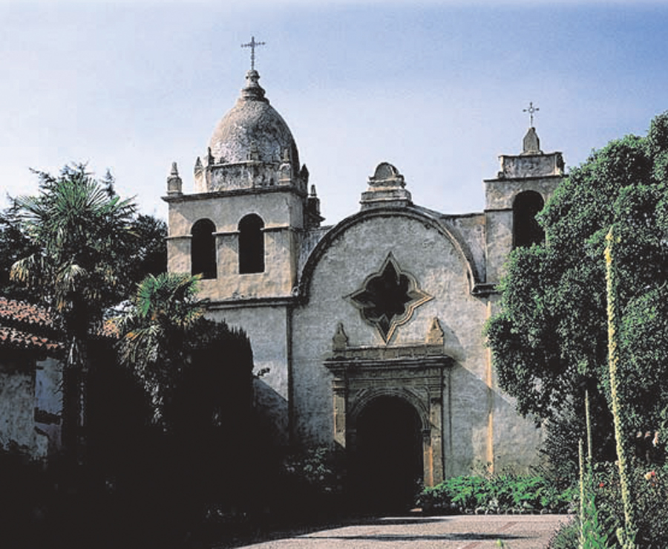
Roman Catholic missionaries played a key role in colonizing the borderlands.
They established missions to spread Christianity to the region’s Native Americans, although at first they had little success.
The only mission that took root in Texas was one that eventually became the city of San Antonio.

Slide 92
Spain began colonizing California in 1769, and its missions there were especially important.
Missionary Junípero Serra established several missions, including one that eventually became the city of San Diego.
Altogether, the Spanish founded almost 20 missions in California between 1769 and 1800.

Slide 93
The Spanish set up presidios to defend their missions.
They also set up pueblos, which were civilian towns. They became centers of farming and trade.
Pueblo
In the middle of the pueblo was a plaza, where people came to do business or worship at a church.
Plaza

Slide 94
Life in Spanish Missions
Native American Activities | Thousands of Native Americans worked at missions, farming, building churches, and learning crafts.
Treatment of Native Americans | Although they were not overworked, Native Americans did not have control over their lives in the missions. If they violated mission rules, they often were imprisoned or whipped. Native Americans often rebelled against such treatment. Thousands died because of poor living conditions and European diseases.

