Slide 1
Chapter 2: Europe looks outward

Slide 2
Chapter 2: Europe looks outward
Introduction
Section 1: The Age of Exploration
Section 2: Spain’s Empire in the Americas
Section 3: Europeans Compete in North America
Section 4: France and the Netherlands in North America

Slide 3
INTRODUCTION
Europe was aware of the riches of Asia and Africa. Attempts to increase trade with the lands eventually developed into an era of European exploration that reached far beyond Europe’s borders.
Factors that led to European Exploration:
-The Crusades: Europe was exposed to new ideas and possibilities.
-Growth of Trade: European traders were interested in Asian goods.
-Renaissance: changed the way Europeans thought about themselves and the world
-New Nations: enhanced trade and overseas exploration

Slide 4
Introduction
New Technology
Printing press: made it easier to print books, allowing more people access to new information.
Better maps & instruments
Astrolabe: technology that allowed sailors to determine their latitude at sea using the stars
Compass: allowed sailors to determine their direction

Slide 5
Introduction
Early explorers
Unaware of the Americas
Assumed there were only Europe, Africa, and Asia
Maps did not include the Americas.

Slide 6
Section 1: The Age of Exploration
Focus Question: How did the search for a water route to Asia affect both Europe and the Americas?

Slide 7
Early Portuguese voyages
Henry the Navigator – created a center for exploration in the 1400s
Bartholomeu Dias – sailed around southern tip of Africa but returned home before completed.
Vasco da Gama – sailed around Africa all the way to India. He was the first Portuguese to land in India.
Their travels helped establish trade between Asia and Portugal. The Portuguese capitol, Libson, became the European trade center.

Slide 8
The Age of Exploration
In 1963, scientists discovered remains of an early Viking settlement in Newfoundland (Canada).
Explorer Leif Erikson and the Vikings are believed to have reached America before Columbus.
The Vikings were a seagoing people, originally from a part of northern Europe known as Scandinavia.
Leif Erikson and 35 others sailed from Greenland to the Americas in 1001 where they spent the winter in a place they called Vinland.

Slide 9
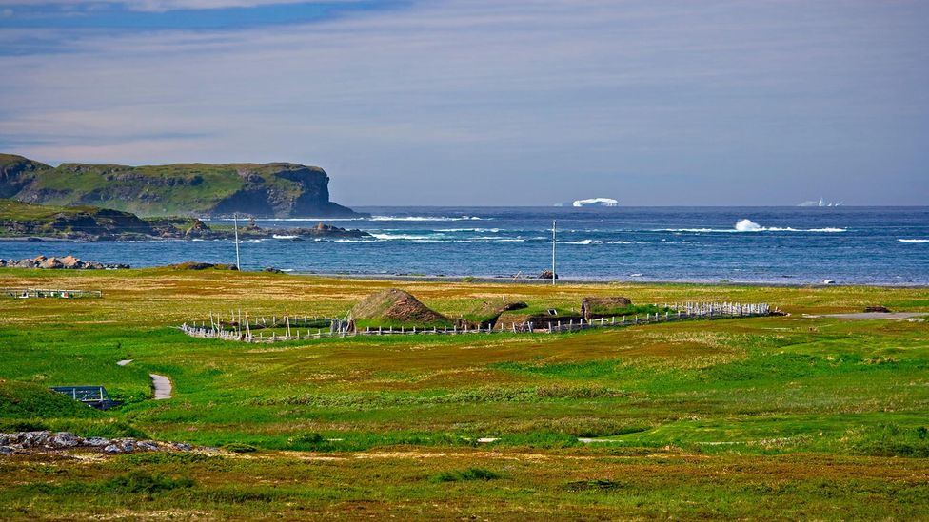
The Vikings’ name for the land they discovered was Vinland.
L’Anse Aux Meadows National Historic Site

Slide 10
Christopher Columbus
Christopher Columbus grew up in Genoa, Italy.
In the 1470s, he settled in Portugal where he sailed on Portuguese ships, studied maps and charts, and learned about the world beyond Europe.
Christopher Columbus developed an idea for a voyage to Asia but could not get support from the Portuguese King for the finances for this voyage.
The king believed the world was larger than Columbus had calculated, and the voyage would have taken longer than he expected.
Columbus moved to Spain and after 6 years he convinced King Ferdinand and Queen Isabella of Spain to support his idea.

Slide 11
Columbus Voyages
In 1492 about 90 men prepared to make the voyage to Asia.
Columbus was given 3 small ships between 55 and 90 feet long: the Nina, the Pinta, and the Santa Maria.
They traveled about 170 miles per day by wind.
He and his crew reached land on October 12th, 1492 and claimed it for Spain.
Believing he was in the Asian islands known as the Indies, Columbus called the curious islanders “Indians”.
Columbus then set sail and landed on the island of Cuba which he thought was Japan. After later traveling to the island of Hispaniola Columbus returned to Spain in January 1493.
Notes:
Columbus predicted that they would reach Asia in 21 days. After a month at sea, his crew became restless and thought about rebelling against him.

Slide 12
Pinta, Nina, Santa Maria

Slide 13
Spain Backs More Voyages
Columbus reported that there was gold in the land.
He set sail again in 1493, this time with 17 ships and 1,500 soldiers, settlers, and priests. The Spanish planned to colonize what they thought was West Indies and convert the people to Christianity.
On his 2nd voyage Columbus discovered his men left on Hispaniola were killed. Columbus then rebuilt and began to enslave the Indians to dig for gold.
On his 3rd voyage Columbus reached the north coast of South America and claimed it was the Asian Mainland.
In his last voyage Columbus went to prove that he had indeed found Asia. He returned home with his beliefs unchanged and died in 1506 thinking he had found Asia.

Slide 14
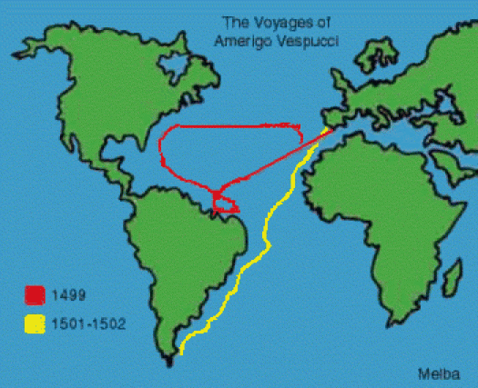
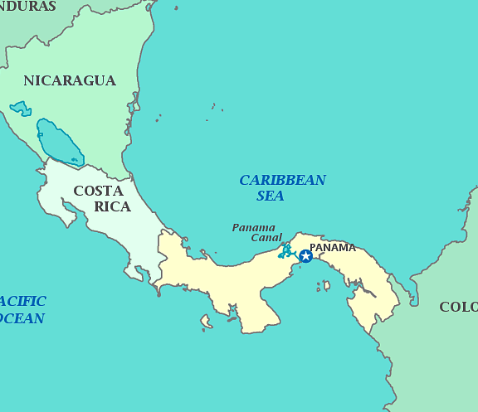
Continuing search for Asia
Italy
Italian explorer Amerigo Vespucci was the first to discover that the Americas were not Asia.
He was made two trips and determined that the land Columbus found was not Asia, but a different continent.
A German mapmaker labeled the the region “the land of Amerigo,” which was soon shortened to America.
Spain
Vasco Nunez de Balboa continued to explore and colonize in 1510, exploring the Caribbean coast of Panama. He was the first European to set eyes on the Pacific Ocean.
Notes:
Magellan finally reached the Philippine Islands. There he and many others were killed in battle.

Slide 15
Continuing search for Asia
Portugal
Portuguese explorer Ferdinand Magellan set out to find an Atlantic-Pacific passage.
Magellan found a passage between the Atlantic and Pacific at the southern tip of Argentina.
Today it is the “Strait of Magellan”. A strait is a narrow passage that connects two large bodies of water.
Magellan finally reached the Philippines, where he and others were killed in a battle with Filipinos.
The surviving men fled back to Spain in 1522, being the first to circumnavigate, or travel around, the entire Earth, which allowed Europeans to understand the size of the Earth.

Slide 16
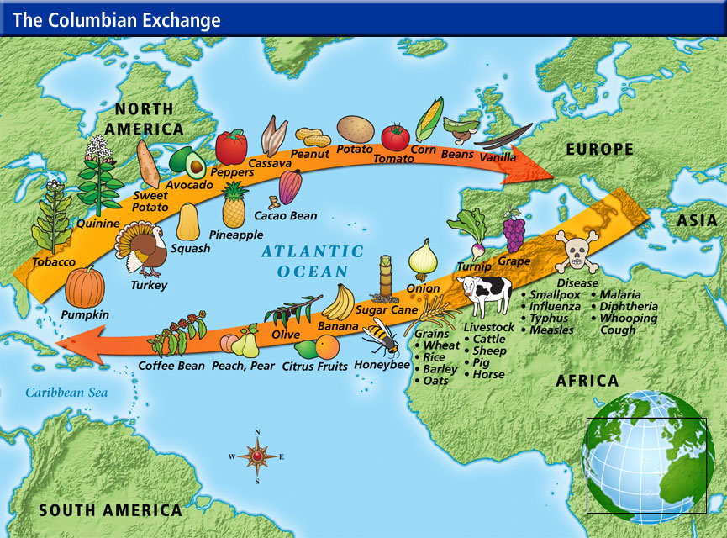
The Columbian Exchange
The Columbian Exchange was the transfer of people, products, and ideas between the Eastern and Western Hemispheres.
Notes:
The Columbian Exchange greatly affected almost every society on earth, bringing destructive diseases that depopulated many cultures, and also circulating a wide variety of new crops and livestock from the Eastern to Western Hemispheres that, in the long term, increased rather than diminished the world human population.

Slide 17
Impact of The Columbian Exchange
Effects on the Americas | Effects on Europe
Positive: Introduced to new animals: cows, hogs, chickens, pigs, sheep, goats, horses New foods such as wheat, oats, bananas, sugar cane, and rice Negative: Europeans brought germs to which Native Americans had no immunity. Smallpox, chickenpox, measles, and other diseases killed thousands. | Positive: Gained new animals such as Llamas, turkeys, squirrels, and muskrats Learned how to grow new crops Gained new foods such as maize, potatoes, cocoa, beans, etc.

Slide 18
Checkpoint
Which country financially supported the voyages of Columbus?
What impact did the Columbian Exchange have on Europe?

Slide 19
Section 2: Spain’s Empire in the Americas
Focus Q: How did Spain establish an empire in the Americas?

Slide 20
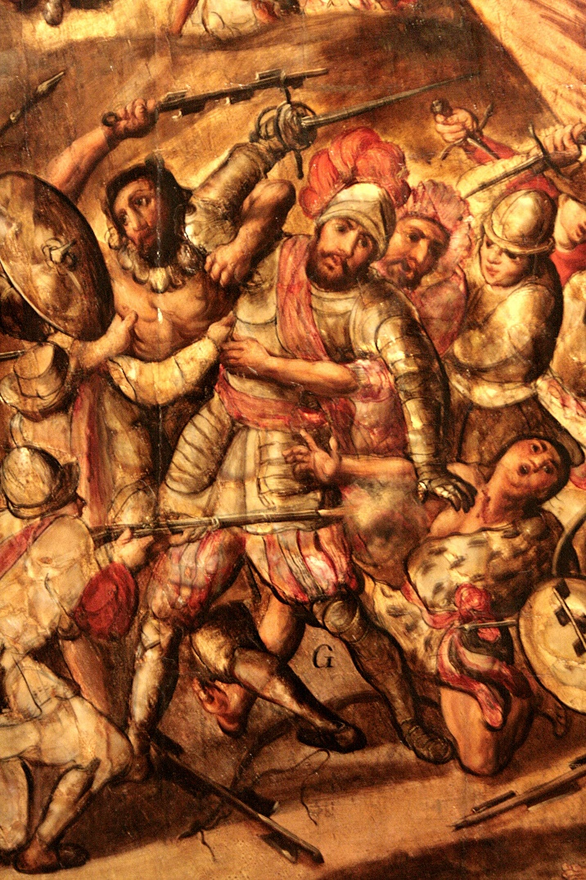
Spanish Conquistadors
From Spain’s island colonies in the Caribbean, Spanish conquistadors set out to conquer the new world.

Slide 21
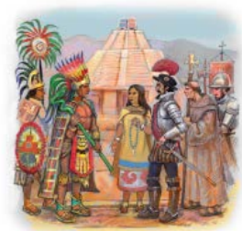
Hernando Cortes
In 1519, conquistador Hernando Cortes and 500 soldiers sailed to Mexico from Cuba where Native Americans presented him with gifts of gold.
Cortes marched on Tenochtitlan, the capital of the Aztecs, who were led by ruler Moctezuma.
Aztec leader Moctezuma offered Cortes gold to leave, but he was taken hostage as Cortes claimed all of Mexico for Spain.
Cortes and the Spaniards were forced out by the Aztecs.
Cortes returned a year later with a larger force and destroyed Tenochtitlan and built Mexico City, the Capital of New Spain.

Slide 22
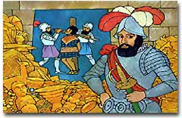
Francisco Pizarro
Francisco Pizzaro landed on Peru in 1531 to search for the Incas’ gold.
Despite a huge ransom offered by the Inca, Pizzaro and the Spanish executed the Inca ruler, defeated the Incas and captured their capital city of Cuzco.

Slide 23
Why the Spanish were victorious
How could a few hundred Spanish soldiers defeat Native American armies many times their size?
1. Weapons and Technology were much better for the Spanish. They had cannons, armor, and muskets.
2. The Spanish rode horses, which Native Americans hadn't seen before.
3. The Native Americans were divided among themselves. In Mexico, many Native Americans hated the Aztecs because of their cruelty, so they sided with the Spanish.
4. Diseases killed many of the Native Americans.

Slide 24
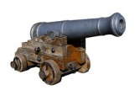
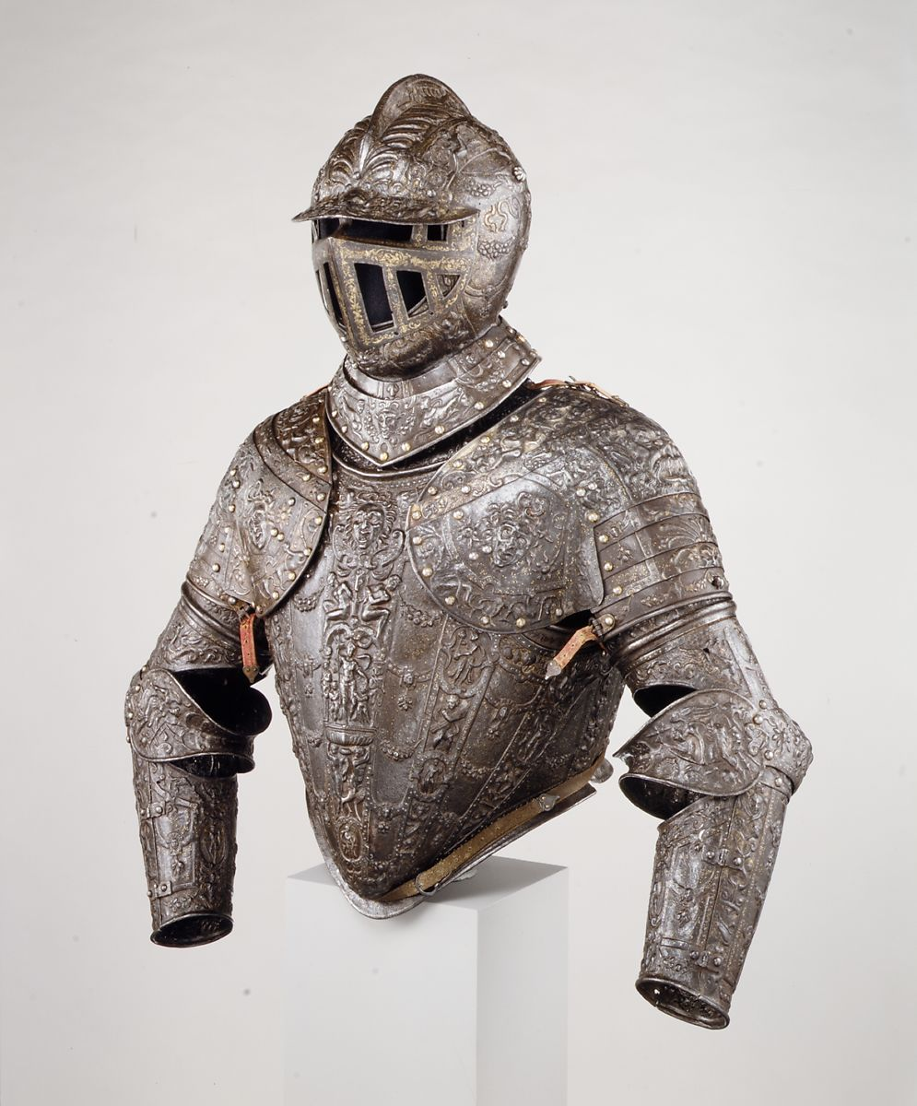
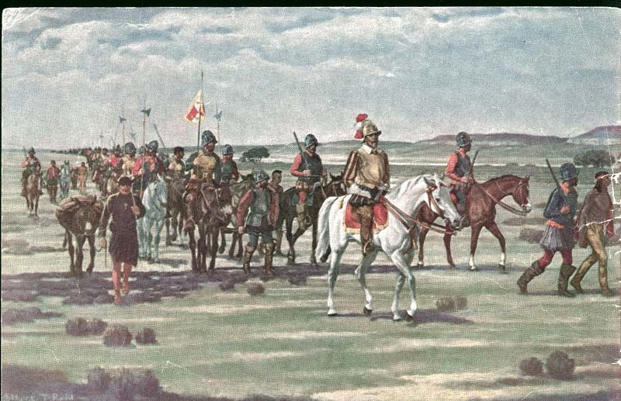
Spanish Technology

Slide 25
Spanish Explorers
In 1513, Juan Ponce de Leon was the first Spaniard to step foot in what is now the United States. He sailed from Puerto Rico to the U.S. and discovered and named La Florida (Florida).
The 400-man expedition
In 1528, 400 Spaniards exploring Florida were attacked by Native Americans.
About 80 survivors fled to present day Texas.
After starvation, disease, and enslavement reduced their number.
Only four lived to escape captivity, and they fled to Mexico City where they relayed stories about cities filled with gold.

Slide 26
MORE SPANISH EXPLORERS
Along with 1,100 Spaniards and Native Americans, Conquistador Francisco Coronado was looking for a “Golden City” when explored much of New Mexico, Arizona, Texas, and Kansas.
Spanish explorer Hernando De Soto found the Mississippi River while was searching for gold in Southeastern United States.
De Soto traveled as far north as the Carolinas and as far west as Oklahoma. He died in what is now Louisiana, having found the MS River but no gold.

Slide 27
Colonizing Spanish America
Spain created a formal system of government in its colonies.
A colony is a group of people who settle in a distant land but are still ruled by the government of their native land.
Government officials granted settlers huge pieces of land to start plantations – large farms worked by laborers who live on the property.

Slide 28
Spanish colonial America
Spanish government granted encomiendas – land grants that included the right to demand labor or taxes from native Americans.
Native Americans were forced to work in mines for gold and silver.
Bartolome de Las Casas traveled through new Spain and worked to reform Encomienda's in the mid 1500s.

Slide 29
Spanish colonial America
The Spanish established 3 types of settlements.
Missions: religious communities
Pueblos: towns, centers of trade
Military forts, or presidios
The Spanish set up missions, religious settlements, in their colonies to convert Native Americans to Christianity.
San Francisco, San Diego, San Antonio, and many other U.S. cities were started as Spanish missions in the 1700s.

Slide 30
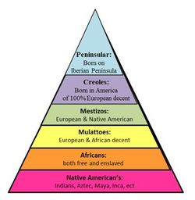
Society in Spanish colonies
A rigid social system based on birthplace and ethnic group developed in the Spanish colonies.
At the top of the social structure in Spanish colonies were the peninsulares – Spanish colonists who had been born in Spain.
Almost all government officials
This rigid system helped Spain keep control of its empire in the Americas for more than 300 years.

Slide 31
Government officials
←
Plantation owners
←
Ranchers, farmers, merchants
←

Slide 32
Checkpoint
How were Native Americans treated under the encomienda system?
Who were the “Peninsulares” social class of early Latin America?

Slide 33
Section 3: Europeans Compete in North America
Focus Q: How did conflicts in Europe spur Exploration in America?

Slide 34
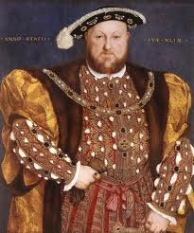
Religious Conflicts
During the Protestant Reformation, many European States split from the Roman Catholic Church.
English Protestants found a supporter in King Henry VIII who left Roman Catholic Church and turned England into a Protestant country.

Slide 35
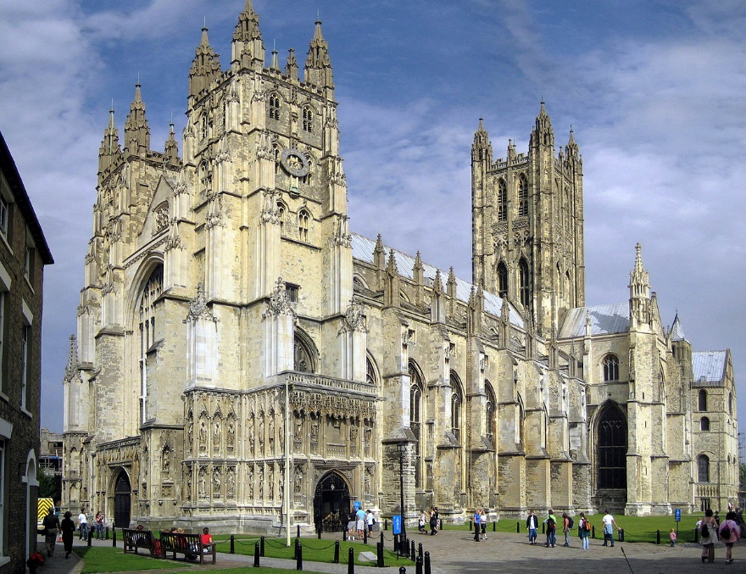
King Henry VIII
When King Henry’s wife did not produce a male heir to the throne, Henry sought to divorce and remarry.
Catholic Law does not permit divorce so Kind Henry created a Protestant Church and named it the Church of England.

Slide 36
Economic Conflict
Religious tensions created by the Reformation inflamed rivalries that already existed between the European nations.
They were not willing to depend on another for trade or security.
Thus, Spain supported Columbus to gain goods from the colonies to become wealthy.
Spain would have gold from the colonies sent back to pay for wars and build a strong army.
Spain and other European countries used the system of mercantilism, meaning that the colonies existed to make the home country wealthy and powerful.

Slide 37
Mercantilism
Mercantilism – a nation’s power is based on its wealth
Encouraged settlement of North America
Resources
Trade
Increased rivalry between nations

Slide 38
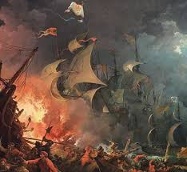
Protestant England and Catholic Spain relations were strained.
King of Spain assembled a fleet of 130 warships, the Spanish Armada, hoping to force the English Queen from the throne.
However, the English ships met the Spanish off the coast of France and defeated them.
The defeat of the Spanish Armada ships by England weakened Spain's control of the seas.
This allowed countries like England and France to start colonies in the Americas.
As England and France founded colonies, these religious conflicts spread to the Americas.

Slide 39
Religious rivalries in the Americas
Religious divisions spread to America
Catholics: Spanish and French
Worked to spread their faith to natives
Protestants: Dutch and English
Established colonies to practice beliefs in peace

Slide 40
checkpoint
How did the Protestant Reformation lead to European colonization of the Americas?

Slide 41
Northern voyages
European nations hoped to gain a quicker and easier route to Asia from a Northwest Passage.
In 1497 John Cabot searched for the passage, supported by England.
He explored the area around Newfoundland.
On a second voyage, he may have explored much of the North American coast, but we cannot be sure. – His ships disappeared without a trace.
More Europeans became interested, and England, France, and Holland all financed voyages of exploration to North America.

Slide 42
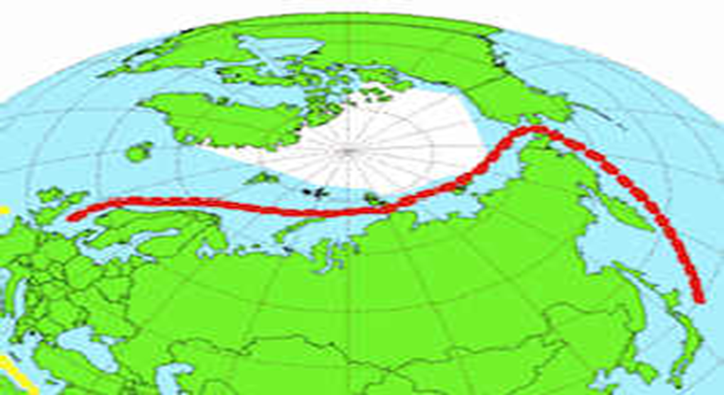
Northern Voyages
English explorer henry Hudson made 4 voyages in search of a northwest passage.
Two during 1607-1608 were unsuccessful. His English supporters gave up on him but the Dutch financed his third trip in 1609.
He reached New York and explored up the river that is today the Hudson River.
Hudson was mutinied by an unhappy crew in 1611 they were unhappy about spending winter there.
He, his son, and 7 loyal crew members were forced on a small boat, never heard from again.

Slide 43
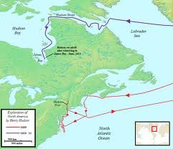
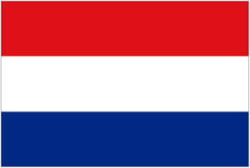
Section 4: France and the Netherlands in North America
Focus Q: What impact did the establishment of French and Dutch colonies in North America have on Native Americans?
Dutch Exploration

Slide 44
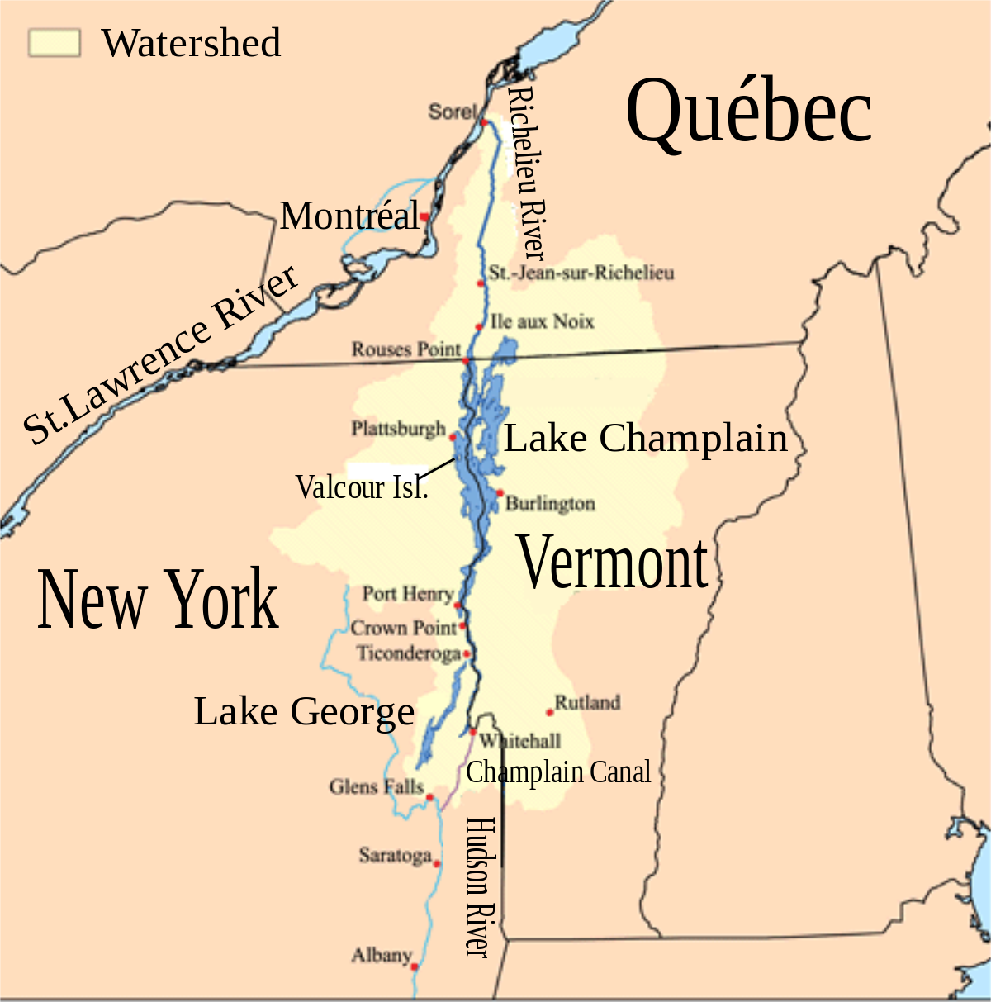
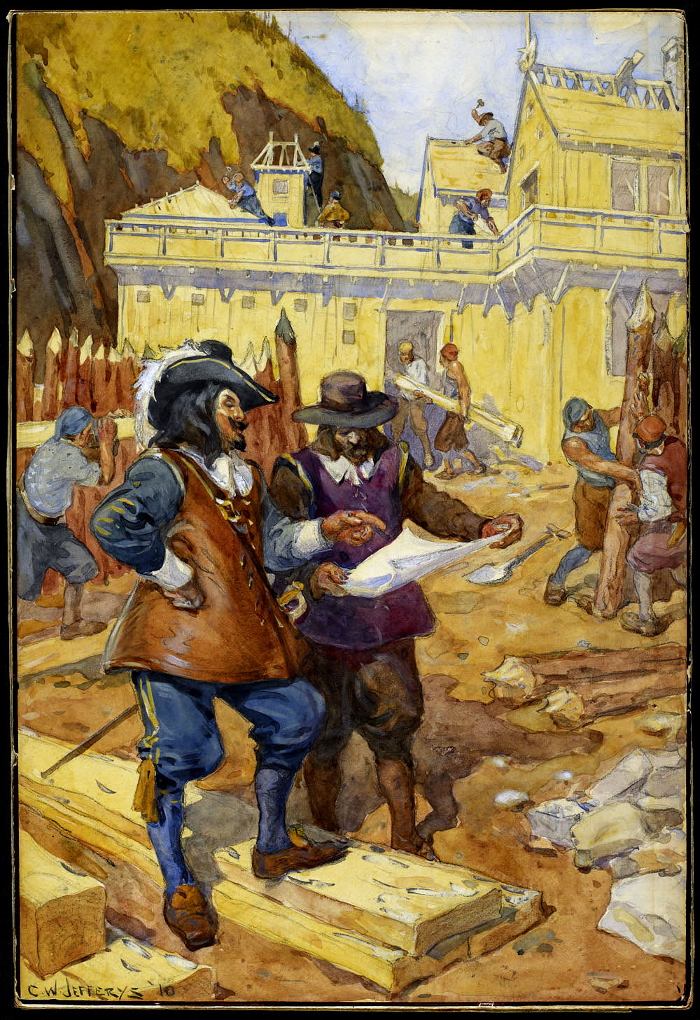
New France
Samuel de Champlain made 11 voyages from France and established what today is Quebec. He continued into Vermont and New York.
This gave the French an influence in this region that lasted 150 years.
Unlike the Spaniards, the French were not looking for gold, but for fish and furs.
Notes:
France began to settle colonies in the early 1600s.

Slide 45
Life in New France
While the Spanish forced Native Americans into harsh labor, French colonists established an animal skin and fur trade with Native Americans.
Beaver skins sent to Europe and made into hats were very profitable.

Slide 46
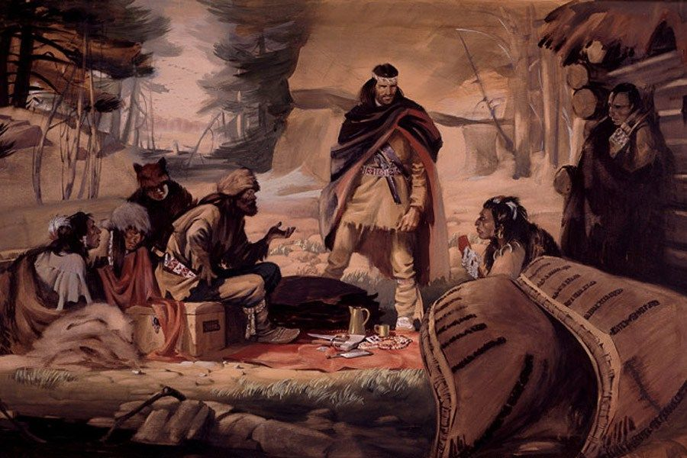
Trade
Trading posts were established in Nova Scotia, Quebec City, and Montreal and became busy centers of commerce (business).
Coureurs de bois French term for “runners of the woods” were people who traded pelts independently.
They sought Native Americans to trade with, and many married native American women.

Slide 47
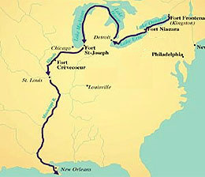
Exploring the Mississippi
Jacques Marquette, a French missionary, established two missions along the Great Lakes (Michigan).
Marquette and Louis Joliet, a French Canadian Fur Trader, traveled along the Mississippi River for a month, thinking it was the Northwest Passage.
Although it was not, they provided the French with a water route into the heart of North America.
The exploration of the Mississippi River was completed in 1692 by Robert Cavalier, Also known as La Salle.
La Salle reached the Gulf of Mexico, claiming the MS River Valley for France. La Salle named the region Louisiana after King Louis XIV.

Slide 48
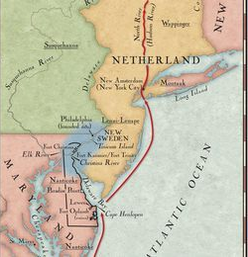
New Netherland
Dutch land claims in North America were based on Henry Hudson’s exploration of the Hudson River.
Dutch traders arrived in 1610 and began a busy trade with Native Americans that became very profitable.
The Dutch West India Company established permanent settlements in northern U.S. which they called “New Netherland."

Slide 49
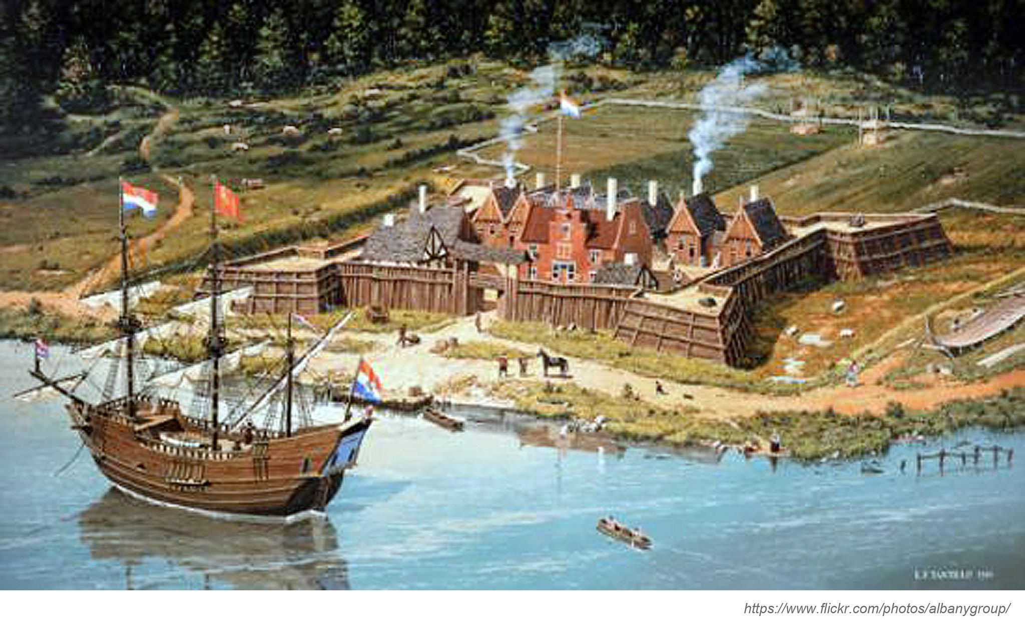
NEW NETHERLAND
In 1624, 300 settlers arrived from Netherland and settled at to Fort Orange, a Dutch fur-trading post, which today is Albany. The colonists renamed their home New Amsterdam. The population grew to about 800.
New Netherland was a barrier that kept English settlers from moving westward.
English forces seized New Netherland 1664 and changed the name to New York after the king’s brother, the Duke of York.

Slide 50
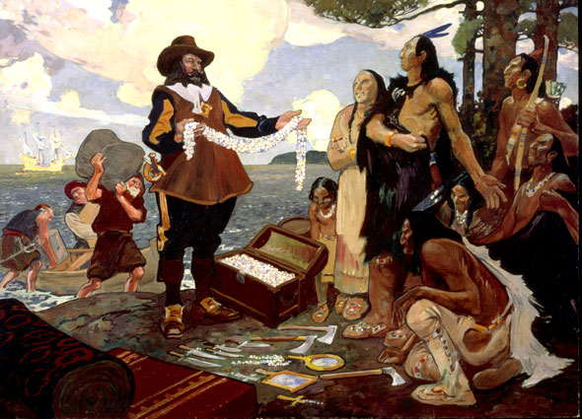
Negative Impact on Native Americans
Native Americans provided furs to French and Dutch. Europeans gave Native Americans manufactured goods in return, such as cloth, iron pots, tools, and guns.
Ultimately, The French and Dutch settlements had a negative impact on Native Americans.
Different Native American tribes split and created alliances with the Dutch and French, and tribes fought against each other.
An alliance is an agreement between parties that benefits them both.

Slide 51
Negative Impact on Native Americans
Europeans brought diseases to America which caused the greatest number of Native American deaths.
Over trapping of animals weakened the food chain on which Native Americans depended.
As the fur-bearing animals disappeared, Native American land became more valuable to the colonists than the Native Americans themselves.

