Slide 1
Chapter 1: Roots of the American people
Section 1: The Earliest Americans
Section 2: Cultures of North America
Section 3: Trade Networks of Asia and Africa
Section 4: The European Heritage

Slide 2
The earliest Americans
Focus question: How did early civilizations develop in the Americas?

Slide 3
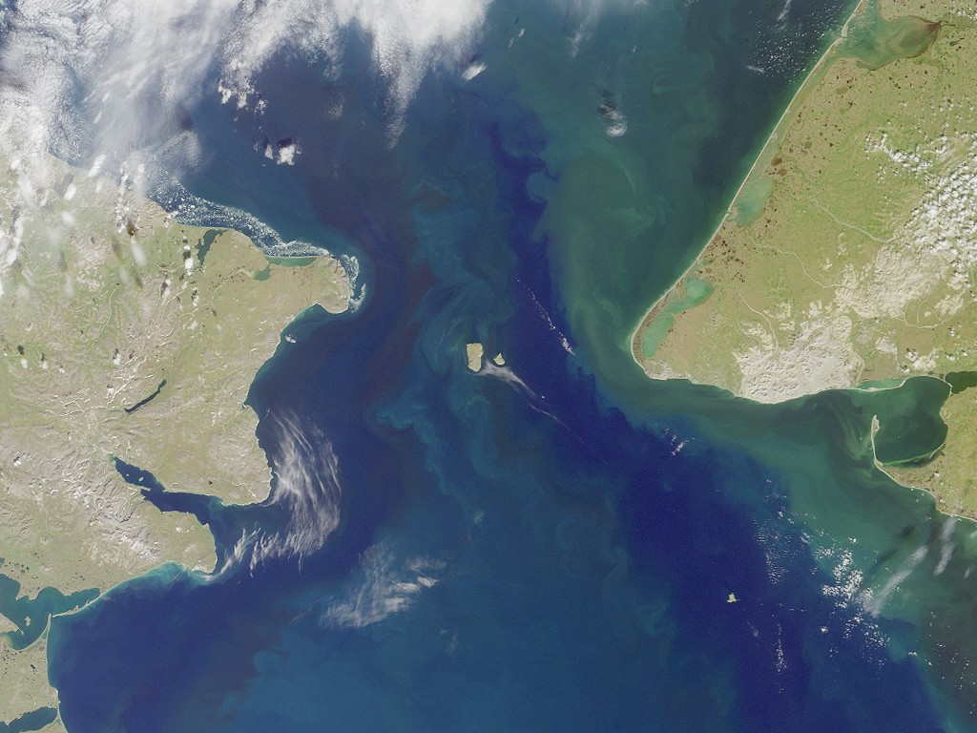
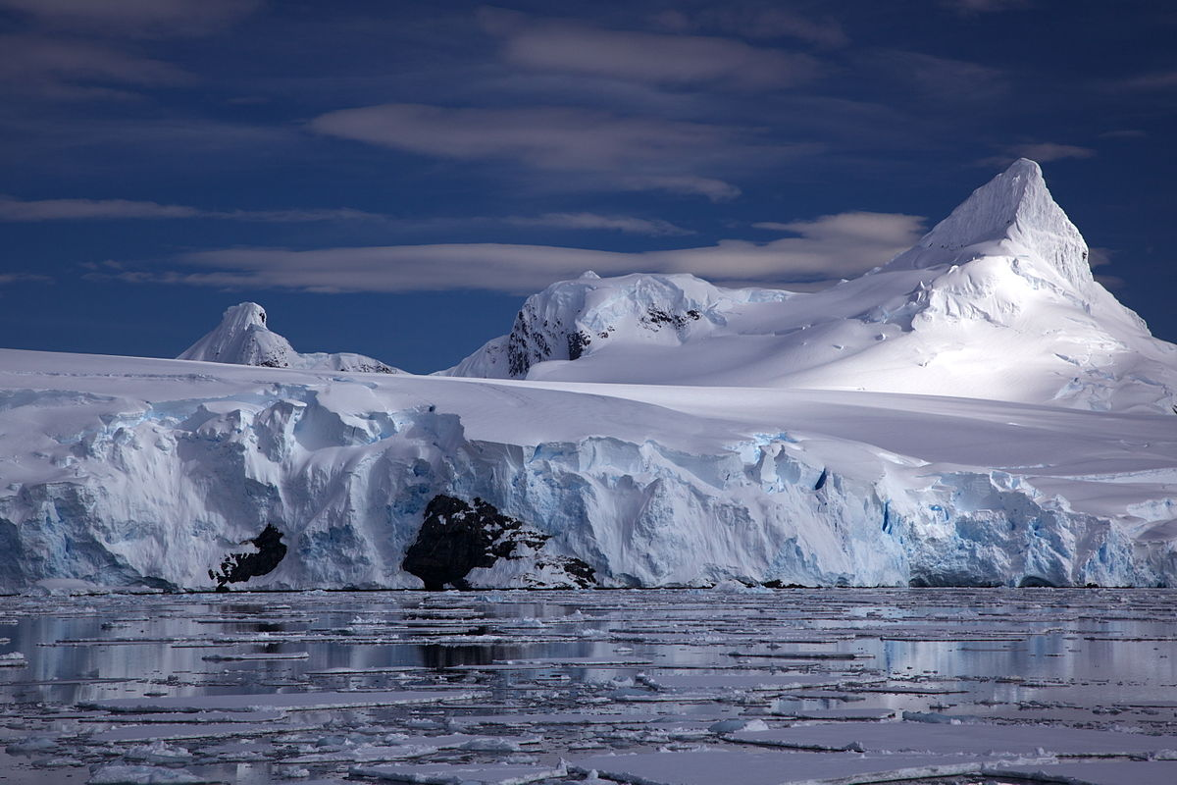
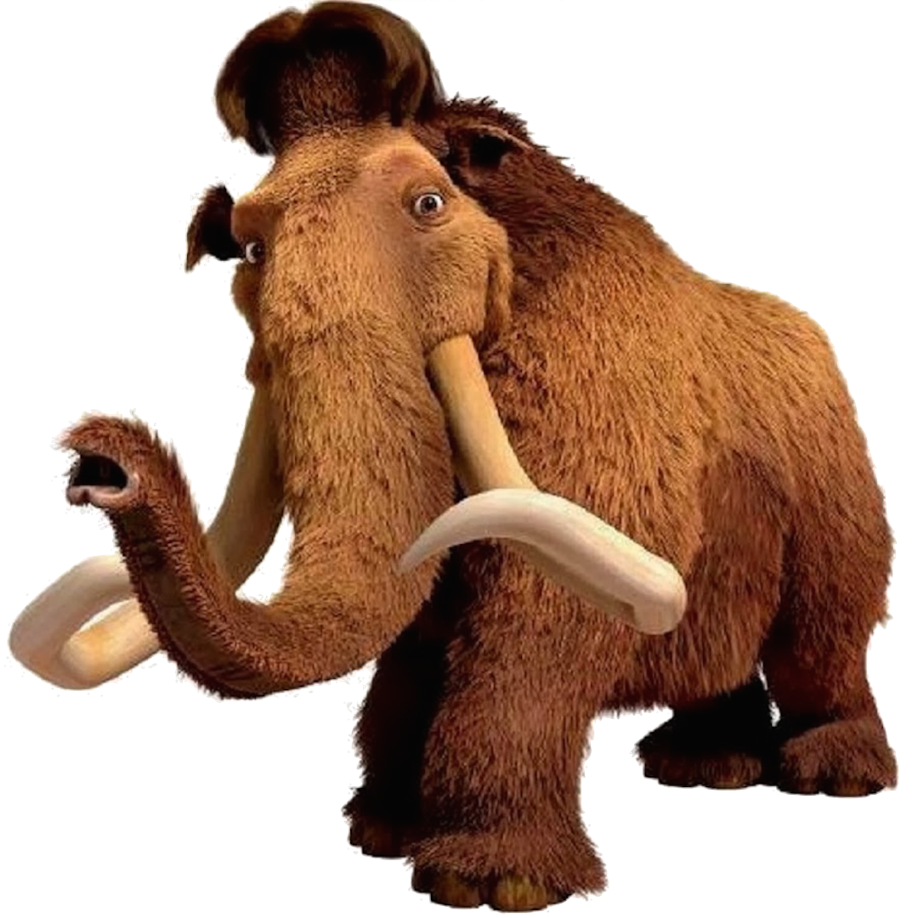
The land bridge theory
The Bering Strait
glacier
During an ice age, a lot of Earth’s water formed glaciers, or thick sheets of ice, and lowered the sea level, exposing a “land bridge” connecting Siberia and Alaska.
The land bridge “Beringia” now lies beneath the Bering Strait.
The people who crossed the land bridge to North America were probably following prehistoric animals they hunted for food.
Notes:
Not everyone agrees with the land-bridge theory. Some scientists think people may first have crossed the arctic waters by boat and traveled southward along the Pacific coast. This idea is known as the coastal-route theory. But many native Americans deny both and have their own traditions and “creation stories.”

Slide 4
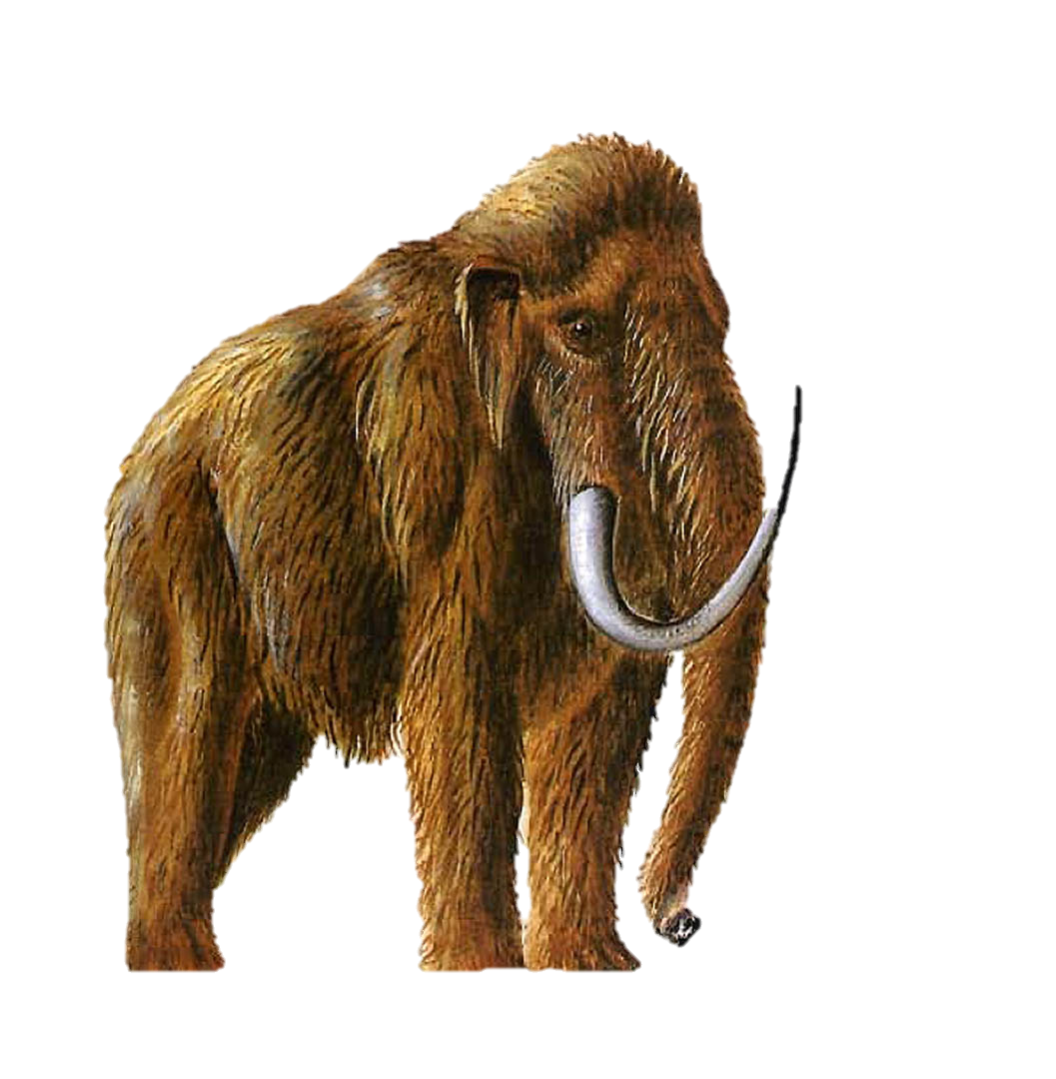
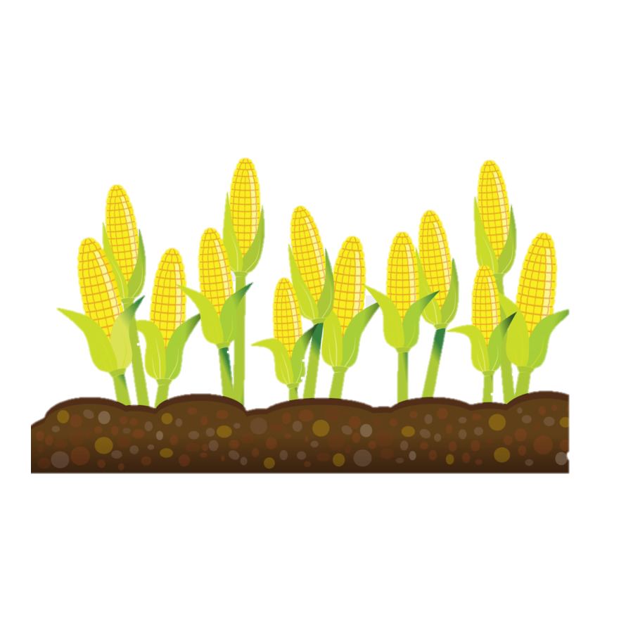
Learning to farm
Hunters became gatherers of wild plants and small game.
Some 8,000 years ago, gatherers in Mexico began farming.
Early American plants included beans, squash, and maize, which is a type of corn.
Notes:
For centuries, people moved place to place hunting animals.
Large animals disappeared so hunters had to find new food sources. Hunters became gatherers of wild plants and small game.
Game animals provided food, furs for clothing, and bones for tools
They would move from place to place in search of hunting grounds. These people were called nomads.

Slide 5
Learning to farm
Families no longer had to wander in search of food.
They developed methods of irrigation, a method to water crops by channeling water form rivers or streams.
They learned to raise animals such as cattle, pigs, and llamas.
They learned to raise animals such as cattle, pigs, and llamas.
With a more dependable food supply, the population grew and they were able to form communities. With a surplus, they could trade with others.
Communities grew into cities. The cities became centers of government and religious life.
Notes:
The ice age ends… glaciers melt… ocean levels rise… land bridge is gone.
The large mammals began to disappear, possibly from overhunting or changes in the climate. Humans needed to find other sources of food so they caught fish, hunted smaller animals, while also gathering berries and grains.

Slide 6
checkpoint
How do scientists think people first reached the Americas?
Notes:
Put questions in guided notes

Slide 7
What is a civilization?
A civilization is an advanced culture in which people have developed cities, science, and industries.
The three major civilizations that developed in the Americas were the Mayas, Aztecs, and Incas.

Slide 8
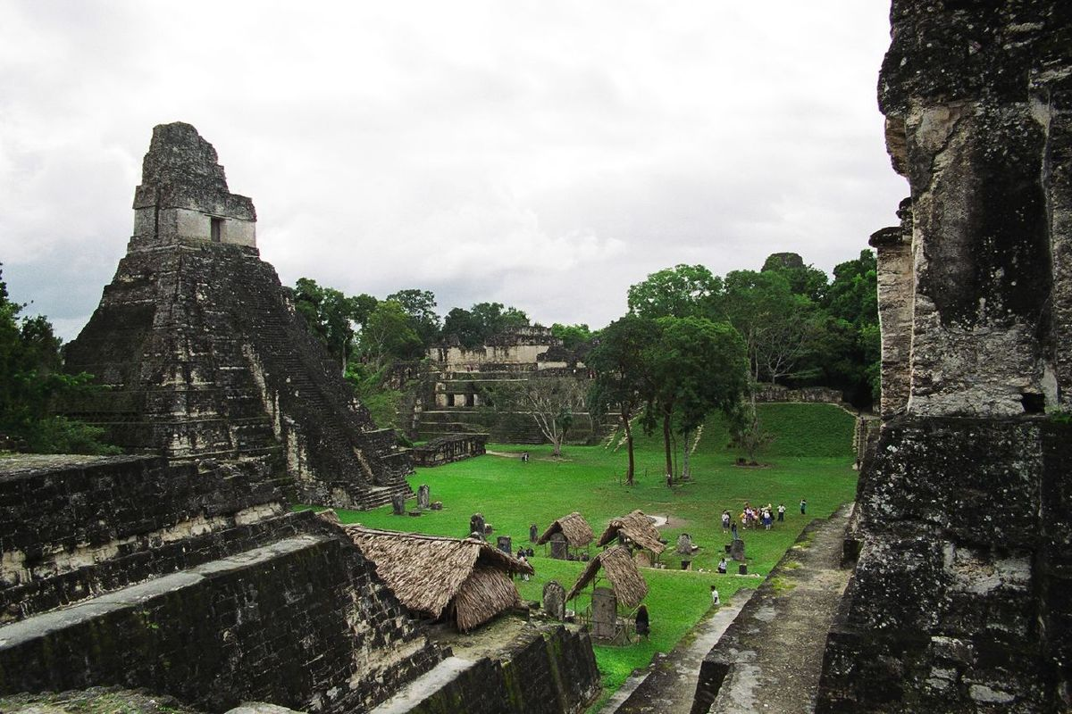
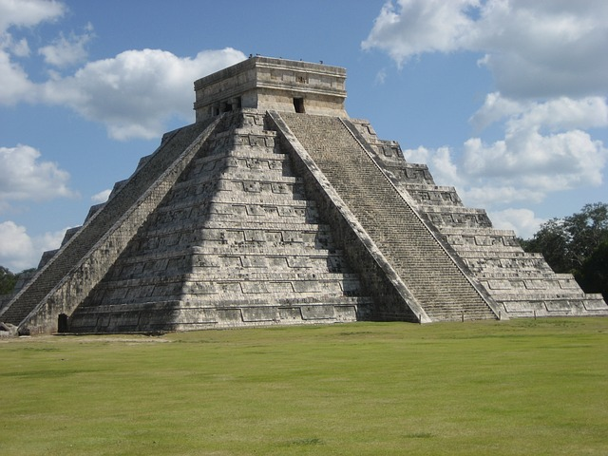
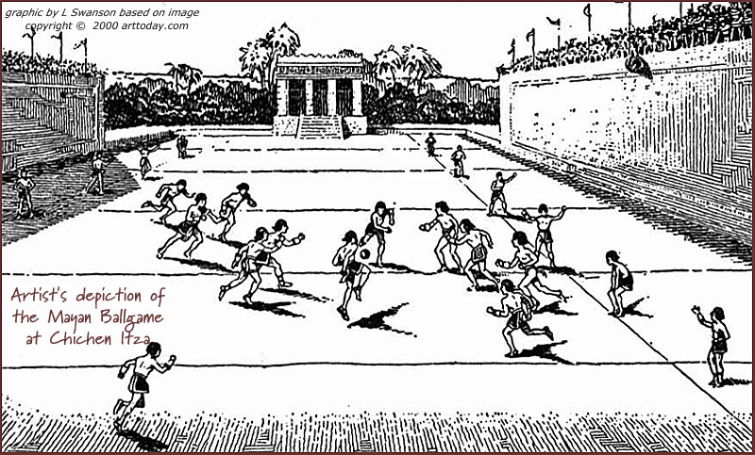
Mayas
The Maya civilization lived between A.D. 250 and A.D. 900 in what is now Mexico and Central America.
The Mayas developed arts, a system of government, and a written language.
From their study of the stars and the sky, they developed a very accurate calendar.
Notes:
Around A.D. 900, the Mayas began to abandon their cities. Disease and overpopulation may have caused the decline.
#3. Why was the development of a calendar an important innovation?
The development of a calendar by the Mayans allowed them to accurately plan for the planting and harvesting seasons. This allow the Mayans to become more successful farmers.

Slide 10
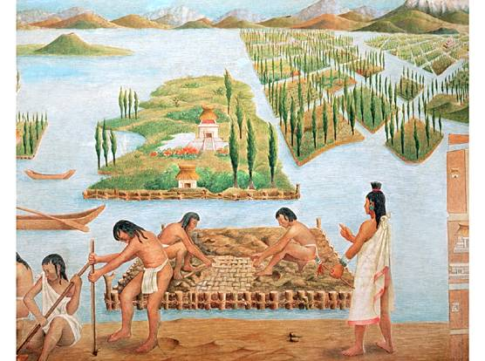
Aztecs
Tenochtitlan, present-day Mexico City, was the capital city.
Practiced agriculture
The Aztecs were very religious.
Built temples to honor gods.
Prosperity depended on pleasing their gods.
practiced human sacrifice as an offering to gods

Slide 11
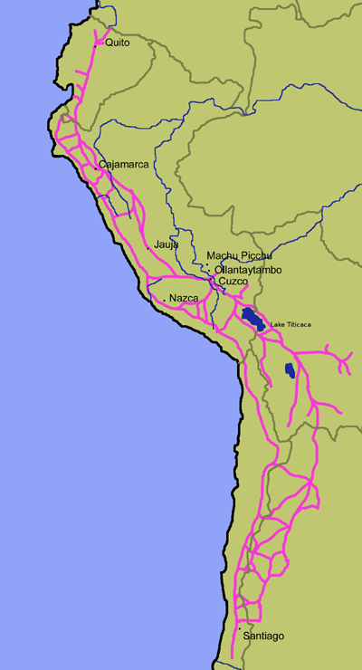
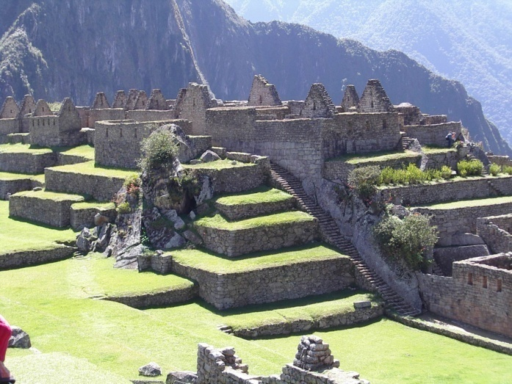
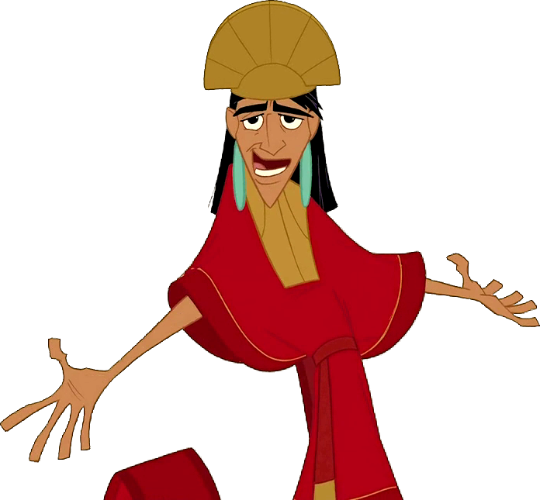
Incas
In the 1400s, the Incas had the largest empire.
elaborate cities with canyons and a vast network of roads
Rulers had gold.
Capital city: Cuzco
Incan suspension bridge
Notes:
constructed buildings of huge stones carefully shaped to fit together. Engineers built walls to hold soil in their fields, canals to carry water, and bridges over deep canyons.

Slide 12
checkpoint
What is a civilization?
Who had the largest civilization in the 1400s?

Slide 13
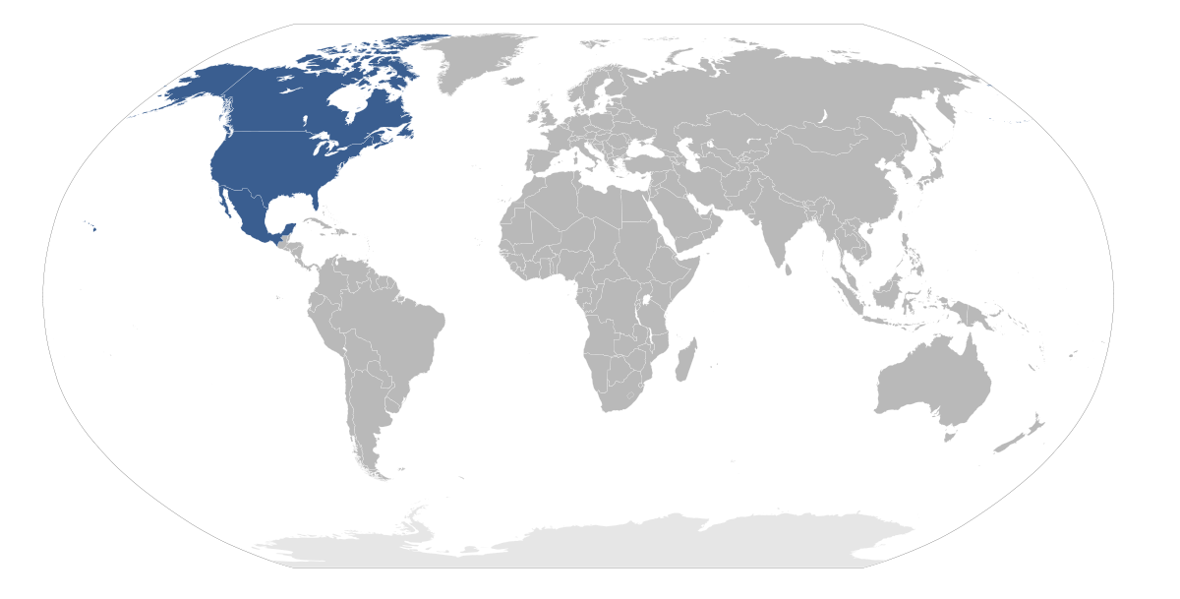
Cultures of North America
Focus Q: How did geography influence the development of cultures in North America?

Slide 14
Cultures of north America
As groups of people started living together, they developed a unique culture, or ways of living. (music, religion, art, stories and traditions.
Throughout North America, people began developing different culture areas that were influenced by the geographical features around them.
By A.D. 1500, when the first Europeans reached the Americas, the native Americans living in North America were a richly diverse group of people.

Slide 15
Geography established different cultures
The Mississippians of the Mississippi River Valley were very religious and built large mounds for their burial sites. They formed the first cities of North America.
The Anasazi of the Southwest portion of the United States lived in the cliffs and made pottery from the clay.
The Hohokam of the Southwest became farmers and traded with the coastal people of the California Coast.

Slide 16
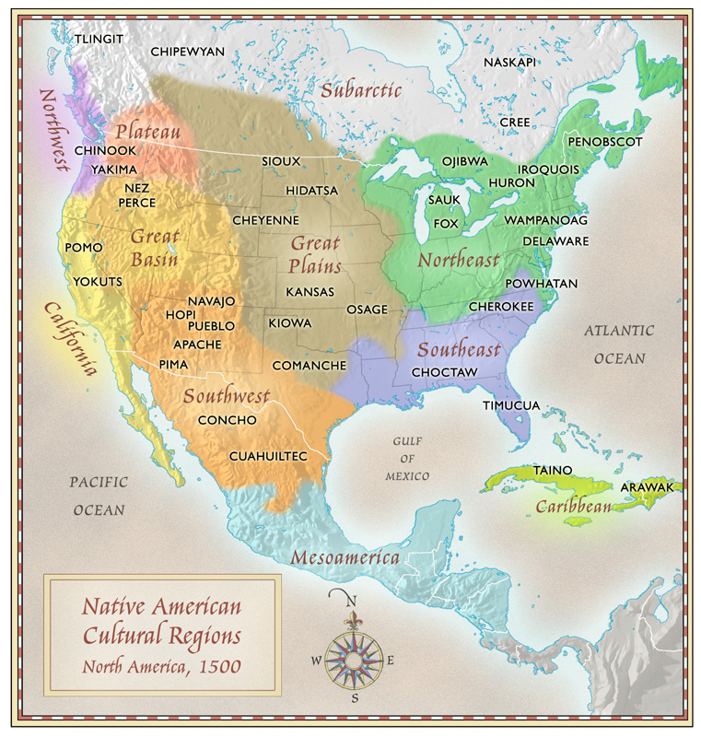

Slide 17
Native American culture
Agriculture allowed civilizations to develop.
Connection with nature; believed spirits dwelled in nature
Traditions reflected their beliefs of these spirits.
Passed down traditions through storytelling
Cultures were influenced by various climates and living conditions across North America.
Notes:
Ex: Pueblo Indians revered spirits known as kachinas and carved kachina dolls for their children. Indians of the Southeast held the “Green Corn Ceremony in late summer for the spiritual renewal at the end of the growing season.

Slide 18
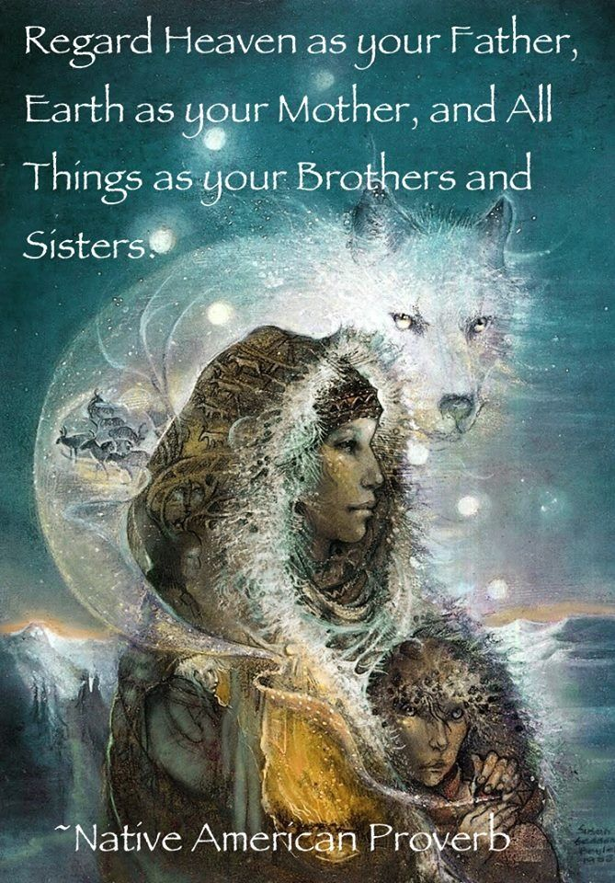
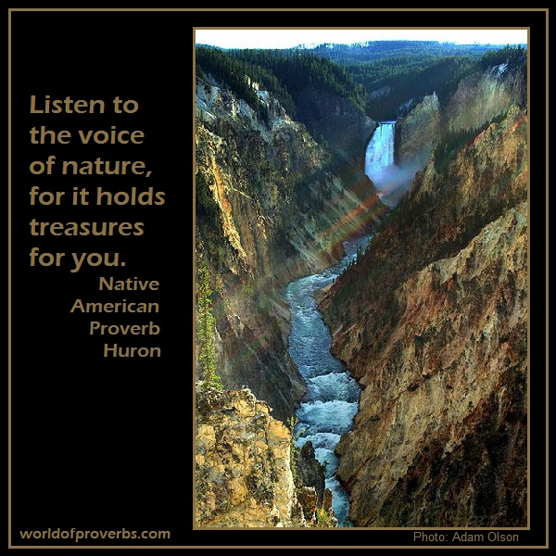

Slide 19
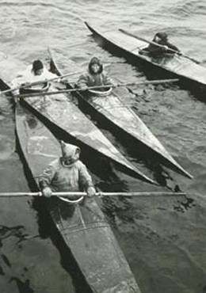
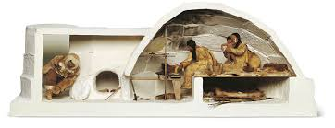
Far North
Arctic region
Hunted marine mammals, fish and caribou for survival
Built kayaks, small boats made from skins

Slide 20
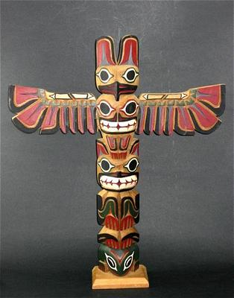
Northwest
Abundance of food – salmon, deer, roots, berries
Practiced a potlatch, a ceremony at which hosts showered their guests with gifts such as cloth, furs, baskets, and canoes.
A family’s status was judged by how much wealth it could give away.

Slide 21
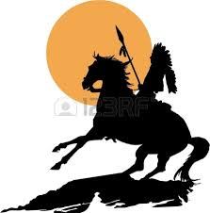
Far West
In the Far West winters were cold in the forest and grasslands, but further south conditions changed to desert like atmosphere.

Slide 22
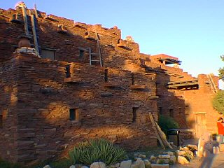
Southwest
Pueblo people built large apartment homes made of adobe, or sun-dried brick.
Had stable towns that lasted for hundreds of years
Learned how to collect and store rain for dry times

Slide 23
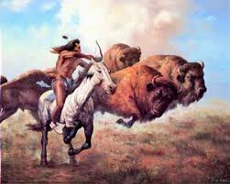
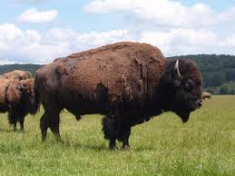
Great plains
Dry, treeless land in the west, but covered in grass and had fertile river valleys
Built tepees made of animal skin
Hunted buffalo to use for food, shelter, and tools.
Notes:
ropes, shields; bones for tools

Slide 25
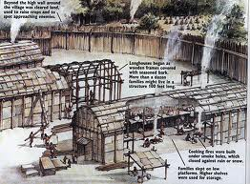
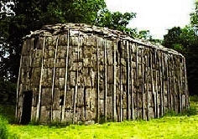
Eastern woodland
Hunting, fishing, foraging for nuts and berries
Covered in forests
wooden longhouses
Two dominate tribes:
Algonquian people – Canada, the Great Lakes area, along Atlantic Coast to Virginia
Iroquoian people – New York

Slide 26
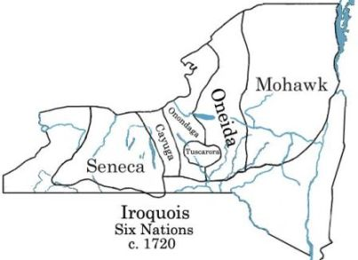
Iroquois
The Iroquois were made up of 5 distinct nations, or tribes.
Women had great influence, such as owning property and choosing the clan’s tribal chief.

Slide 27
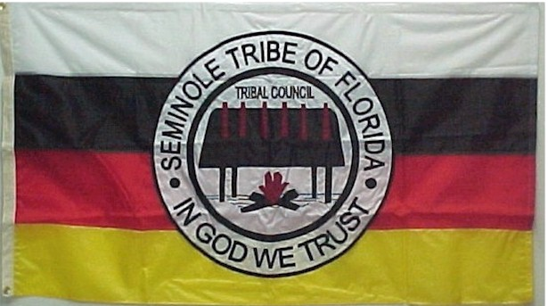
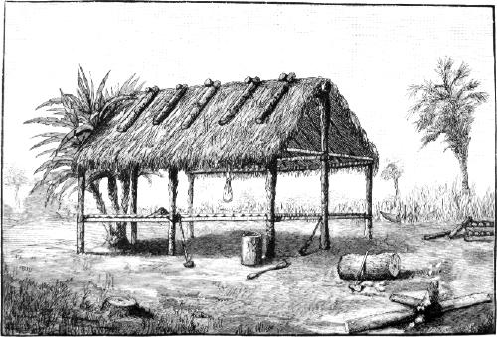
Southeast
Mild climate, hot and steamy summers
Farming
Cherokees, Creeks, Natchez tribes
Houses made of wood, straw, and mud clay

Slide 28
Checkpoint
Why did Native American lives vary across the continent?

Slide 29
Trade Networks of Asia and Africa
Focus Q: how did trade link Europe, Africa, and Asia?

Slide 30
Trade Networks of Asia and Africa
By the 1500s, a complex trade network linked Europe, Africa and Asia.
Ships from China and India brought spices, silks, and gems to ports on the Red Sea.
These cargoes were taken to markets through the Middle East.
Trade was linked to the rise of the religion of Islam.

Slide 31
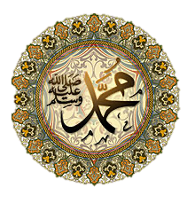
The Muslim link in trade
Islam emerged in the Arabian Peninsula in the 600’s, founded by the prophet Muhammad.
Muhammad taught people that there was one true God.
Followers are called Muslims and believe God’s word is contained in a sacred book, the Koran (Quran).
Why is this important? Islam was passed along through trade.
Arab armies traveled across North Africa and into Spain. Muslim merchants spread their religion into Africa to India. Millions of people across 3 continents became Muslims.
Arab scholars made great contributions in mathematics and science, such as developing algebra and confirming the belief that the earth is a sphere.

Slide 32
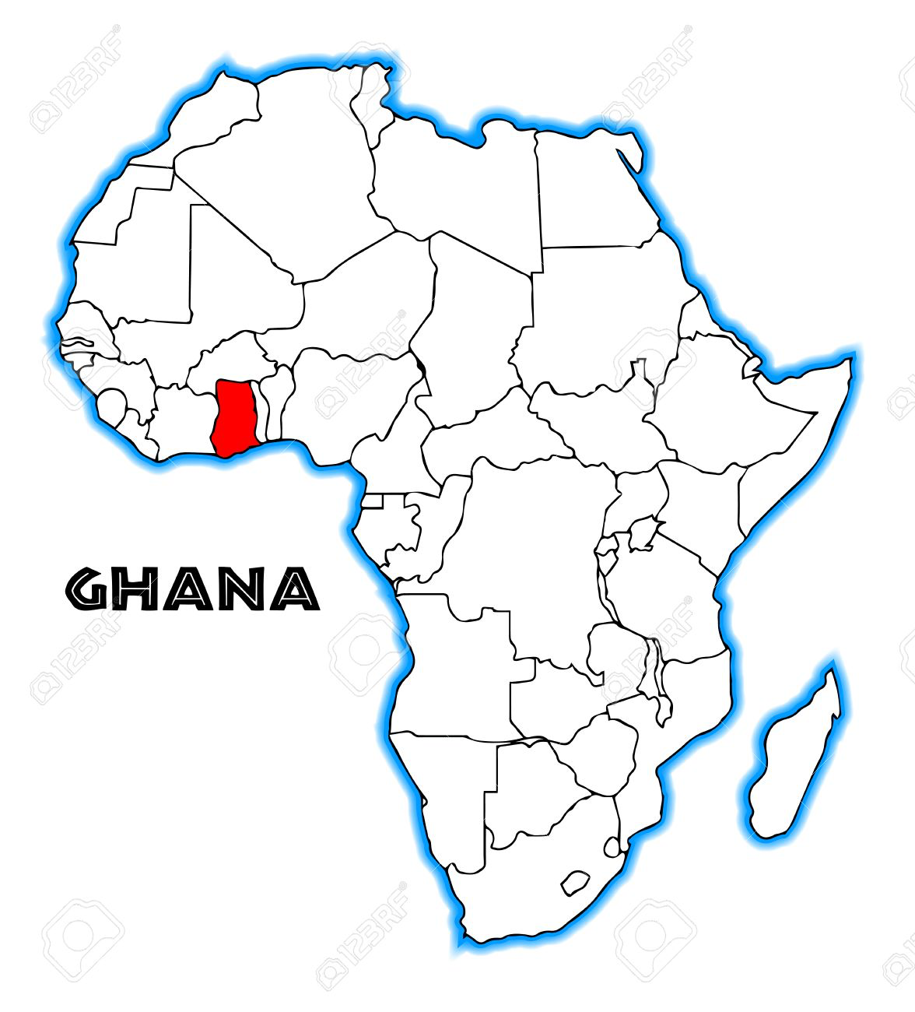
The African link in trade
Around 1000 A.D., trade centers appeared in eastern Africa.
Zimbabwe became a flourishing center. It brought prosperity to other cities on the East Coast of Africa and attracted trade from Asia.
Cloth, spices, pottery, ivory, gold and furs were major goods traded in East Africa.
The Atlantic Slave Trade also developed between East Africa and Asia across the Indian Ocean.
Notes:
People in the Middle East wanted gold from West Africa, and people in West Africa needed salt from the desert.

Slide 33
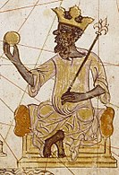
The African link in trade
Ghana was the first major trade center in West Africa, located between sources of salt in the desert and gold further south.
Because people in West Africa needed salt from the desert and the demand for gold increased, rulers of Ghana became rich!
Ghana was absorbed into the empire of Mali.
Mali was ruled by Mansa Musa.
As Mali prospered, the capital Timbuktu became a center of learning.

Slide 34
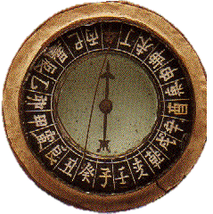
The east Asian link in trade
China established trade links across Asia and Africa. Trade centers became cities.
The Chinese had the highest level of technology at the time! They made great advances in navigation, such as inventing the magnetic compass.
Notes:
China had a higher level of technology than any other civilization of the time.
Along the way they traded in the middle east for products like cloves, nutmeg, and peppercorns from the spice islands in southeast asia. The silk road declined in importance when alternative sea routes were discovered.

Slide 35
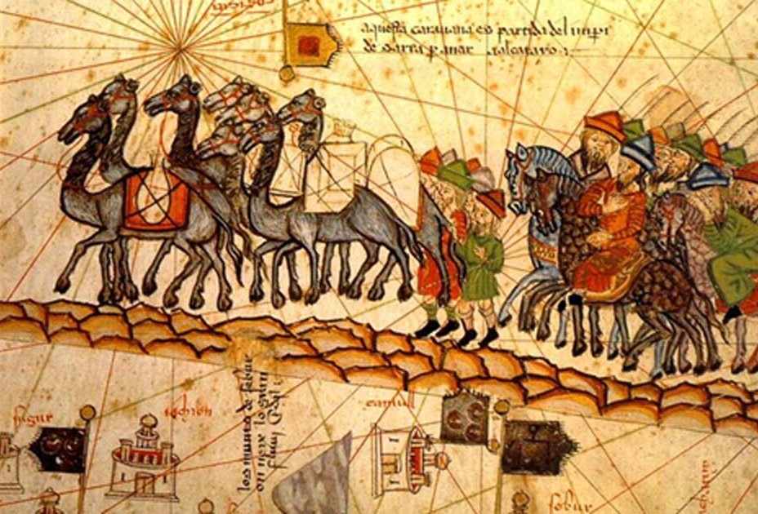
The Silk Road
Chinese silks, bronze goods, pottery, and spices flowed west from China along a route known as the Silk Road.
It was not a single road, but a series of routes that stretched about 5,000 miles.
Merchants on the Silk Road brought silk and other goods from China across Asia for sale in Middle Eastern and European markets.

Slide 36
Checkpoint:
How did trade link Europe, Africa, and Asia?

Slide 37
The European Heritage
Through migration and trade, Europeans, Africans, and Asians exchanged goods, inventions, and ideas.
Judeo-Christian traditions and Greek and Roman ideas influenced European civilization; the Crusades and Renaissance led Europe to look beyond its borders.
Notes:
The trade links between Asia and Africa developed at a time when much of Europe was isolated. In this section we look at the development of Europe and see how they began to look outward toward the riches of asia.

Slide 38
The Judeo-Christian Tradition
Two religions of the ancient Middle East: Judaism and Christianity
Judaism Developed among the Israelites around 1700 B.C. The first major world religion to teach monotheism, the idea that there is only one God. Believed in obedience to the Ten Commandments and other religious and moral laws. | Christianity Jesus: a Jewish teacher believed to be the Messiah, the Savior chosen by God, God in human form. Teachings of Jesus emphasized love, mercy, and forgiveness, and that all people have an equal chance for salvation, or everlasting life. appealed to many people and spread from the Middle East across Europe Romans first viewed it as a threat, but later made it the official religion of the Roman Empire.
Notes:
Roman rulers of Judea arrested, tried, and crucified Jesus. Followers of Jesus said he rose from the dead 3 days later.
Eventually it became the dominant religion of all of Europe

Slide 39
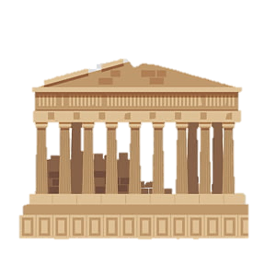
Greek and Roman Traditions
Athenian Democracy
Greek city-state of Athens was a direct democracy: a form of a government in which an assembly of ordinary citizens makes decisions.
Any adult male could participate in the Athenian Assembly. Women, slaves, and foreign-born people were excluded.
Athenians believed democracy depended well-rounded, educated citizens.
Boys were educated in history, grammar, poetry, music, and public speaking.
Notes:
Importance: While Judaism and Christianity shaped European religious and moral thinking, the ancient civilizations of Greece and Rome shaped political traditions. Greek and Roman ideas would later deeply influence the Founders of the United States.***
Long years of civil war led to collapse of Roman republic. In 27 B.C., Octavian declared himself emperor. Roman Empire lasted for almost 500 years, during which their ideas bout law and government spread.

Slide 40
Greek and Roman Traditions
Roman Government and Law
In 509 B.C., Romans overthrew the king and set up a republic, a form of government in which people choose representatives to govern them.
In the Roman Republic, an elected senate and assembly made the laws.
A code of laws defined rights of citizens. (all equal under the law, innocent until proven guilty)
1787: The founders of the United States gave lawmaking power to an elected Congress, similar to the Roman Senate.

Slide 41
New Horizons
The Middle Ages:
The 1,000 year period after the fall of Rome during which Europe was fragmented into many small states.
The Roman Catholic Church had great power in daily life and was the center of learning.
Notes:
After a period of decline, the roman empire fell to invaders in A.D. 476. Europe fragmented into many small states. The 1000 year period after the fall of Rome is known as the middle ages.

Slide 42
New Horizons
The Crusades
The leader of the Roman Catholic Church declared a “holy war”.
A series of wars between Christians and Muslims over the Holy Land (land where Jesus lived and taught) over 200 years
There were nine crusades over the next 200 hundred years, but Christians failed to win control of the Holy Land
Important long-term effect: Europe was exposed to new ideas and possibilities such as new foods and spices, the Muslim civilization, and advanced technology for navigation.
The Crusades helped Europeans to look beyond their own world.

Slide 43
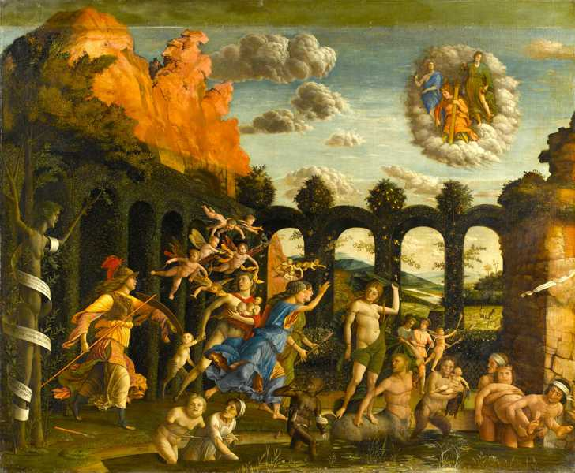
New Horizons
The Renaissance: a rebirth of learning in the 1300s
rediscovery of classical texts from ancient Greece and Rome
science and inventions
printing press allowed for large production of books.
New nations took over trade routes in Atlantic Ocean.
The Protestant Reformation:
a demand for reforms in the Roman Catholic Church led by German Monk, Martin Luther
Followers called Protestants for their protests against Catholic Church practices.
Over time, Luther’s movement split and many Protestant churches emerged, pushing Europe into a long series of wars between Catholic and Protestant forces.

Slide 44
An Age of Exploration Begins
3 Causes for Era of Exploration
Renaissance
Rise of nations
Expansion of trade
In the 1400s, a center for exploration was set up in southern Portugal
Inspired a generation of explorers
Goal: expand Portugal & spread Christianity
In 1498, Vasco de Gama sailed around southern tip of Africa to India.
Became an important trade route and helped Portugal gain large wealth

