Slide 1
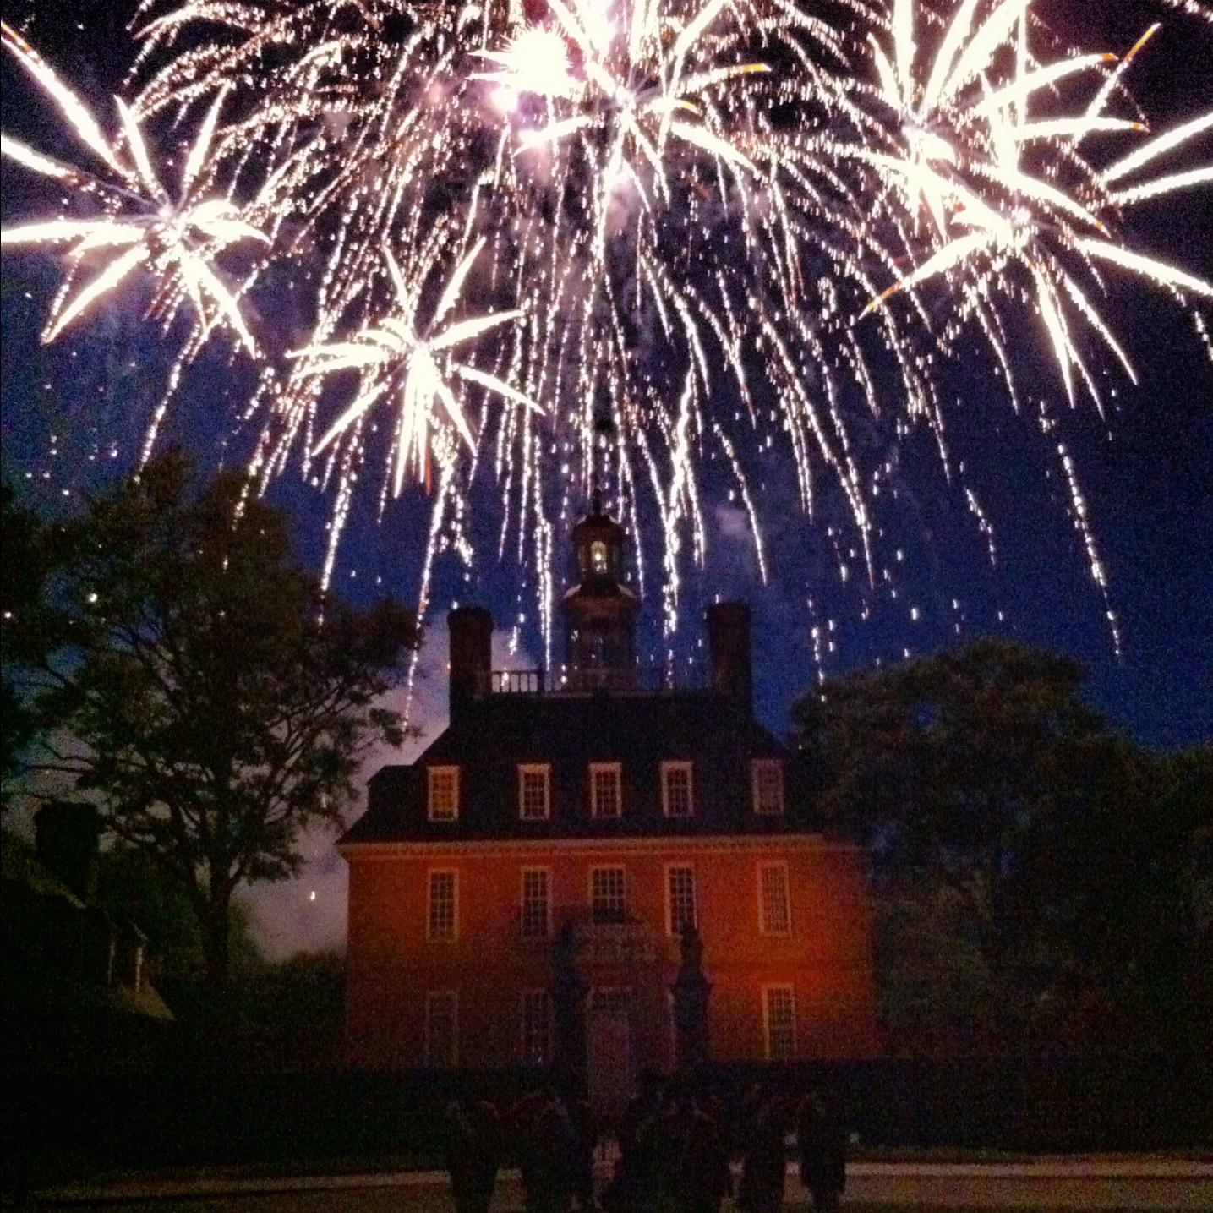
Chapter 6
Moving towards Independence
Notes:
Thomas Paine: https://upload.wikimedia.org/wikipedia/commons/thumb/2/2d/Thomas_Paine.jpg/1200px-Thomas_Paine.jpg
Common Sense: http://mrnussbaum.com/images/common%20sense.jpg
1

Slide 2
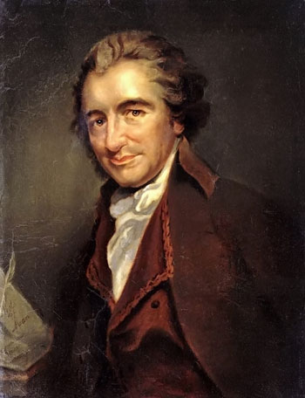
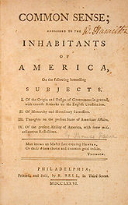
A. Thomas Paine: Common Sense *Propaganda vs. Truth
Notes:
Richard Henry Lee: http://photos.geni.com/p5/2981/6690/53444836773f9dc8/RichardHenryLee_original.jpg
Resolution: https://upload.wikimedia.org/wikipedia/commons/thumb/9/90/Lee_Resolution_for_Independency.png/220px-Lee_Resolution_for_Independency.png
2

Slide 3
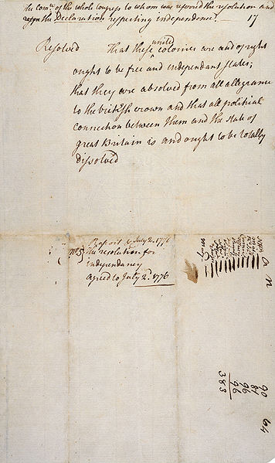
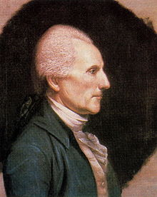
B. Lee’s Resolution: The colonies
are and should be free and
independent states
1. Prompted Declaration of
Independence
2. Implication: Win or die
Notes:
https://i.pinimg.com/736x/59/68/fe/5968fec54cea3696d459d71f21404f1f--thomas-jefferson-quotes-author-quotes.jpg
3

Slide 4
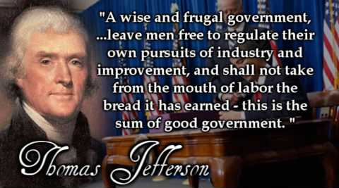
C. The Declaration of Independence
1. Written by Thomas Jefferson
Notes:
Signing: http://www.ushistory.org/declaration/images/trumbull-large1.jpg
http://lpmaryland.org/wp-content/uploads/2014/06/Declaration-of-Independence.jpg
4

Slide 5
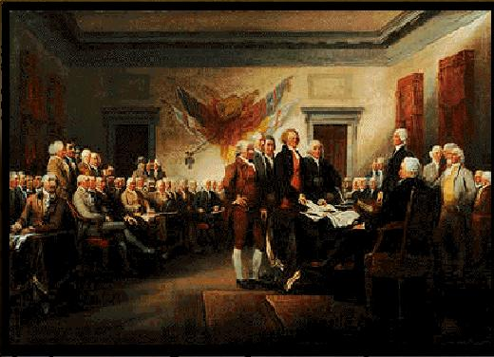
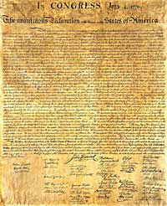
2. Parts:
a. Preamble: Why?
*Separate and equal
b. Declaration of rights: We hold these
truths…
1. Self-evident and unalienable
2. Purpose of government: Of
the people
3. Cause for change: Despotism
Notes:
Signing: https://i.pinimg.com/736x/65/58/1b/65581b68d05ace590712515172166df8--declaration-of-independence-the-declaration.jpg
Document: https://media.buzzle.com/media/images-en/gallery/conceptual/1200-178164419-candle-glasses-quill-pen.jpg
5

Slide 6
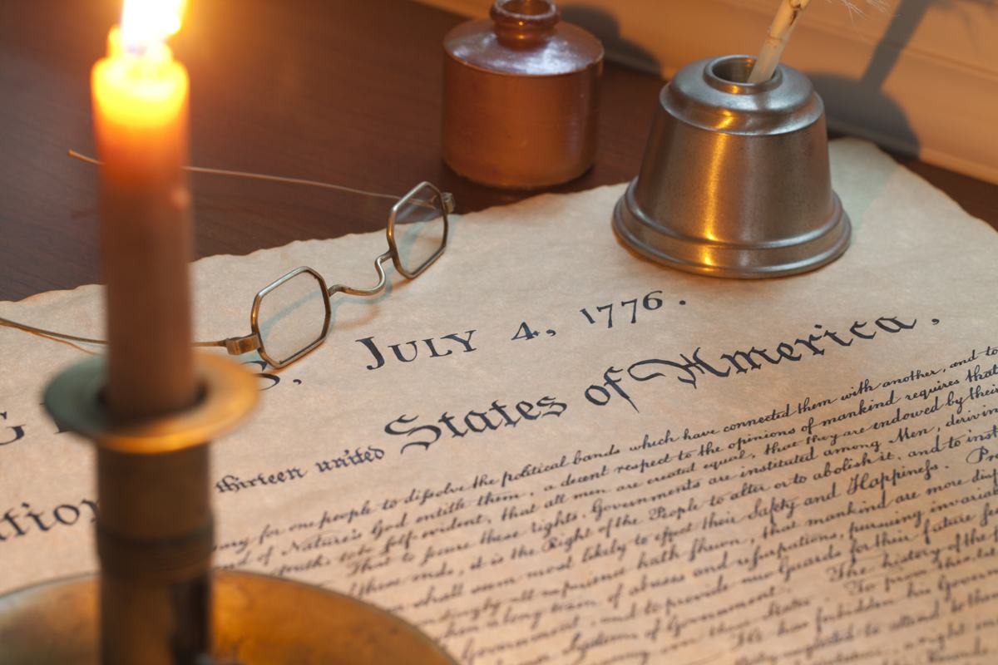
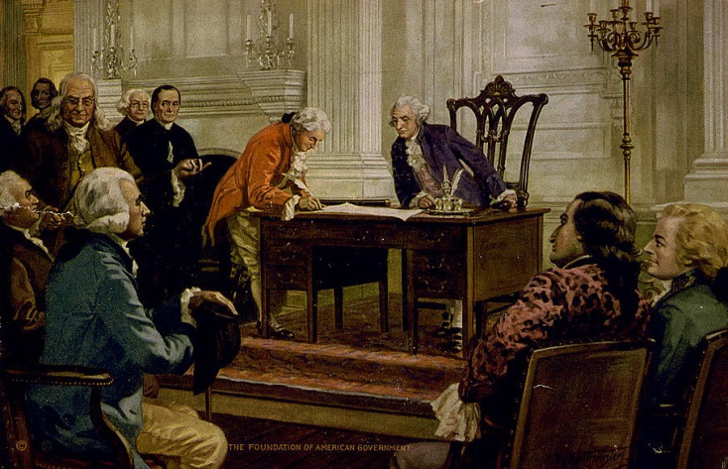
c. Complaints: 1. Tyrannical control of legislature 2. Population control: Army d. Resolution: Dissolve bond with England
Notes:
http://americanns.weebly.com/uploads/1/4/5/9/14597924/6792675_orig.jpg?1
6

Slide 7
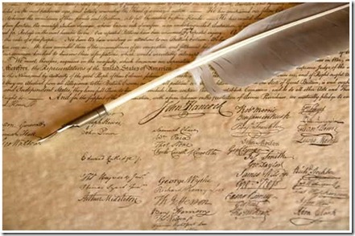
Response: Counting the cost *Free and Independent States
Notes:
Photo Credit: https://www.3dartistonline.com/users/314/thm1024/blackloyalists.jpg
Use Schuyler Sisters.
7

Slide 8
Journal: Free write
Notes:
https://www.delawarescene.com/images/organizations/711.jpg?v=1298932912
8

Slide 9
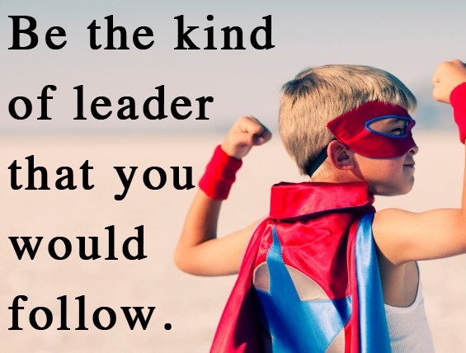
Journal:
What makes someone a good leader? Who do you think are the leaders in the eighth grade? Explain why you think so.
Notes:
https://i.pinimg.com/originals/33/10/a5/3310a57901cf6bddcc7677d8200a3084.jpg
9

Slide 10
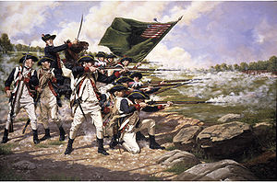
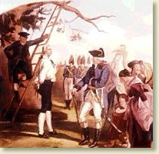
II. Continued Battles
A. The Battle of Long Island [Br.]
1. Washington forced to abandon
New York
2. Nathan Hale, School teacher
and spy, is captured and killed
* “I only regret that I have but
one life to lose for my
country.”
Notes:
Top Right: https://upload.wikimedia.org/wikipedia/commons/thumb/b/b3/BattleofLongisland.jpg/1200px-BattleofLongisland.jpg
Bottom Left: http://hankeringforhistory.com/wp-content/uploads/hanging-nathan-hale.gif
10

Slide 11
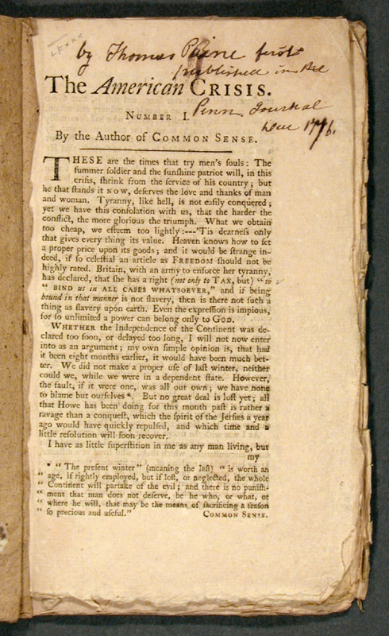
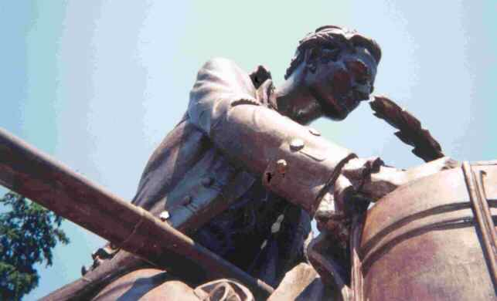
Many deserters prompt Thomas Paine’s The Crisis: “These are the times that try men’s souls.”
Notes:
The Crisis: http://www.indiana.edu/~liblilly/history/images/thumbnails/jc178-c401-pts-1-3_00001.jpg
Thomas Paine: https://i.ebayimg.com/thumbs/images/m/mBjRWXrm2tv14qBWrniZlOw/s-l225.jpg
11

Slide 12
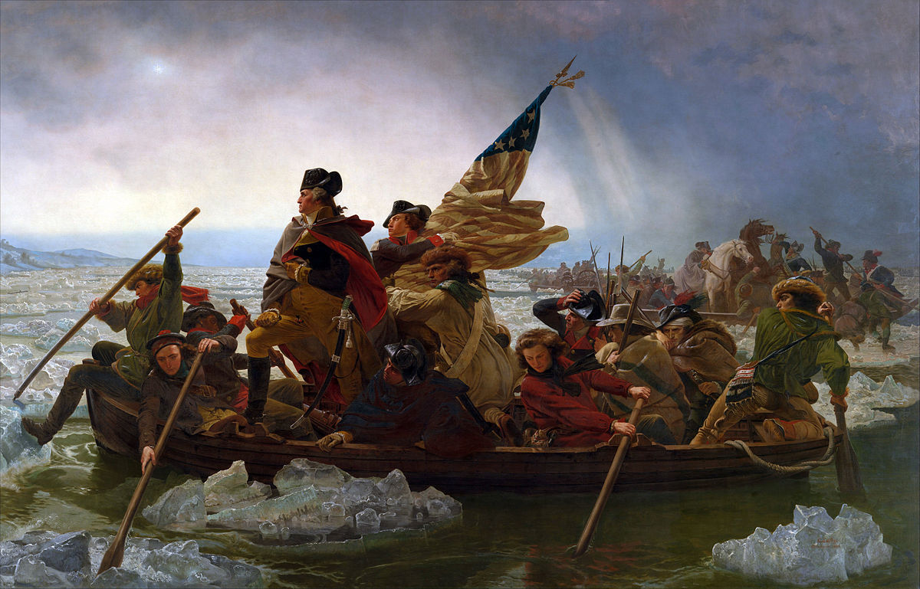
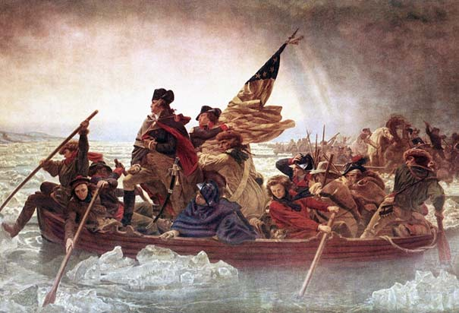
Washington crosses the Delaware
Notes:
https://upload.wikimedia.org/wikipedia/commons/thumb/9/95/Washington_Crossing_the_Delaware_by_Emanuel_Leutze%2C_MMA-NYC%2C_1851.jpg/1200px-Washington_Crossing_the_Delaware_by_Emanuel_Leutze%2C_MMA-NYC%2C_1851.jpg
12

Slide 13
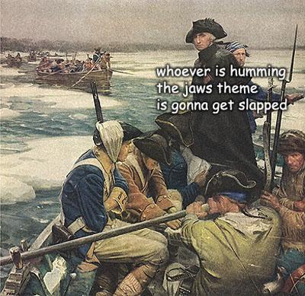
Notes:
https://i.pinimg.com/564x/a4/f1/f0/a4f1f0210c5a8f8bb34ae553469a7c92--american-war-american-revolutionary-war.jpg
13

Slide 14
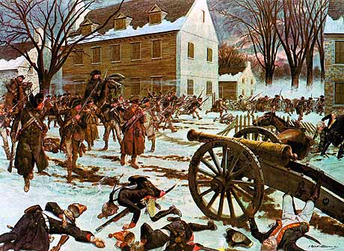
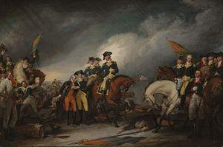
B. The Battle of Trenton: Turning Point #1 [Am.]
1. Surprised the British the day after
Christmas
2. 1,000 Hessians captured
(Mercenaries)
3. Decoy Escape
Notes:
Trenton right: https://upload.wikimedia.org/wikipedia/commons/thumb/9/9c/Battle_of_Trenton_by_Charles_McBarron.jpg/1200px-Battle_of_Trenton_by_Charles_McBarron.jpg
Trenton Left: http://www.revolutionary-war.net/images/battle-of-trenton-surrender-by-john-trumbull-wcpd.jpg
14

Slide 15
Journal:
Describe the hardest day of your life.
Notes:
https://i.pinimg.com/originals/40/7a/43/407a43cf10c1915a9667875aee753ee4.jpg
15

Slide 16
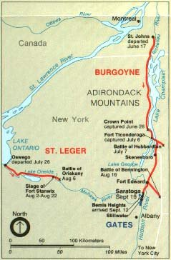
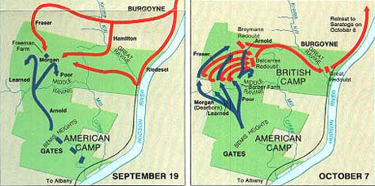
C. The Battle of Saratoga [Am]
1. Burgoyne (Br.) splits forces: Unsuccessful
a. Howe sent South by George III
b. Burgoyne takes Ft. Ticonderoga
Notes:
Maps left: http://tccl.rit.albany.edu/knilt/images/a/a8/Saratoga_sept_19_oct_7.jpg
Burgoyne’s route : http://www.ushistory.org/us/images/00037107.jpg
16

Slide 17
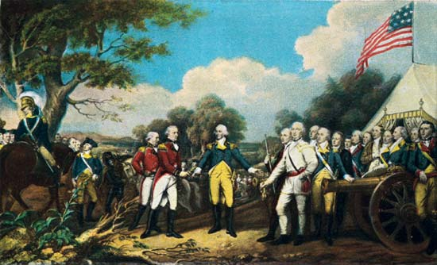
Colonists surround Saratoga.
British surrender
Turning Point #2. Convinces
Europe that the Colonists might
win.
Notes:
http://cdn.history.com/sites/2/2014/01/burgoyne-surrenders-to-gates.jpg
17

Slide 18
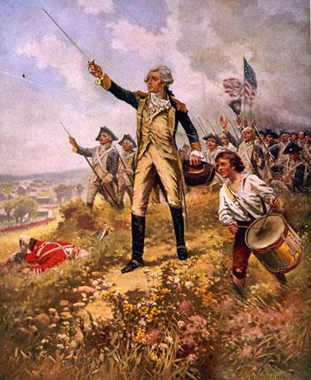
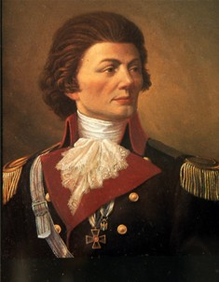
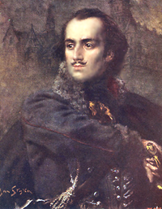
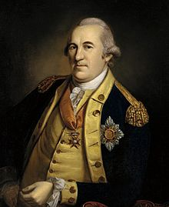
III. Foreign Allies
French Treaty and F, N, and S
all go to war with England.
B. Foreign soldiers help train
1. Marquis de Lafayette- officer (Fr)
2. Thaddeus Kosciusko (fortification)
and Casimir Pulaski
(cavalry) – Polish
3. Friedrich William Ludorf Gerhard
Augustin Baron von Steuben—his
discipline trained the army.
Notes:
Lafayette (top right): http://www.ushistory.org/valleyforge/images/lafayette.jpg
Kosciusko (L): http://explorepahistory.com/kora/files/1/2/1-2-9B2-25-ExplorePAHistory-a0h9y0-a_349.jpg
Pulaski: https://upload.wikimedia.org/wikipedia/commons/thumb/4/46/Kazimierz_Pu%C5%82aski.PNG/225px-Kazimierz_Pu%C5%82aski.PNG
Baron Von Steuben: https://upload.wikimedia.org/wikipedia/commons/c/cd/Baron_Steuben_by_Peale%2C_1780.jpg
18

Slide 19
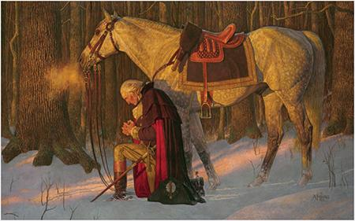
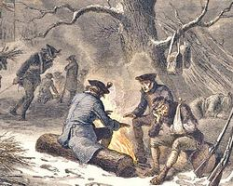
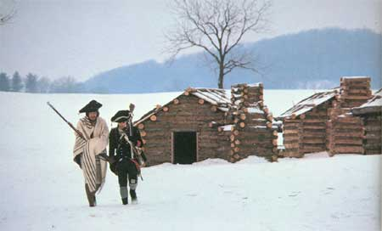
IV. Further Struggles
A. Valley Forge
1. Area 16 x 14 x 6 ½ slept 12
(Average height 5’4”)
2. Starving, cold, ill-fitted uniforms
*Making the best of a bad situation
Notes:
Prayer: http://www.freetoursbyfoot.com/wp-content/uploads/2014/02/The_Prayer_at_Valley_Forge_by_Arnold_Friberg.jpg
Cabins: http://www.freetoursbyfoot.com/wp-content/uploads/2014/02/valley-forge-1777-300x1811.jpg
Campfire:
19

Slide 20
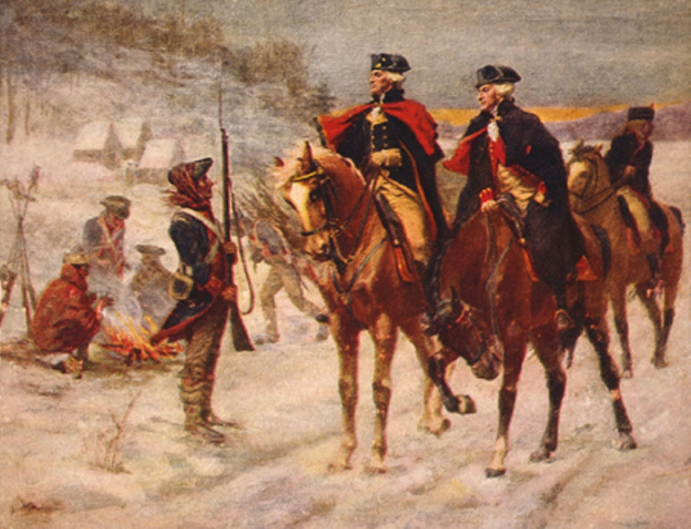
Being cold and still looking good
Notes:
http://s3.amazonaws.com/mtv-main-assets/files/resources/washington-and-lafayette-at-valley-forge-loc-web.jpg
20

Slide 21
Journal:
What would make someone betray
his or her country? Explain!
Notes:
https://trustworks.files.wordpress.com/2011/07/trust-torn.png
21

Slide 22
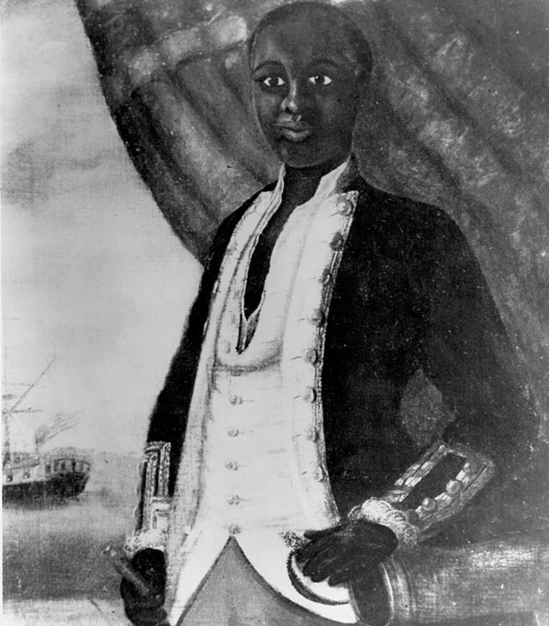
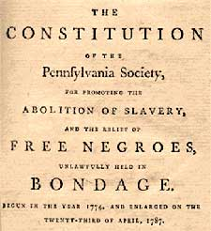
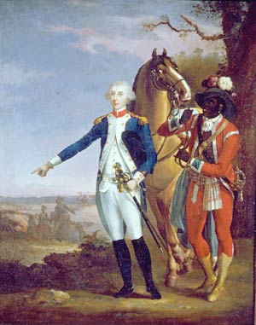
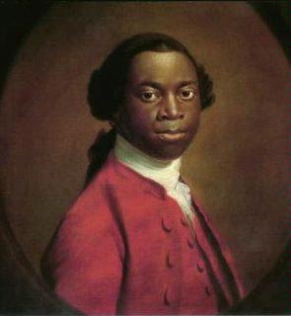
Free African-American and slaves
*Fought for both sides
(~ 7,000 on American side)
*Pennsylvania and others propose
a gradual end to slavery (1780)
Notes:
Black and white 1780: https://www.ncpedia.org/sites/default/files/aasoldierrevwar.jpg
Bottom right: https://68.media.tumblr.com/0833cbb57396f9383b3f0284fea4a85c/tumblr_inline_nfwzpy2QWm1s6mmtz.jpg
Equiano: https://upload.wikimedia.org/wikipedia/commons/thumb/c/c5/EquianoExeterpainting.jpg/220px-EquianoExeterpainting.jpg
Pennsylvania Society: http://www.personal.psu.edu/cjm5/blogs/benjamin_franklin_then_and_now/pic6.jpg
22

Slide 23
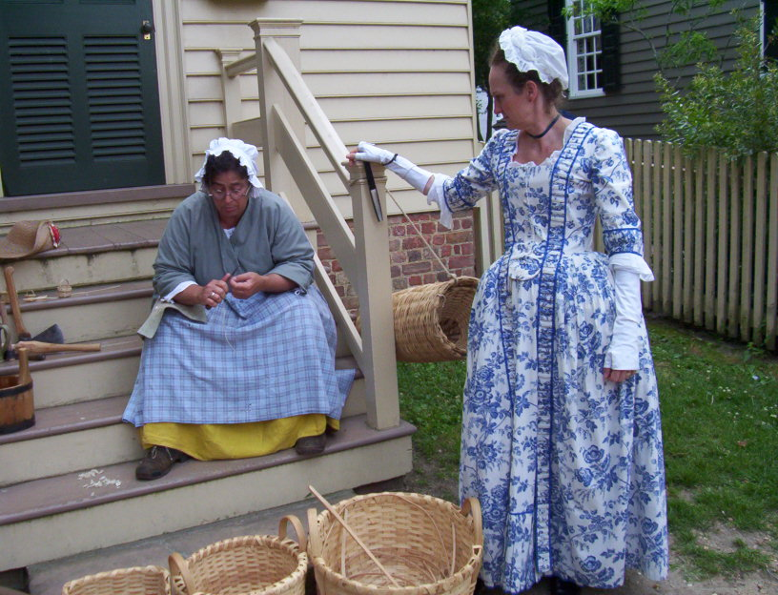
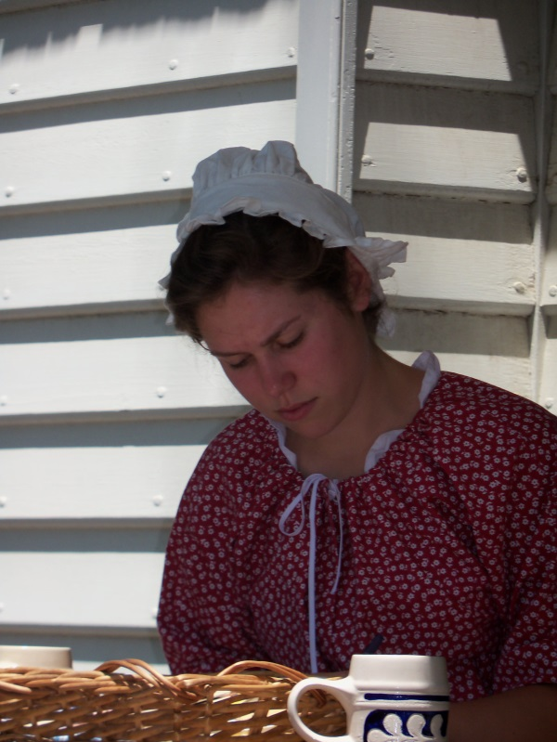
C. Women
* Increased responsibility at home, with the war effort, and even in battle.
Notes:
Photo Credit: Amy Brailey
23

Slide 24
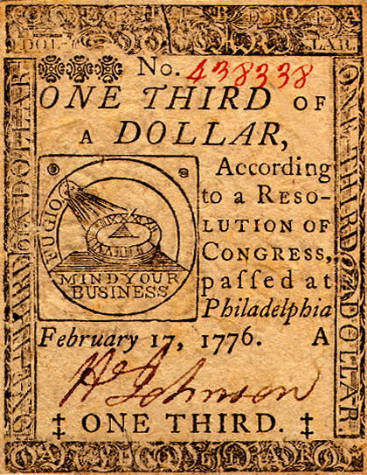
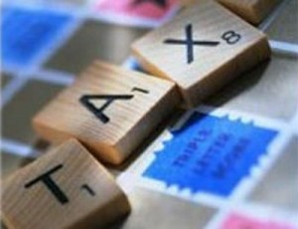
D. How to pay for the war?
* Congress didn’t have power to tax.
Notes:
Tax: http://www.thefinanceview.com/wppicture/t103.jpg
1/3 dollar: https://i.pinimg.com/originals/d4/15/6b/d4156be03b6f34089bda7b9901bc6979.jpg
24

Slide 25
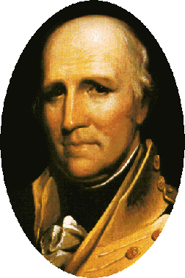
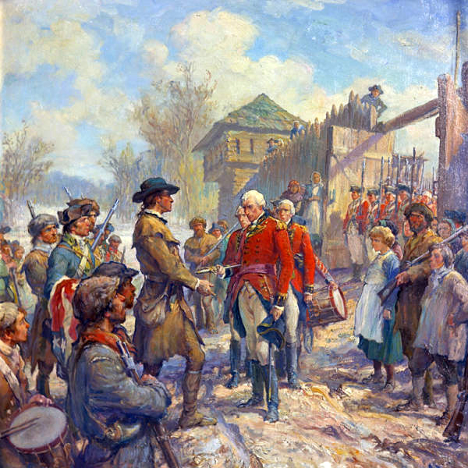
E. Native American Struggles
* Warring tribes, picking sides, and
small pox.
* George Rogers Clark captures two
outposts on the Mississippi.
Notes:
George: https://upload.wikimedia.org/wikipedia/commons/9/9b/George_Rogers_Clark.jpg
Surrender: https://allthingsliberty.com/wp-content/uploads/2015/01/Fall_of_Fort_Sackville.jpg
25

Slide 26
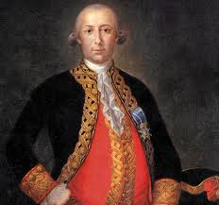
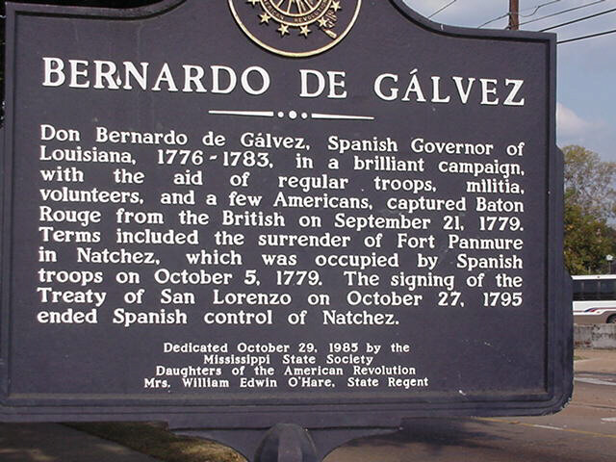
F. Spain helps out providing supplies and safe passage
*Bernardo de Gálvez
Notes:
Portrait: http://allthingsliberty.com/wp-content/uploads/2013/03/BernardoG%C3%A1lvez.gif
Sign: http://bdgsar.org/images/galvez_memorial_large.png
26

Slide 27
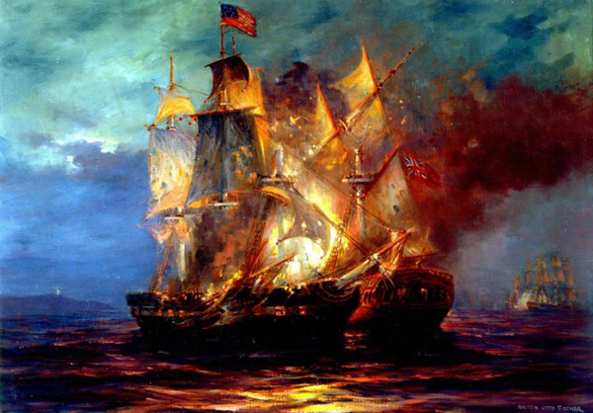
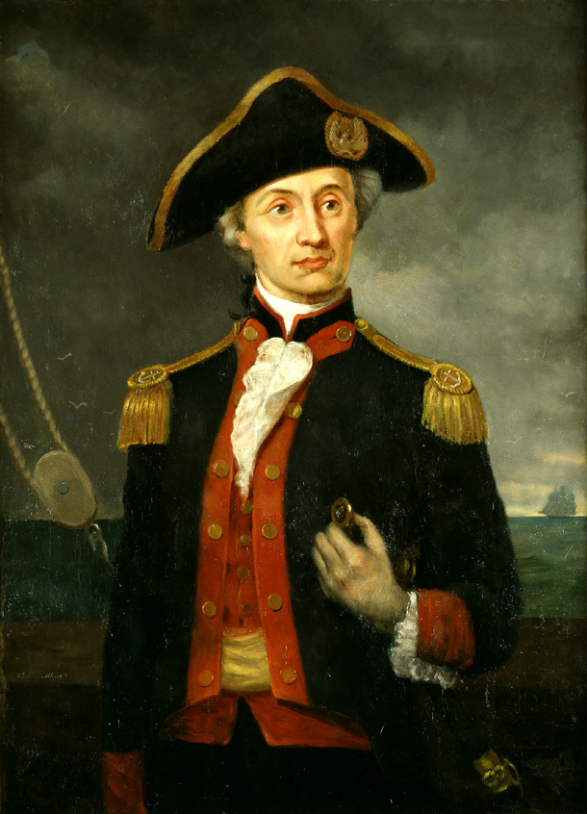
G. John Paul Jones and the Bonhomme Richard [Am]
* “I have not yet begun to fight.”
Notes:
Portrait: https://upload.wikimedia.org/wikipedia/commons/thumb/f/f2/Cpt_John_Paul_Jones.jpg/220px-Cpt_John_Paul_Jones.jpg
Ships: https://crashmacduff.files.wordpress.com/2014/09/1.jpg
27

Slide 28
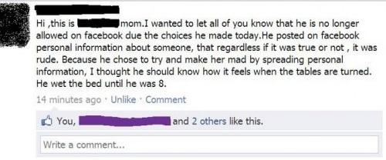
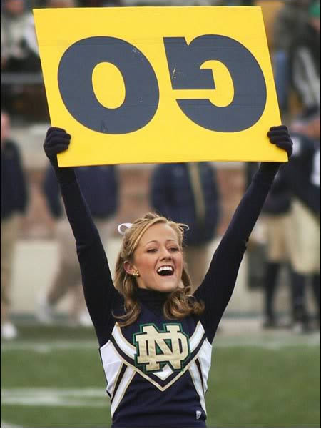
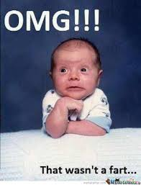
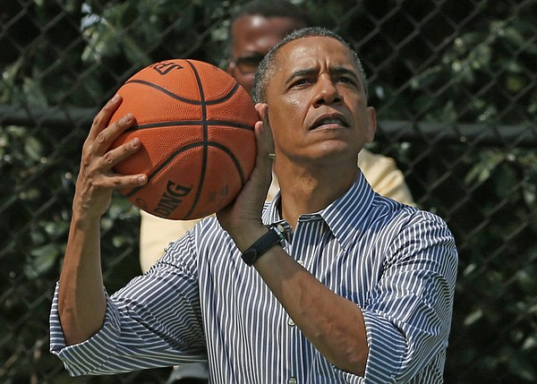
Journal:
Describe your most embarrassing moment.
Notes:
Cheerleader: https://i.pinimg.com/originals/c8/d9/61/c8d961a16c968162ba488eee95337d5b.jpg
Baby: https://i.pinimg.com/736x/1a/0f/ba/1a0fba7aca10e694c692bcd02b2cf7f2--so-funny-funny-stuff.jpg
Obama: http://www.theblaze.com/wp-content/uploads/2013/04/600x429.jpg
FB: https://www.oddee.com/wp-content/uploads/_media/imgs/articles2/a98200_public-punishment_9-wet-bed.jpg
28

Slide 29
V. The End of the War
A. Minor skirmishes in Georgia
and South Carolina
Notes:
Two skirmishers: https://c1.staticflickr.com/3/2566/4222139980_df2ed7a282.jpg
Group: https://i.pinimg.com/736x/85/3f/4f/853f4f4a5f7d318e93b7ed209c282b6d--jersey-girl-new-jersey.jpg
29

Slide 30
B. Francis Marion -“The Swamp Fox”
Notes:
Top Left: http://timmonstree.org/photo/Sweet-Potato-Print.jpg
Right: http://www.americanartshow.com/Large%20Prints/Werner%20Willis/Swamp%20Fox,%20Francis%20Marion.JPG
Behind tree: http://web.ftc-i.net/~gcsummers/sfmuralcut.gif
30

Slide 31
King’s Mountain: Loyalists vs. Patriots [Am]
Notes:
Painting: http://cdn1.buuteeq.com/upload/9567/kings-mountain.jpg
Map: http://www.rvtowster.com/Travel%202009/Kings%20Mountain%202009/a%20kmtn_143%20vc%20battle%20map_1.jpg
31

Slide 32
Cowpens: [Am] - Fake retreat and Ambush
Notes:
Battlefield: https://i.pinimg.com/736x/6b/cd/8e/6bcd8ecd482a0808c5f6e40b80f82801--warfare-the-battle.jpg
Map: http://www.socialstudiesforkids.com/graphics/cowpensbattlemaplarge.jpg
32

Slide 33
E. Benedict Arnold sells out
Notes:
Benedict Arnold: http://revolution.mrdonn.org/benedictarnold.jpg
Memorial: http://nhdbenedictarnold.weebly.com/uploads/1/6/4/3/16437288/4857588_orig.jpg
33

Slide 34
Battle of Yorktown [Am] *Cornwallis, surrounded, surrenders * “But if not…”
Lord Cornwallis
SURRENDERS!
Notes:
Painting: https://upload.wikimedia.org/wikipedia/commons/thumb/b/b8/Surrender_of_Lord_Cornwallis.jpg/1200px-Surrender_of_Lord_Cornwallis.jpg
Boy: Amy Brailey
34

Slide 35
Notes:
Photo Credits: Amy Brailey
35

Slide 36
G. Result: Treaty of Paris * Set boundaries of America
Notes:
Treaty: https://rlv.zcache.com/the_original_treaty_of_paris_1783_canvas_print-r4da91799ed0d4e1c8073b7ef493cb5e2_x96q5_8byvr_324.jpg
Map: https://i.pinimg.com/236x/13/54/5d/13545dd10ea1bb23a702a8bdf1cc6616--treaty-of-paris-american-revolutionary-war.jpg
36

Slide 37
Journal:
What are 5 questions you expect to be on the test? If they’re short, answer them.
Notes:
https://d2pu2bk1b66iw6.cloudfront.net/photos/2016/04/13/150-64737-test22-1460582025.jpg
37

