Slide 1
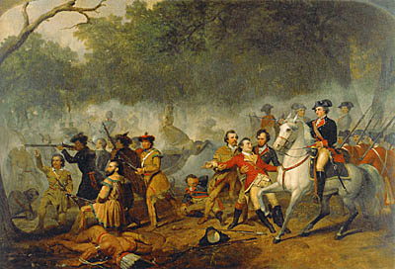
Chapter 5
I. The French-Indian War

Slide 2
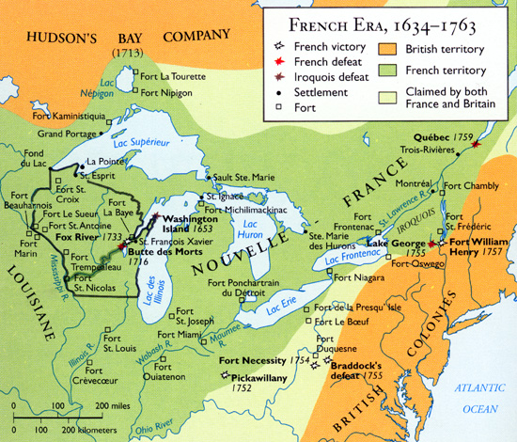
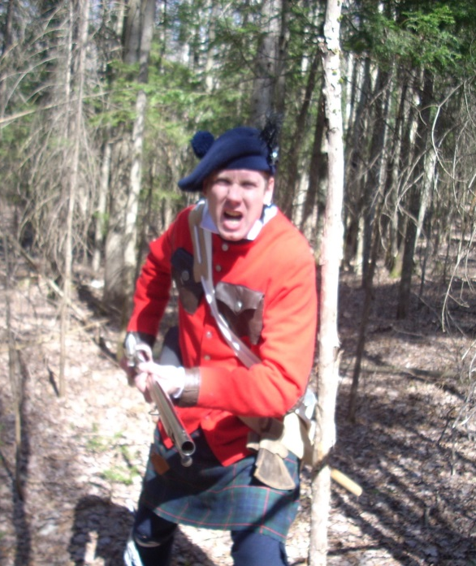
Cause: Both French and British Claimed land in the Ohio River Valley

Slide 3
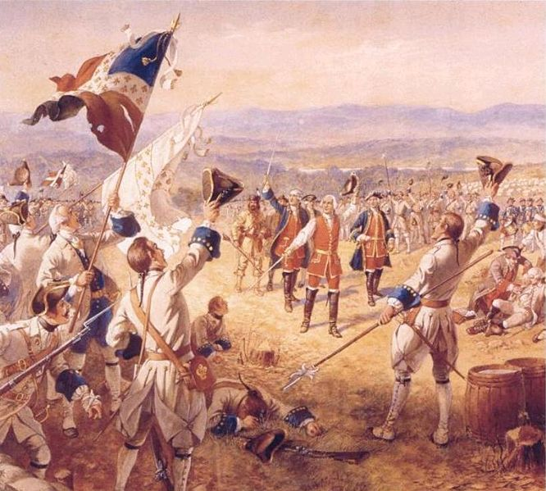
Resources of each side 1. French
a. Advantages:
+ Strong, unified government
+ Strategic forts (waterways)
+ Well-trained army and Indian
support
b. Disadvantages:
- New France had scattered
settlements

Slide 4
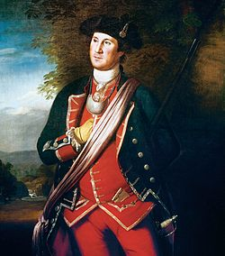
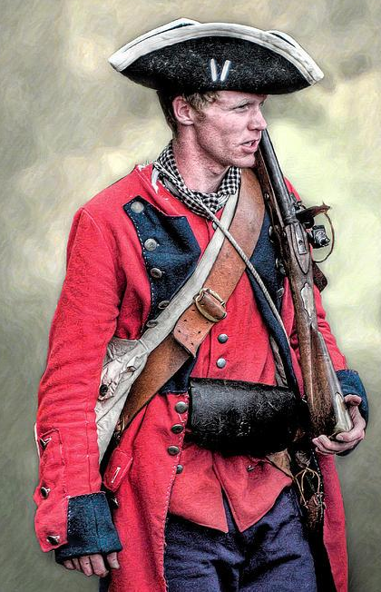
2. British a. Advantages: + 15 x the population of New France + Support of the Iroquois Confederation (eventually) + English navy is the strongest in the world b. Disadvantages - Lack of unity among the colonists - No central government organized - Selfish motives

Slide 5
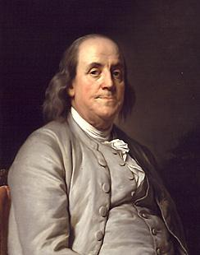
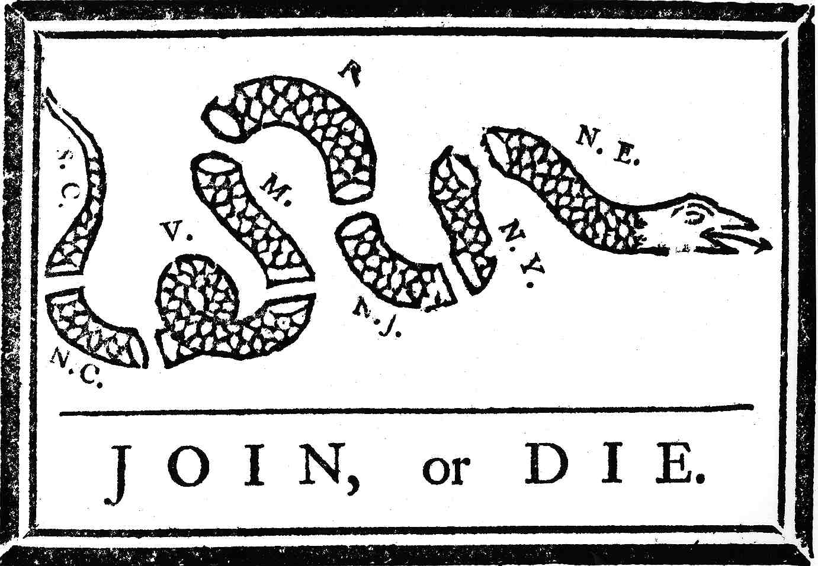
C. Basic Outline
Albany Plan of Union:
Franklin’s plan for
centralized government

Slide 6
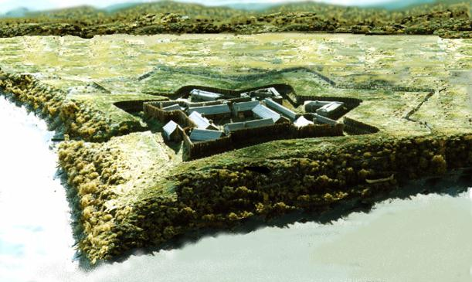
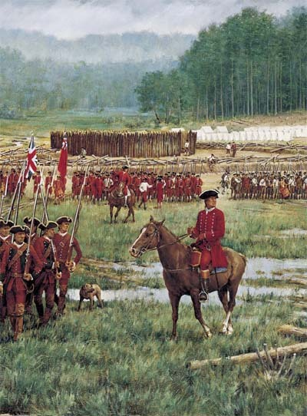
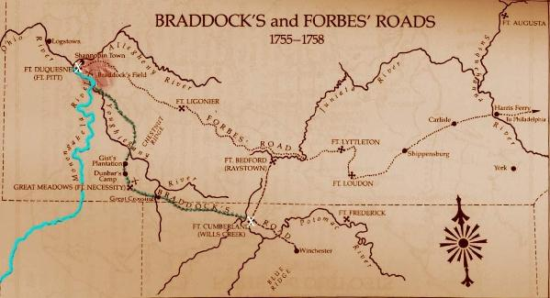
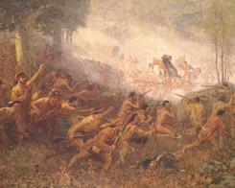
Attacks on Ft. Duquesne (Ft. Pitt) (3) *Ambush prepares for the American Revolution

Slide 7
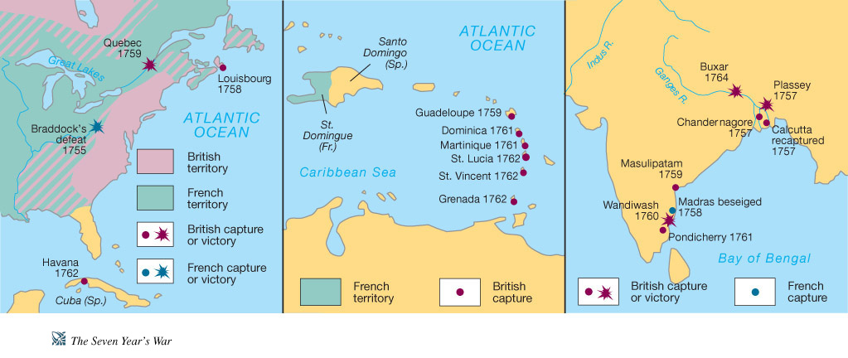
3. Britain starts the Seven Years’ War

Slide 8
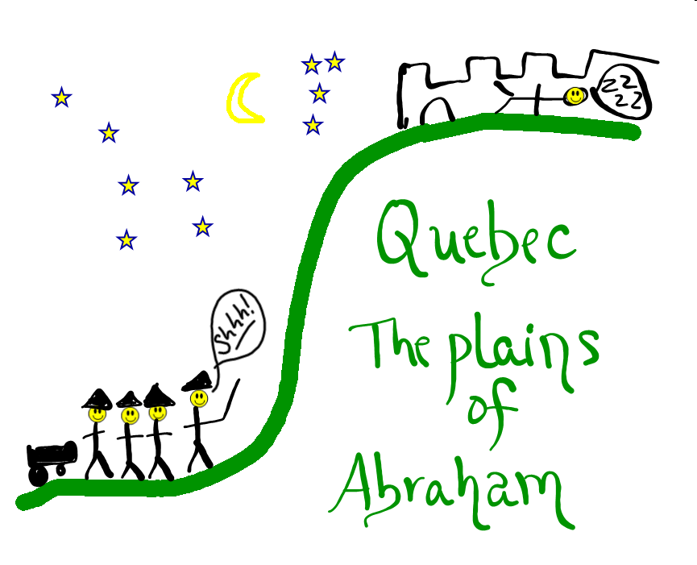
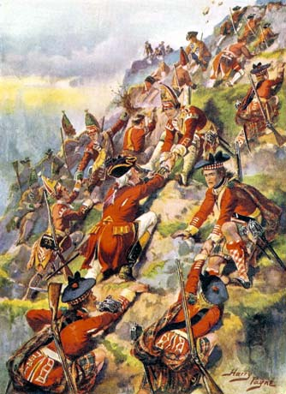
Wolfe (B) vs. Montcalm (F) in Quebec on the Plains of Abraham
* Both died

Slide 9
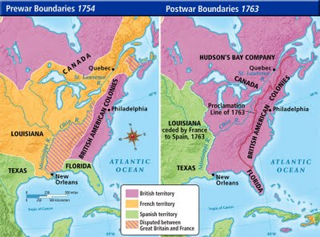
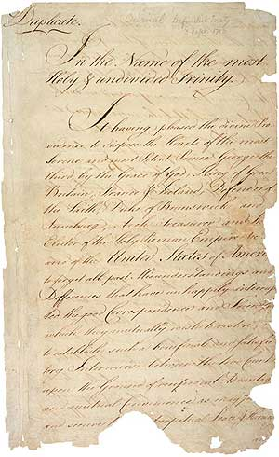
Result: Treaty of Paris *New Orleans (F) All else (B), B gets Canada and Florida, Spain gets the Louisiana Territory.

Slide 10
Photo Credits
French Indian War: http://www.ushistory.org/declaration/lessonplan/images/frenchindian_washington.jpg
Soldier: http://images2.fanpop.com/image/photos/11700000/French-Indian-War-Highlander-colonial-america-11732590-2560-1920.jpg
Map: http://people.emich.edu/rbalkam/Maps/page16/files/french-era-1634-1763.jpg
Montcalm’s Victory: http://people.emich.edu/rbalkam/Maps/page16/files/french-era-1634-1763.jpg
George Washington: http://s3.amazonaws.com/mtv-main-assets/files/resources/large_peale-1772-web.jpg
Soldier: http://fineartamerica.com/images-medium/french-and-indian-war-british-royal-american-soldier-randy-steele.jpg

Slide 11
Photo Credits Cont.
Ben Franklin: https://upload.wikimedia.org/wikipedia/commons/c/cc/BenFranklinDuplessis.jpg
Join or Die: http://images.fineartamerica.com/images-medium-large-5/join-or-die-cartoon-1754-granger.jpg
Ft. Duquesne: https://upload.wikimedia.org/wikipedia/commons/thumb/2/20/Fort_Duquesne.jpg/260px-Fort_Duquesne.jpg
Washington at Necessity (R): https://presidentgeorgewashington.files.wordpress.com/2010/03/battleoffortnecessity.jpg
Natives: http://www.britishbattles.com/images/monongahela/monongahela-illustration-l.jpg
Map: http://www.mohicanpress.com/images/braddock_map.jpg
7 Years’ War: http://wps.ablongman.com/wps/media/objects/262/268312/art/figures/KISH378.jpg

Slide 12
Photo Credits Cont.
14. Battle of Quebec: http://cdn-6.britishbattles.com/images/quebec/general-wolfes-army.jpg
Smart Board Drawing: Amy Brailey
Treaty of Paris: https://upload.wikimedia.org/wikipedia/commons/thumb/6/60/Treaty_of_Paris_1783_-_first_page_(hi-res).jpg/240px-Treaty_of_Paris_1783_-_first_page_(hi-res).jpg
17. Map: http://jb-hdnp.org/Sarver/Maps/ah05_prewarpostwarbdysm.jpg

Slide 13
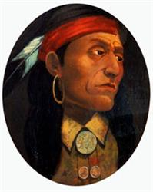
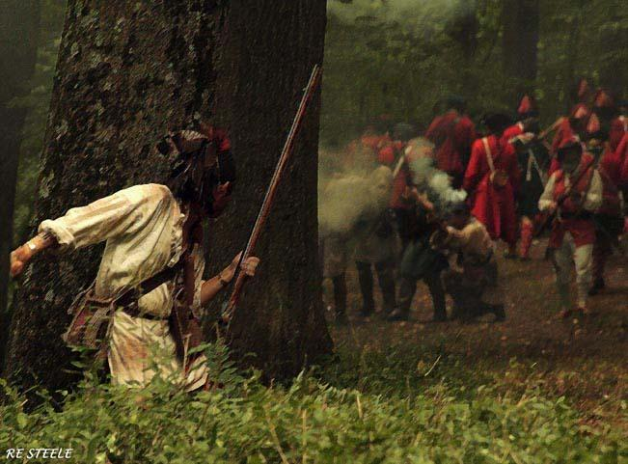
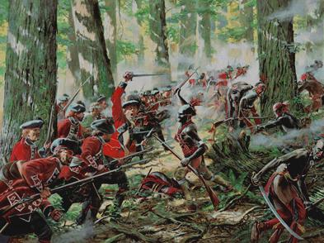
II. Native American Problems
A. Pontiac’s War—Indian attacks
on British Forts, 2,000 killed.
British retaliate, attacking citizens.

Slide 14
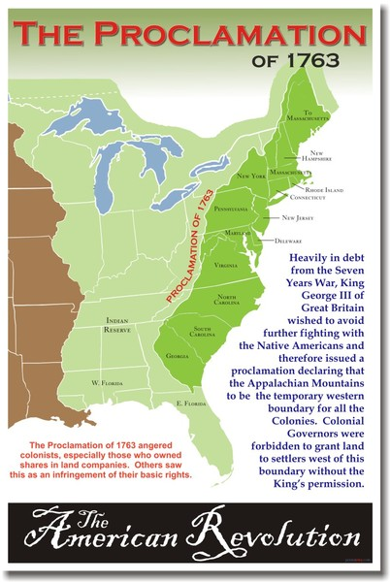
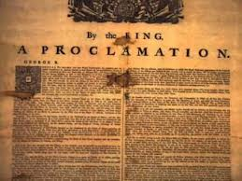
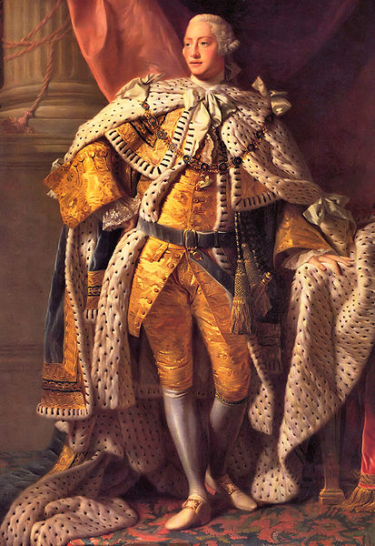
B. The Proclamation of 1763
(solution): No Colonists
West of the Appalachians (troops enforced)

Slide 15
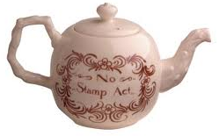
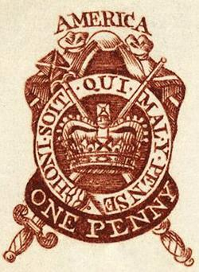
III. Policies and Appeals:
* Rationale: British left in debt by the war
A. British Action:
The Sugar Act: Tax on sugar,
molasses, coffee, silk, and indigo
2. The Quartering Act: House troops
3. The Stamp Act: Purchase stamps
for newspapers, legal papers, and
documents

Slide 16
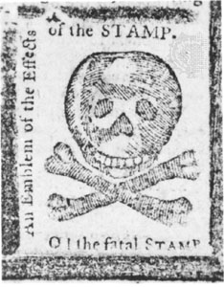
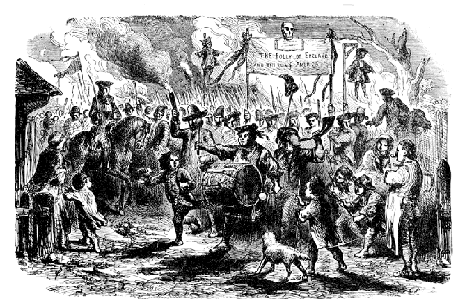
B. Colonists’ Response
1. House of Burgesses passes
resolution: Only we can tax!
2. Sons of Liberty: Protest
3. The Stamp Act Congress

Slide 17
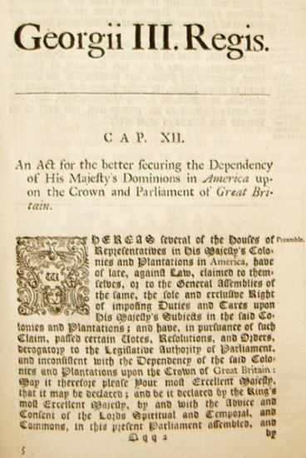
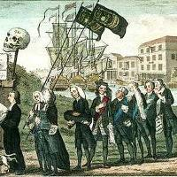
C. British Response: Repealed Acts, but issues the Declaratory Act which says Parliament has control over the Colonies.

Slide 18
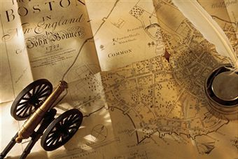
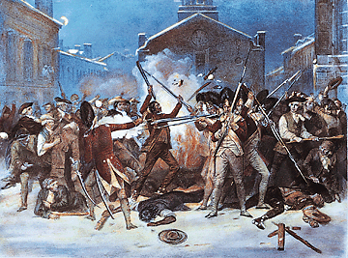
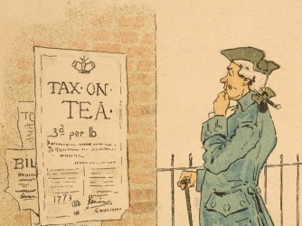
IV. Protests Spread
More British Policies:
1. The Townshend Acts:
Taxes on paint, glass, lead, paper,
and tea (taxed only imported goods)
2. Writs of Assistance: Illegal Searches
(free for all)

Slide 19
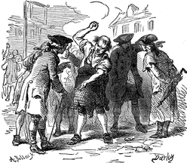
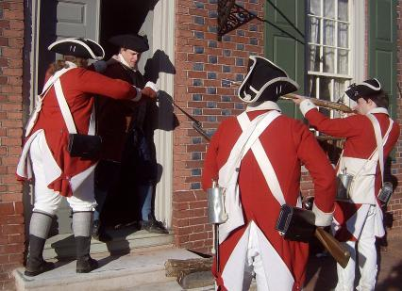
B. Responses (Both Sides)
1. New York Assembly refuses
the Quartering Act (C)
2. Parliament suspends the
Assembly (B)
3. Colonists boycott British
goods (C)
4. Parliament repeals all Townshend
Acts except Tea tax

Slide 20
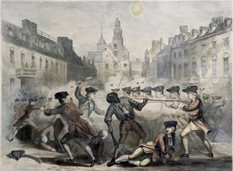
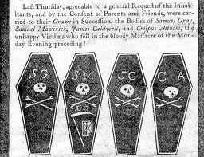
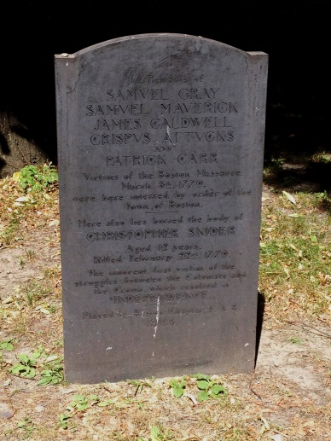
V. The Boston Massacre
Events:
1. Small group of soldiers
2. Mob surrounds, yelling and throwing
snowballs and rocks
3. One soldier slips and his gun fires
4. 5 dead, 6 wounded
*Crispus Attucks—
First wounded

Slide 21
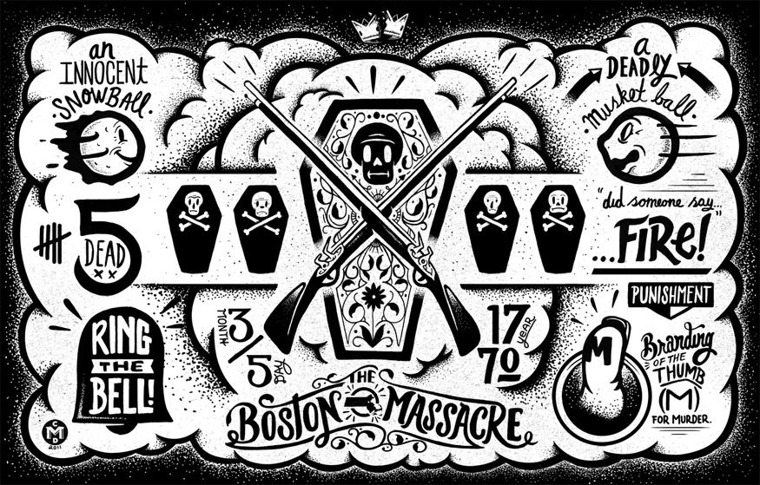
Designed by Christopher Monroe DeLorenzo

Slide 22
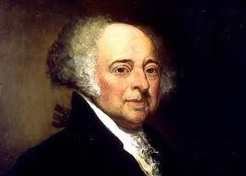
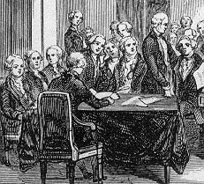
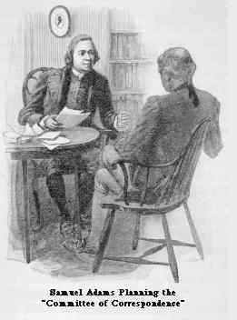
B. Results:
1. John Adams takes the case to
ensure a fair trial
2. Only 2 convicted
3. Samuel Adams forms
the Committee of
Correspondence to
Communicate among
the colonies

Slide 23
Photo Credits
Chief Pontiac: http://history-world.org/Pontiac.jpg
Pontiac’s War (R): https://41.media.tumblr.com/98df28ac48e3cd6df160e53612518a04/tumblr_n83rjhTyG31tseacco1_500.jpg
Pontiac’s War (L) Randy Steele: http://images.fineartamerica.com/images/artworkimages/medium/1/forest-fight-randy-steele.jpg
4. Proclamation (L): http://i.ytimg.com/vi/waDQwEeunkU/hqdefault.jpg
5. King George III: http://www.landofthebrave.info/images/King-george-iii.jpg
Map: http://storto8thgrade.wikispaces.com/file/view/Proclamation%20of%201763%20Map.jpg/354960774/376x610/Proclamation%20of%201763%20Map.jpg
Teapot: http://www.williamsburgmarketplace.com/wcsstore/wmarket/images//catalog_images/hero_shot/543629_np1103_hs.jpg

Slide 24
Photo Credits Cont.
Protest: http://3.bp.blogspot.com/_CvDCiEFbNy8/TM99wP9tglI/AAAAAAAAblE/pJhPwf5AZ_s/s400/5+The+Stamp+Act+of+1765+inspired+widespread+antagonism.+This+print+satirises+the+repeal+of+the+act+in+1766+as+the+death+of+the+favourite+female+child..jpg
Map +: http://cache3.asset-cache.net/gc/78426180-map-of-boston-with-miniature-cannon-and-quill-gettyimages.jpg?v=1&c=IWSAsset&k=2&d=b%2B6wpf3oM3KXYYdUe6YbDv9Usu1xdXo53QocN56gIjPa2o%2FRG0G5z4U66QDoNbD3
Stamp: http://philschatz.com/us-history-book/resources/CNX_History_05_02_Stamps.jpg
Protest: https://ioncoalition.files.wordpress.com/2014/11/stampactriotsboston.jpg
Fatal Stamp: http://f.tqn.com/y/militaryhistory/1/L/3/_/-/-/stamp-act-large.jpg
Declaratory Act: http://rulersandleaders.com/historic_documents/J-Declaratory-Act.jpg

Slide 25
Photo Credits Cont.
Tea: http://cdn.history.com/sites/2/2013/12/townshend-acts-hero-AB.jpeg
15. Protest:
http://www.crareacatholic.com/lasalle/Resources/8th%20Websites/Megan%20Chrissy%20Erin%20rev.%20war/Megan%20rev.%20war/images/cripus.gif
16. Quartering top (R): http://www.historycentral.com/Revolt/photos/Boycott.GIF
Quartering bottom: http://huttohistory.wikispaces.com/file/view/quartering_acts_1.jpg/297014828/294x224/quartering_acts_1.jpg
Boston Massacre: https://www.bostonathenaeum.org/sites/default/files/taste_009_champney-bloody-massacre.jpg
Gravestone: Amy Brailey
Article: http://cdn.loc.gov/service/pnp/cph/3a40000/3a45000/3a45700/3a45777r.jpg
Cartoon: http://payload.cargocollective.com/1/3/111092/1789543/DeLorenzo_Momentus_875.jpg
John Adams: https://pastnow.files.wordpress.com/2013/12/joh.png

Slide 26
Photo Credits Cont.
23. Trial of the Boston Massacre: http://law2.umkc.edu/faculty/projects/ftrials/bostonmassacre/scene1a.jpg
Committee of Correspondence: http://www.buffaloschools.org/webpages/jguercio/photos/83091/committee-of-correspondence.jpg

Slide 27
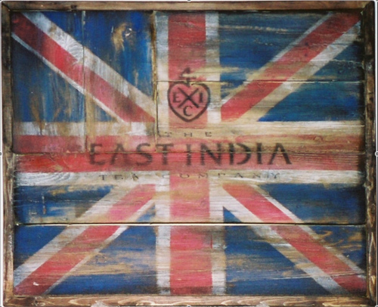
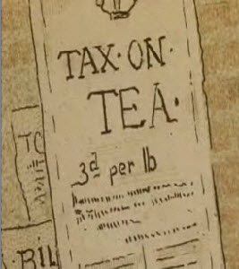
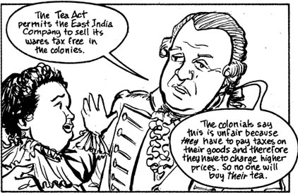
VI. Dispute over tea
The Tea Act: Overturned
the Navigation Acts by letting the East India Company sail directly to the colonies
+ Lowered the price of tea
-- Gave the East India Company a Monopoly

Slide 28
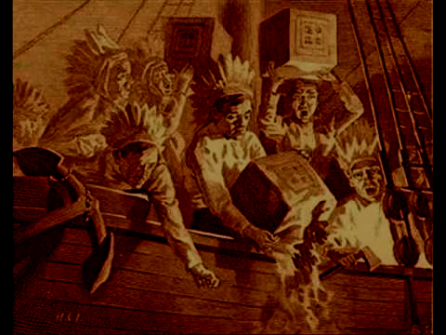
B. The Boston Tea Party
1. Colonists try to stop tea from being
unloaded. Successful in New York,
Philadelphia, and other ports
2. Boston’s Governor orders the tea
unloaded
3. The Sons of Liberty “unload the tea”

Slide 29
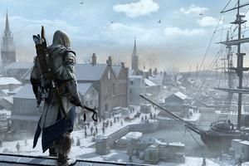
VII. Britain issues The Intolerable cts
A. The Boston Port Act: Closed Boston
Harbor
B. Limited Government: Gave the
Governor more power and eliminated
the legislature
C. The Quartering Act
D. The Quebec Act:
Blocked Colonists’
Expansion

Slide 30
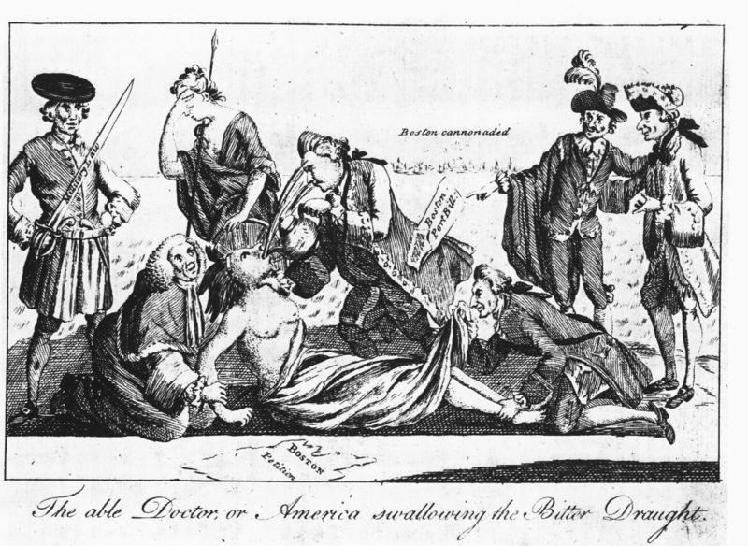

Slide 31
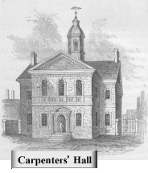
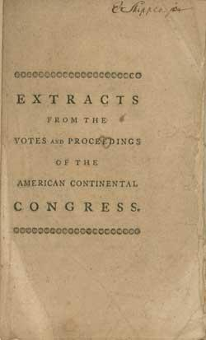
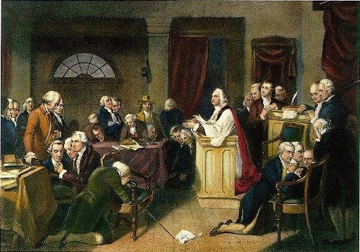
Colonists Respond: First Continental Congress
* Listed rights and grievances,
called for British boycott, and
petitioned

Slide 32
IX. War Begins
Warning by Paul Revere
Signal in the Old North
Church: One if by land; Two if by sea.

Slide 33
Lexington: “Shot heard round the world”
“I heard the report [of the gun], turned my head, and saw the smoke in front of the British troops, they immediately gave a great shout, ran a few paces, and then the whole fired. I could first distinguish irregular firing, which I suppose was the advance guard, and then platoons. At the time I could not see our Militia, for they were covered from me, by a house at the bottom of the street.” ~ Paul Revere

Slide 34
C. Concord: Bridge Battle. British retreat (Ambush)

Slide 35
Photo Credits
Flag: http://americanrevolutionhh.weebly.com/uploads/1/6/6/3/16635582/3924360.png?251
Tea tax: http://i0.wp.com/www.philaahzophy.com/wp-content/uploads/2007/12/teatax.png
Comic: http://ed101.bu.edu/StudentDoc/Archives/ED101fa10/neva/Images/SoLTeaAct.jpg
Boston TP: http://ronhebron.com/blog/uploaded_images/Boston-teaparty-758726.jpg
Assassin’s Creed:
http://ps3media.ign.com/ps3/image/article/122/1221749/01harbor_1332884341.jpg
Boston Port Act: http://www.historycentral.com/Revolt/nimages/Intolerable.jpg
Carpenter’s Hall: http://www.ushistory.org/declaration/related/images/carphallx.gif
Extracts from Congress: https://www.masshist.org/database/images/4838_htp_ref.jpg

Slide 36
Photo Credits
Prayer in Congress: http://adjunct.diodon349.com/America_in_distress/945458_533545526684455_154146671_n.jpg
Addressing Congress: http://www.socialstudiesforkids.com/graphics/continentalcongress.jpg
North Church: http://paintingandframe.com/uploadpic/others/big/boston_old_north_church.jpg
Portrait of Paul Revere: https://upload.wikimedia.org/wikipedia/commons/6/6e/J_S_Copley_-_Paul_Revere.jpg
Paul Revere’s Ride: http://www.historycentral.com/Revolt/nimages/revere.jpg
Paul Revere Statue: http://www.planetware.com/tourist-attractions-/boston-us-ma-boston.htm
Lexington and Concord: http://www.britishbattles.com/images/concord-lexington/british-troops-l.jpg
Concord Bridge: https://www.landofthebrave.info/images/concord-bridge-1.jpg (Bottom right)

Slide 37
Photo Credits
Concord Reenactment (Bottom Left) https://minerdescent.files.wordpress.com/2012/03/concord-bridge-reenactment.jpg
Reenactment (Top Left): http://www.bostoncentral.com/ppix/events1158.jpg
Men by wall: http://3.bp.blogspot.com/_mw7Y2Wpwkeo/SLRcVKqwa4I/AAAAAAAAADg/8gLAkzWFNgM/s320/20080419_D300_210_Patriots_Battle.jpg
Memorial: https://www.nps.gov/mima/images/North-Bridge-by-Jim-Lozousk.jpg

Slide 38
The Second Continental Congress
1. Formed an army: George Washington
(printed money)
2. Loyalists vs. Patriots
3. The Olive Branch Petition:
Stated that colonists were
loyal, but asked for
self-governance

Slide 39
X. Battles of the American Revolution
A. Ft. Ticonderoga [Am]
1. Ethan Allen and the
Green Mountain Boys
2. Control waterway and capture cannons
and ammunition (dragged 300 miles.)

Slide 40
B. Battle of Bunker Hill [Br]
1. American soldiers (Prescott) on
top of Bunker and Breed’s Hill
* “Don’t fire until you see the whites of
their eyes.”
2. British (Howe/Gage) makes 2 attacks
(failed)
3. Third British attack, Americans
run out of ammunition.

Slide 41
Eventually, Washington retakes Boston with Ft. Ticonderoga cannons, (Spiritual issue: British used churches as horse stables)

Slide 42
C. Montreal (Quebec)
1. Montgomery and
Benedict Arnold led
2. Montgomery killed and Arnold
wounded

Slide 43
Photo Credits
Congress: https://cioccahistory.pbworks.com/f/1284514141/continental%20congress%201.gif
Olive Branch Petition: http://exhibitions.nypl.org/treasures/archive/files/119_olive-branch-2-x_8169478a87.jpg
Ariel Fort(R): https://historiann.files.wordpress.com/2008/09/ftticonderoga.jpg
Old map of fort: http://www.mappery.com/maps/Fort-Ticonderoga-1777-Map.mediumthumb.jpg
Side view Fort (L): https://upload.wikimedia.org/wikipedia/commons/thumb/d/d4/Fort_Ticonderoga%2C_Ticonderoga%2C_NY.jpg/300px-Fort_Ticonderoga%2C_Ticonderoga%2C_NY.jpg
Ethan Allen at fort: https://vignette1.wikia.nocookie.net/hattrixtershistory/images/5/5c/AmericanRevolutionTiconderogaEthanAllen.jpg/revision/latest?cb=20090714040907
Ethan Allen: https://s3-us-west-2.amazonaws.com/find-a-grave-prod/photos/2002/150/19_1022872892.jpg

Slide 44
Photo Credits
Background (General Warren):https://upload.wikimedia.org/wikipedia/commons/f/f9/The_Death_of_General_Warren_at_the_Battle_of_Bunker%27s_Hill%2C_June_17%2C_1775.jpg
Battle map: http://www.historycentral.com/Revolt/MapBH.jpg
George and Ft. T: https://s-media-cache-ak0.pinimg.com/originals/ad/18/74/ad1874bb965fd18b61f259c647741412.jpg
Battle of Bunker Hill map: https://bostonraremaps.com/wp-content/uploads/2015/10/BRM2420-Stedman-Bunkers-Hill_lowres-1724x2000.jpg
Montgomery’s Troops: http://www.americaslibrary.gov/assets/jb/revolut/jb_revolut_canada_1_e.jpg
Benedict Arnold: https://theharborandthehudson.files.wordpress.com/2010/10/benedict_arnold21.jpg

Slide 45
Photo Credits
Montgomery: https://upload.wikimedia.org/wikipedia/commons/thumb/4/49/Richard_Montgomery_-_Project_Gutenberg_etext_20110.jpg/170px-Richard_Montgomery_-_Project_Gutenberg_etext_20110.jpg
Color fighting scene: https://s-media-cache-ak0.pinimg.com/564x/df/2e/7f/df2e7f94f6ca5c2db215a6ca9375081b.jpg
Battle of Quebec: https://upload.wikimedia.org/wikipedia/commons/thumb/5/55/American_attack_on_Quebec.svg/240px-American_attack_on_Quebec.svg.png

