Slide 1
Chapter 4 Life in the Colonies
Pages: 99 - 123

Slide 2
Section 1: Governing the Colonies
How did English ideas about government and trade affect the colonies?
How did political idea mold colonial settlements in the Americas?
What kinds of political systems were created to provide order and justice?

Slide 3
Magna Carta
The Magna Carta was the first document to place restrictions on an English ruler’s power.
Limited the monarch’s right to levy taxes without consulting the nobles.
Protected the right to own private property
Guaranteed the right to trail by jury.
At first was only limited to nobles (upper class), however over time the rights were extended to all English citizens.

Slide 4
Parliament
Under the Magna Carta, nobles formed a council to advise the king.
This developed into Parliament, a two-house legislature.
House of Lords
House of Commons
A legislature is a group of people who have the power to make laws.
Notes:
In Colonial America, there was the House of Burgesses in Virginia and the General Court in Massachusetts.
Today, we have a legislative branch known as Congress.

Slide 5
Bill of Rights
A bill of rights is a written list of freedoms that a government promises to protect for its citizens.
In 1688 the Parliament was able to overthrow the King of England in the Glorious Revolution.
In 1689, King William and Queen Mary signed the English Bill of Rights.
The United States first ten amendments are the United States Bill of Rights.

Slide 6
Bill of Rights
The English Bill of Rights upheld habeas corpus, the principle that a person cannot be held in prison without being charged with a specific crime.
This was often a common practice used by Kings/Queens, tyrants, or dictators to eliminate political adversaries.

Slide 7
Colonial Self-Government
The legal rights that Englishmen had led the colonists to expect a voice in their government.
The first two legislative groups for the English colonists were The House of Burgesses, in Virginia, and General Court, in Massachusetts.
By 1760, every British colony in North America had a legislature, but those legislatures still clashed with colonial governors appointed by the king of England.

Slide 8
Colonial Self Government
The colonies offered a greater chance of gaining political rights. The American colonies allowed 50% to 75% of white males to vote.
But the following groups could not vote:​
English women, even those who owned property.​
Native Americans.​
Africans, whether free or enslaved.

Slide 9
Freedom of the Press
A notable court case in 1735 helped establish freedom of the press.
John Peter Zenger, publisher of the New York Weekly Journal, was arrested for printing a series of articles that criticized the governor.
Charged with libel, or the publishing of statements that damage a person’s reputation.
The court found Zenger not guilty determined that the press has a right and responsibility to keep the public informed of the truth.
Freedom of the press gives journalists the right to publish the truth without restriction or penalty.

Slide 10
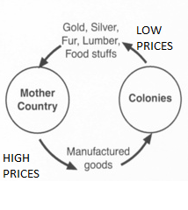
Navigation Acts
The Navigation Acts were passed to strengthen the idea of mercantilism. These laws would help increase England’s economy and put heavy restrictions on English colonies.

Slide 11
Three Parts of the Navigation Acts
Shipment from Europe to English colonies had to go through England first.
Any imports to England from the colonies had to come in ships built and owned by British subjects.
The colonies could sell key products, such as tobacco and sugar, only to England.

Slide 12
Pros and Cons of the Navigation Acts
Pros | Colonial traders had a sure market for their goods in England. The law contributed to a booming shipbuilding industry in New England.
Cons | Many colonists began to resent the Acts because they thought the Acts favored English merchants at the colonists’ expense. Some colonists thought they could make more money if they were free to sell to foreign markets themselves. Some colonists smuggled goods to foreign markets to avoid the Navigation Acts.

Slide 13
Section 2: Colonial Society
How did colonial life take shape?
What were the characteristics of colonial society?
What were the social roots of colonial settlements in the Americas?
What kinds of social systems were created to satisfy religious and cultural needs?

Slide 14
Life on the Farm
Families needed to be self-sufficient and had to help on the family farm planting, cultivating and harvesting crops.
Families usually lived together on the farm with there extended family members, which would include parents and their children, grandparents, aunts, uncles and cousins.

Slide 15
Women’s Role?
Women were expected to handle childcare and domestic responsibilities and had little or no role in public life.
Women often married men chosen by their parents.
Romantic love was not considered the most important reason for marriage.
Any property or money a woman would earn would belong to her husband.
Women would cook, do laundry, spin yarn, made clothing, tended the garden, milked the cows and preserved the food.

Slide 16
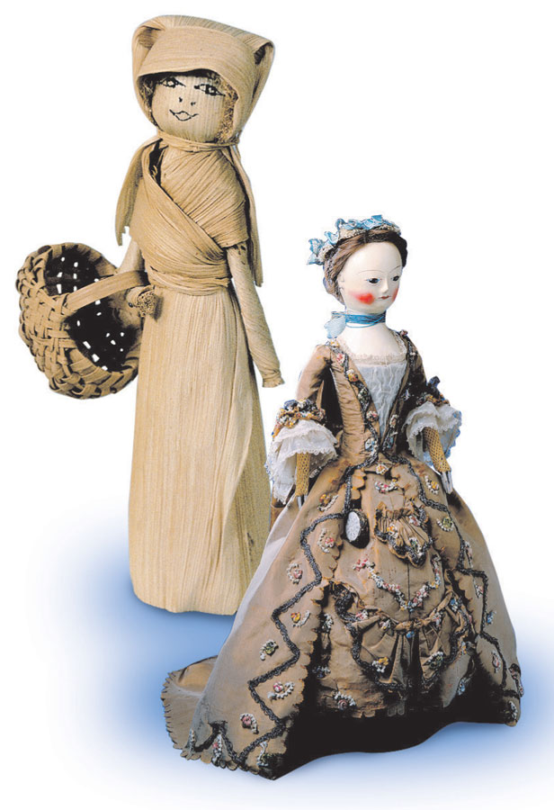
Colonial Children
At around age 7, colonial children were expected to begin working.
household or farm chores
Poor - might become servants in other families.
Boys who were learning trades began as apprentices and then worked independently.

Slide 17
Upper Class Colonial Society
The upper class of colonial society was known as the gentry. They included wealthy planters, merchants, ministers, royal officials, and successful lawyers.
The gentry were a small percentage of the colonist population.
The gentry was primarily made up of wealthy plantations owners.

Slide 18
The Majority
The majority of colonists were a part of the middle class. The middle class was made up of small planters, independent farmers and artisans.
It is important for a society to have a majority of the population in the middle class. That means a high percentage of a society’s population is doing well and most likely happy.

Slide 19
European vs Colonial Class
Major difference between the European social classes and colonial social classes was mobility. What mobility means is the likelihood a person can move from one social class to another.
Unlike in England, lower-class colonists could hope to acquire property and move up the social scale. In Europe you inherited your social status.

Slide 20
Why come to America?
What was a major appeal of living in America?
Many people immigrated to America with the interest of owning land.
Land for sale in Europe was very rare. Land was usually passed down through inheritance. When land was for sale in Europe it was very expensive, because of the small supply and high demand!

Slide 21
Indentured Servants
An indentured servant was an individual from Europe who signed a contract to work from 4 to 10 years in the colonies in exchange for passage to the Americas.
The idea of indentured servants would soon be replaced by slavery.
What problems would arise with the indentured servant system?

Slide 22
African Americans’ Rights?
Free African Americans were allowed to own property. They were also permitted to own slaves. Many free African Americans purchased relatives who were enslaved and set them free. However, free African Americans were not allowed to vote or sit on juries.

Slide 23
Free Labor
Indentured Servants – were Europeans hoping for a chance to start a new life in the new world. They were treated as slaves for 4-10 years. After, their service they were able to own land and earn a living. (The life expectancies of indenture servants was pretty low)
Slaves – clearly had the worse life. They were treated as if they were property and had little to no basic rights.

Slide 24
Privileges and Opportunities
The gentry and middle class had the most privileges and opportunities. Only white males in these classes were the only individuals who had a political voice and right to vote. They also could sit on juries.

Slide 25
Section 3 : Slavery in the Colonies
How did colonial life take shape?
What are some of the economic and social roots of colonial settlements in the Americas?
What kinds of economic systems were created to answer the three basic economic questions:
What goods and services shall be produced?
How shall they be produced?
For whom shall they be produced?
What kinds of social systems were created to satisfy religious and cultural needs?

Slide 26
Notes:
Start of Section 3:
Image Discovery – Guide students in discovering what this image depicts. Take only yes or no questions at first. When a student thinks they know the correct answer, they may guess. If they are incorrect, that student is “out,” so they cannot ask any more questions.

Slide 27
Industry of Slavery
Throughout the colonial time period, millions of Africans were transported to the colonies against their will.
Between 1500s – 1800s, it is estimated that more than 10 million enslaved Africans were transported to the Americas.
500,000 brought to British North America
Slave Traders set up posts along the West African coast.
Africans who lived along the coast made raids into the interior, seeking captives to sell to Europeans.

Slide 28
What was the Middle Passage?
Africans that were enslaved on the raids would be march 300 miles to the coast.
On the coast they were traded for guns and other goods.
They were then loaded onto slave ships and transported across the Atlantic.
The Middle Passage was the dangerous voyage slave ships would take to cross the Atlantic Ocean.

Slide 29
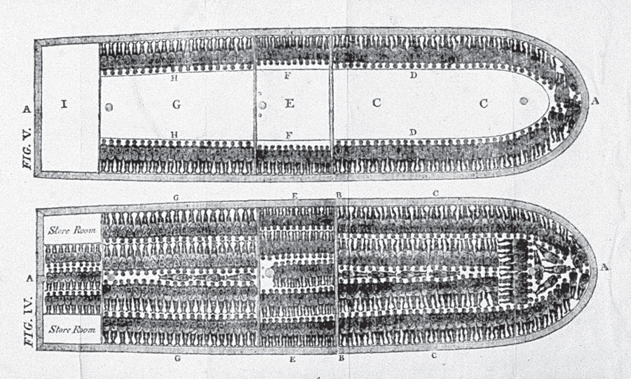
The Middle Passage
To increase their profits, some slave-ship captains forced the maximum number of captives on board.
On average 15 to 20 percent of enslaved Africans died or committed suicide during the Middle Passage.

Slide 30
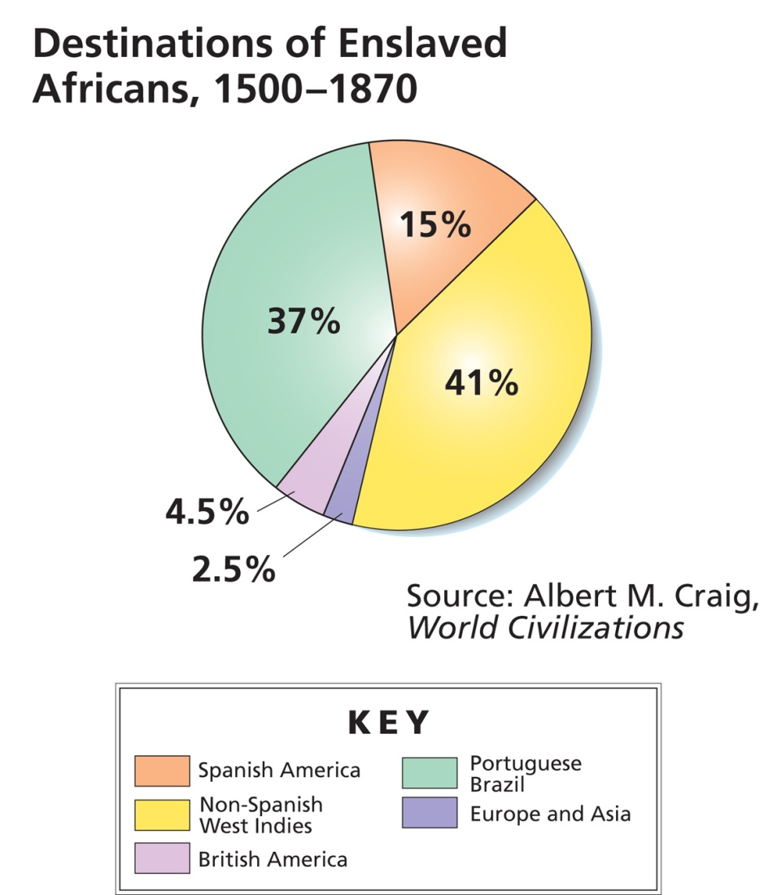
Slavery in the Americas
About 500,000 enslaved Africans ended up in British North America.

Slide 31
The Triangular Trade
The triangular trade was a three-way trade between the colonies, the islands of the Caribbean, and Africa.

Slide 32
Triangular Trade
First Leg | New England traders sailed to the Caribbean islands, where they traded fish and lumber for sugar and molasses. The ships then sailed back to New England, where colonists used the sugar and molasses to make rum.
Second Leg | New England traders sailed to West Africa, where they traded rum and guns for slaves.
Third Leg | New England traders then sailed to the Caribbean islands, where they traded slaves for more molasses.

Slide 33
Although the triangular trade was illegal under the Navigation Acts, many New England merchants violated the rules because it made them wealthy.
$
$
$
$
$
$
$

Slide 34
Slavery in the Colonies
Why did slavery take root?
The Plantation system was a MAJOR FACTOR that led the southern economy to depend on slavery.
Profits from tobacco and rice
Planters preferred slaves over servants. Indentured servants were temporary workers.
Economic conditions were improving in England, so fewer servants came to Americas.
Many New England merchants grew wealthy from The Triangular Trade.

Slide 35
Slavery in the Colonies
Colonies made slavery permanent through laws as the need for cheap labor grew.
Early on, there were attempts to stop slavery.
Georgia had a ban on slavery until the 1750s, but it eventually became legal in all the colonies.
Not every African was a slave, but slavery came to be restricted to people of African descent.
Thus, it was linked to racism, the belief that one race is superior or inferior to another.

Slide 36
Slave Codes
Colonial authorities wrote slave codes because they feared the rise of slave revolts.
Slave codes are strict laws that restricted the rights and activities of slaves.
Under these codes, enslaved people could not:
Meet in large numbers
Learn to read or write
Own a weapon
Leave plantation w/out permission
Slave codes also said that masters who killed slaves could not be tried for murder.

Slide 37
Lives of Enslaved Africans
In the North | Only 10 percent of the enslaved population lived north of Maryland. Northern slaves worked as blacksmiths, house servants, or farm laborers. Over time, they might buy their freedom.
In the South | On rice plantations in South Carolina, slaves kept the customs of West Africa. They made African grass baskets and spoke Gullah, a dialect that blended English and several African languages.

Slide 38
African Cultural Influences
Craftworkers in cities used African styles of quilts, furniture, and other objects.
African drums and banjos became part of American music.
African folk tales became part of American culture.

Slide 39
Section 4: The Spread of New Ideas
How did colonial life take shape?
What are some of the social roots of colonial settlements in the Americas?
How did ideas about religion and government influence colonial life?

Slide 40
Public Schools in the colonies
The Puritans thought education was very important!
Massachusetts developed laws that required colonial youth to receive an education.
Every town with at least 50 families was required to start an elementary school.
Everytown with 100 families had to have a grammar school for older students.
Puritan grammar schools are like today’s high schools.
Towns that did not set up a school were fined.

Slide 41
Modern Public Schools vs. Colonial Schools
Unlike modern public schools, colonial public schools included instruction in religion.
Puritan schools were run with both private and public money.
Puritan education laws were not completely compulsory.
In the south, there were few schools. So the southern gentry often hired private tutors to teach their children. Poor children often received no formal education at all.

Slide 42
Higher Education
Grammar Schools | Some boys went on to grammar schools, which prepared them for college. Grammar schools taught Greek, Latin, geography, mathematics, and English composition.
Colleges | The first American colleges were founded largely to educate men for the ministry. Harvard University (1638) was the first college in the English colonies. The College of William and Mary (1693) was the first college in the South.

Slide 43
Education for African Americans
In NY, a church group ran a school for free African Americans, Native Americans and poor whites.
Some missionaries taught enslaved people to read, and those enslaved people passed along their learning. Others taught themselves from stolen or borrowed books.

Slide 44
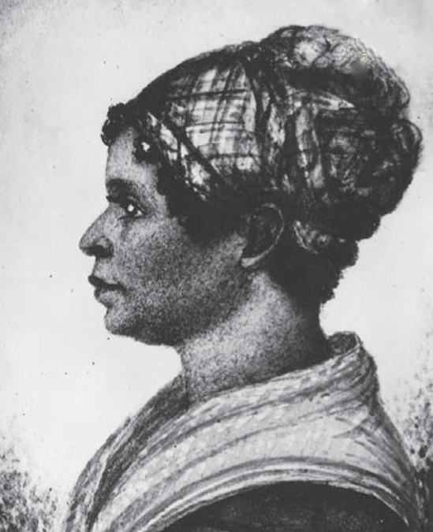
Roots of American Literature
Poetry:
The first colonial poet was Anne Bradstreet. She published a book of poetry in 1650.
Another poet, Phyllis Wheatley: an enslaved African in Boston. Her first poem was published in the 1760s when she was 14.
Phillis Wheatley
Notes:
Phyllis Wheatley: captured by slave traders at age 8. Luckier than most because the family she worked for educated her and gave her time to write. She won fame as a poet and later gained her freedom.

Slide 45
Benjamin Franklin
Many would consider Benjamin Franklin to be America’s Renaissance man.
Benjamin Franklin was the founder of a newspaper, the Pennsylvania Gazette, which became the most widely read newspaper in the colonies.
Inventor of the Stove, street lamps, lightning rod, bifocals
Most popular work: Poor Richard’s Almanac
Co-Founder of first public hospital, library, fire department, liberal arts academy (University of Pennsylvania)

Slide 46
The Great Awakening
The Great Awakening was a Christian revival that swept through the colonies in the 1730s and 1740s.
Christians wanted to spread religious beliefs because of the decline of religious zeal in the colonies.
Effects:
The rise of many new churches in the colonies
Split of some churches
More tolerance of religious differences
Jonathan Edwards was a preacher who taught people to examine their lives and commit to God.

Slide 47
Philosophies/Ideas from the Enlightenment Era
The Enlightenment was an intellectual movement in the 1600s started by a group of thinkers who said all problems could be solved by human reason.
John Locke (English) and Baron de Montesquieu (French) were two Enlightenment thinkers whose ideas were used in the establishment of the United States government.

Slide 48
John Locke and Natural Rights
People have certain inalienable natural rights are rights that belong to every human being from birth.
Locke believed they consisted of life, liberty, and property.
Locke also thought they were inalienable, which means that they cannot be taken away.
Locke believed people/societies formed governments in order to protect their rights.

Slide 49
Baron de Montesquieu
Montesquieu suggested a separation of powers in the government because it keeps any one group or individual from gaining too much power.
He believed the government should be divided into three branches:
executive
judicial
legislative
This division of power became the basis of government in the United States.

